Slide 1


This slide is intentionally blank

Slide 2
What is Perple_X doing?
Constrained Gibbs Energy Minimization
Unconstrained Gibbs Energy Minimization
Iteration, Iteration, and Iteration…

Slide 3
Constrained Gibbs Energy Minimization*
The pressure, temperature, and composition of the system is specified
and the stable phases are predicted
Key assumptions:
Bulk equilibrium – no mineral zoning, no retrograde minerals, etc.
The mineralogical models describe all important solution behavior – e.g. if Zn is a component, then Zn solution must be described in every phase in which it is a potentially important constituent
*Perple_X programs VERTEX and MEEMUM

Slide 4
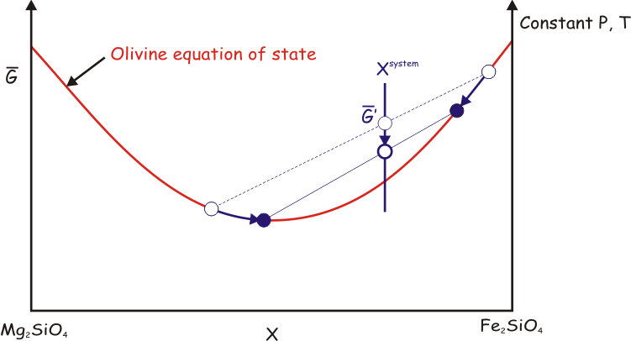
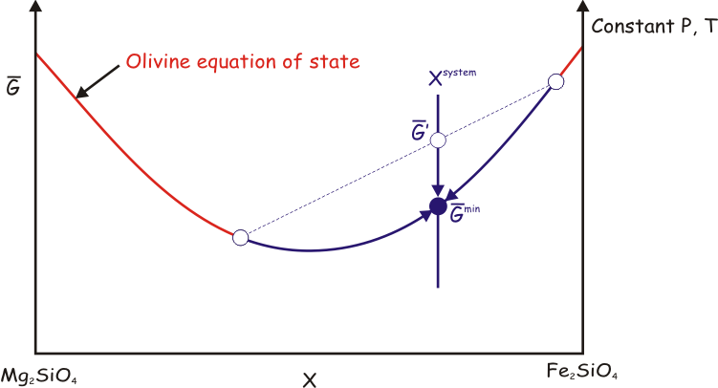
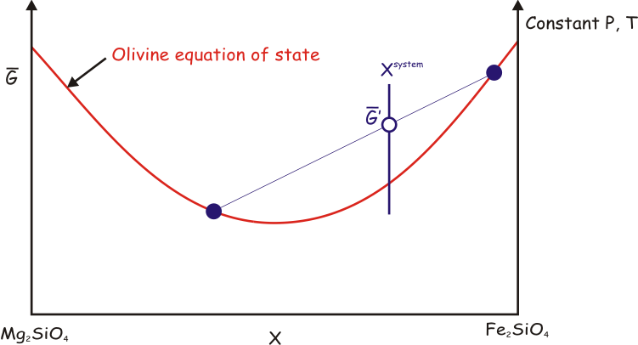
Constrained Gibbs Energy Minimization
The stable state of a system minimizes its Gibbs Energy (G)

Slide 5
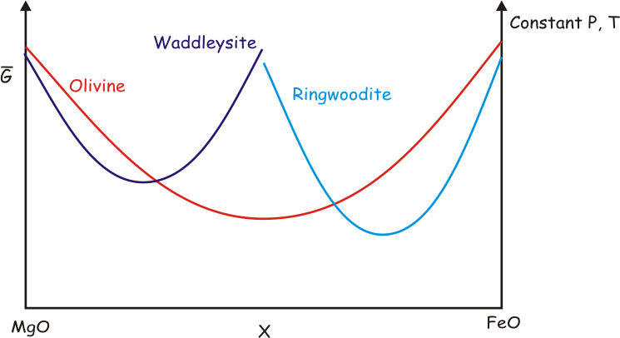
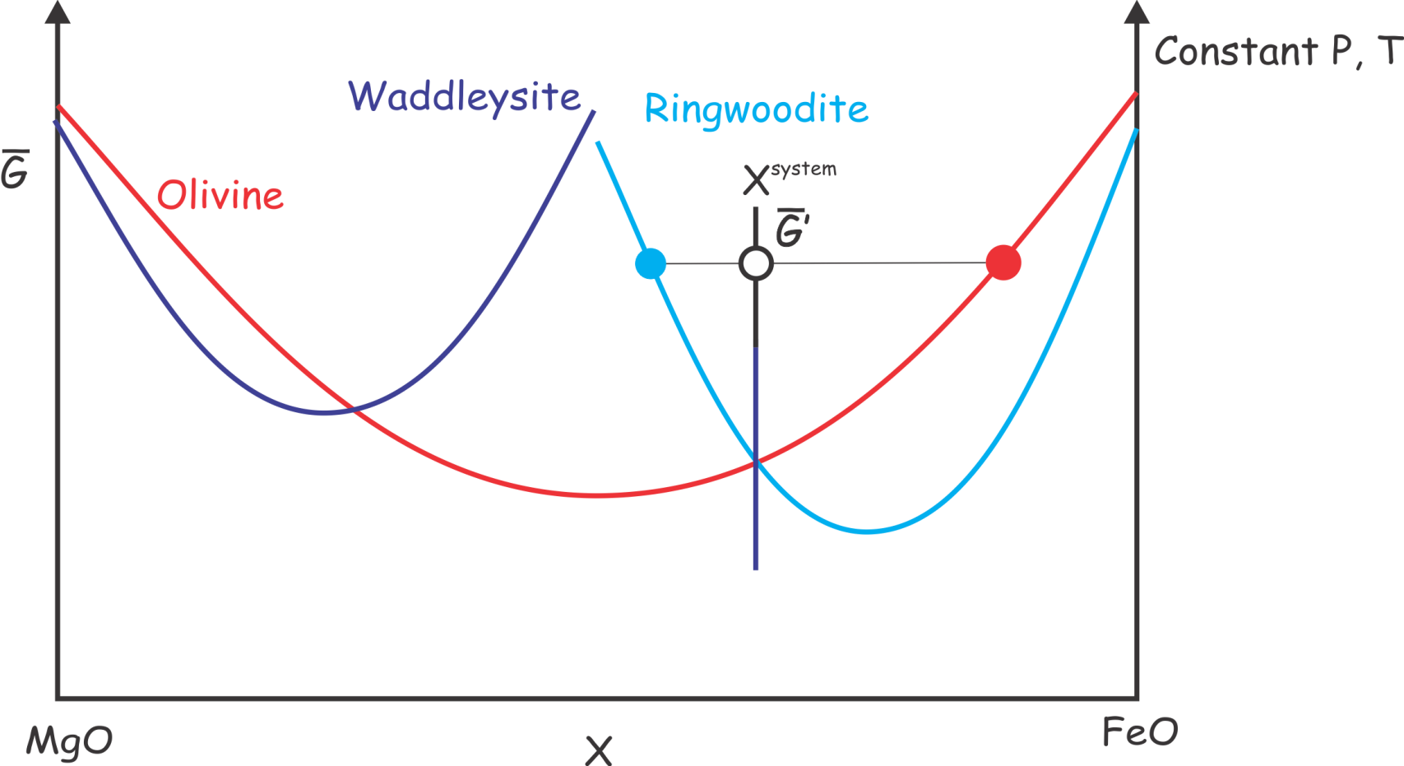
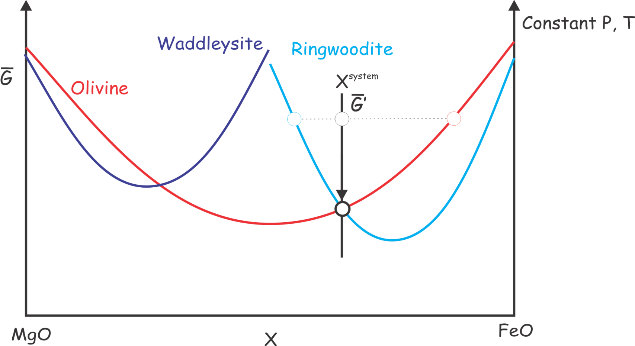
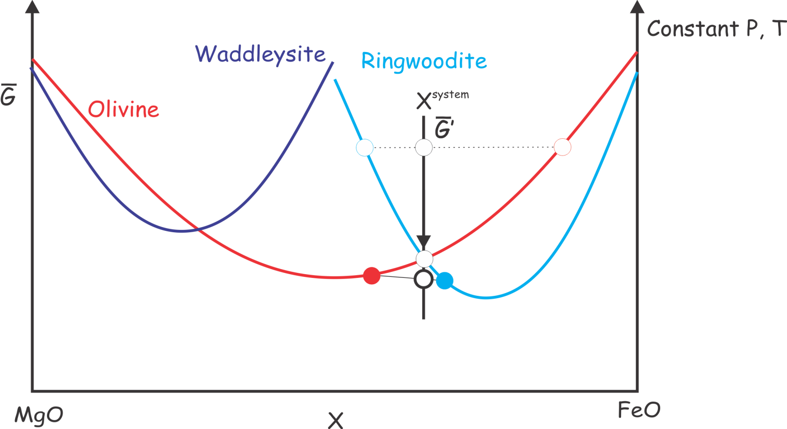
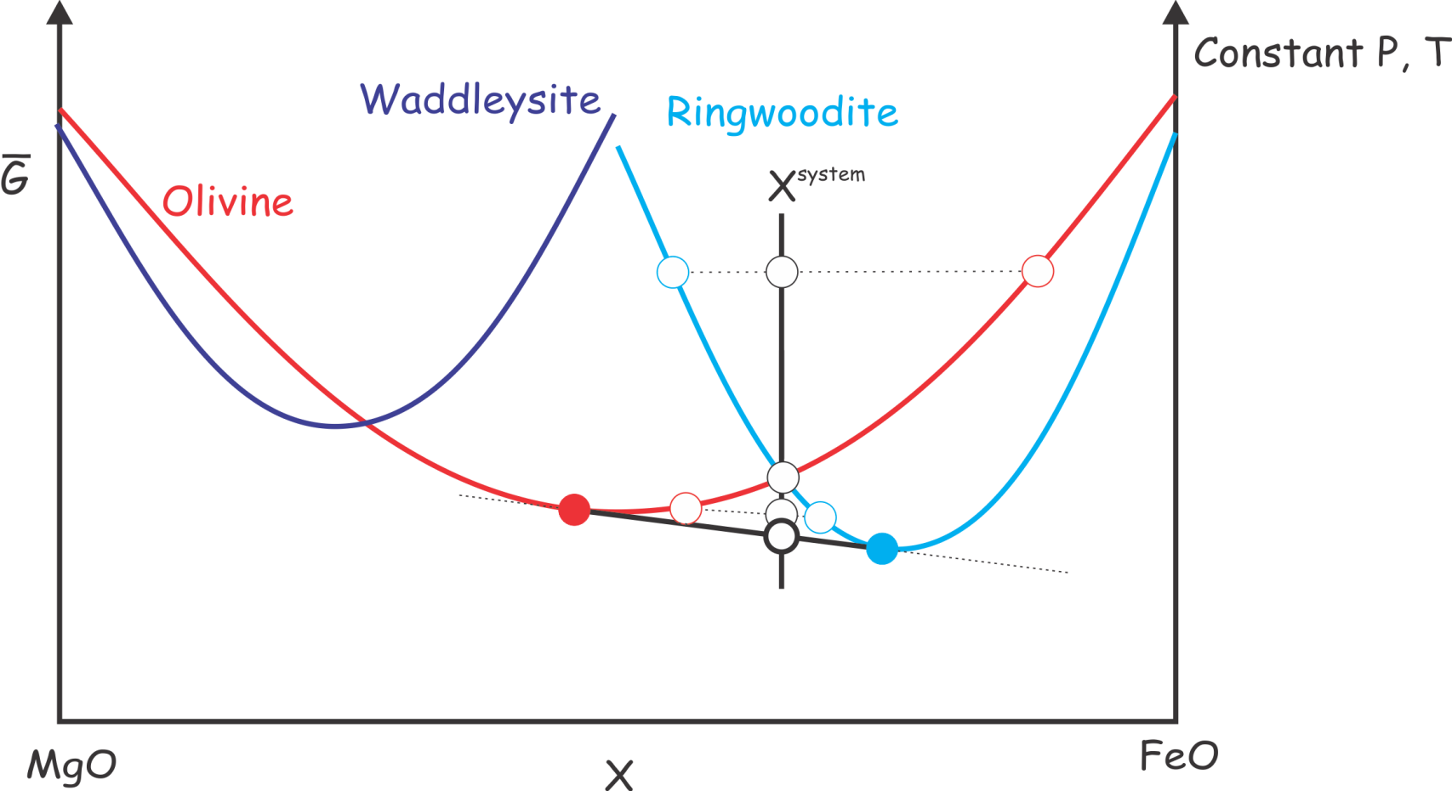
Non-Linear Gibbs Energy minimization
Brown & Skinner 1974, Saxena & Eriksson 1983, Wood & Holloway 1984, deCapitani & Brown 1987, Bina 1998, etc., see Connolly 2017 for a review of petrologic optimization schemes

Slide 6
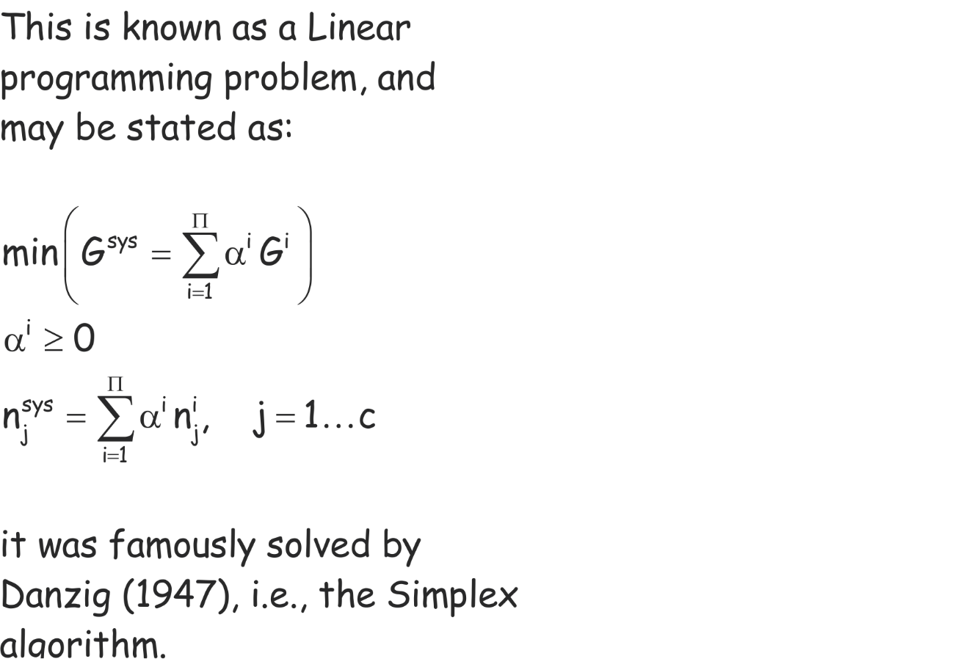
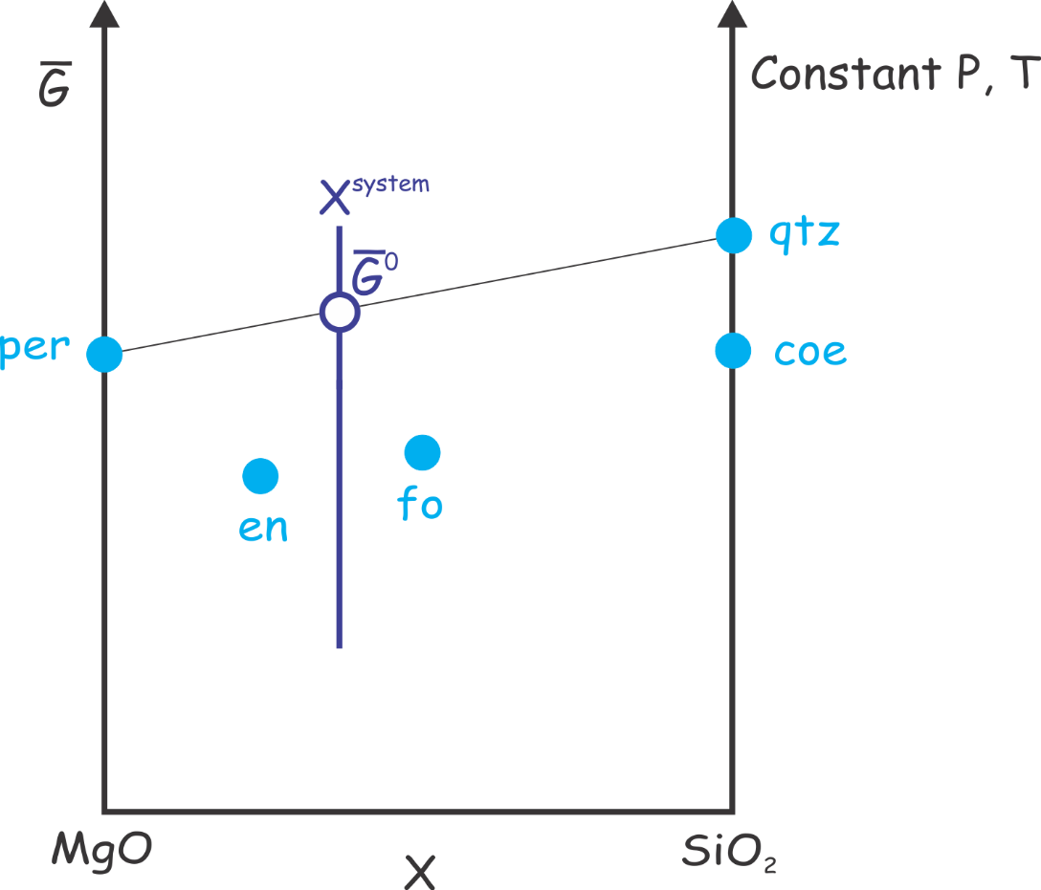
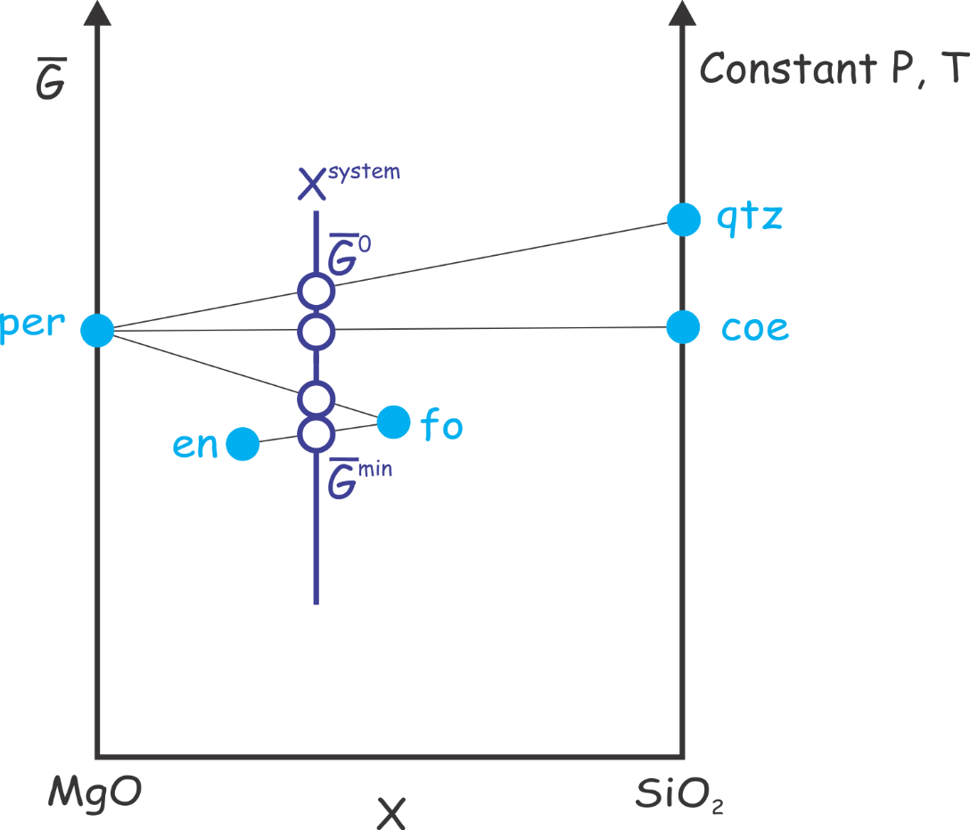
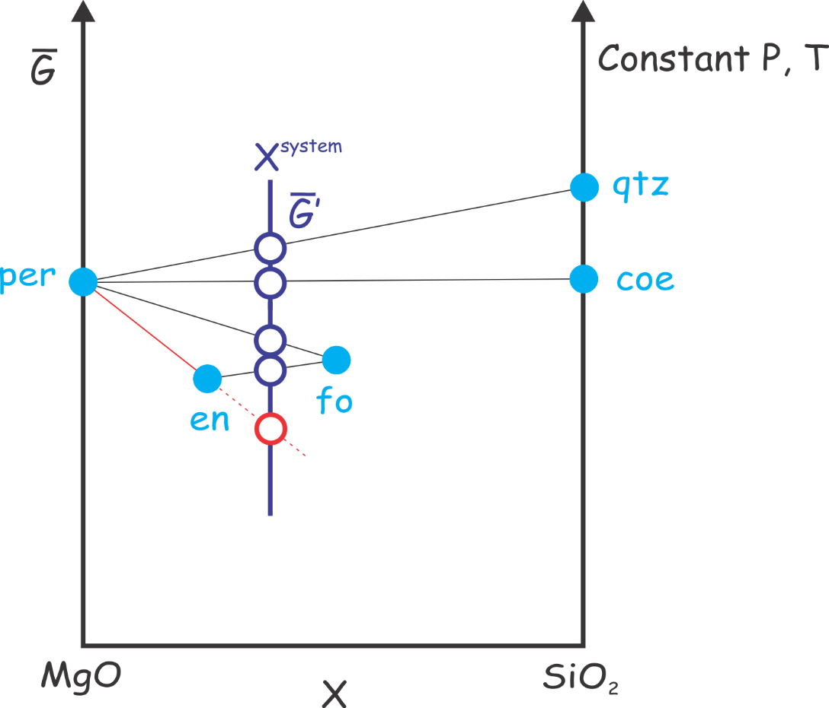
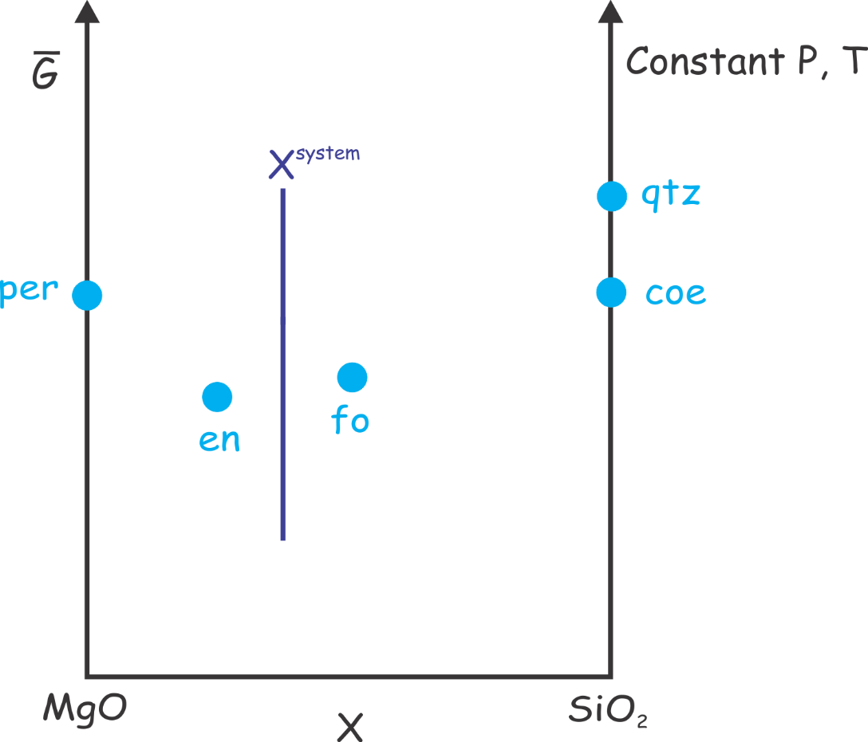
Linear Gibbs Energy Minimization

Slide 7
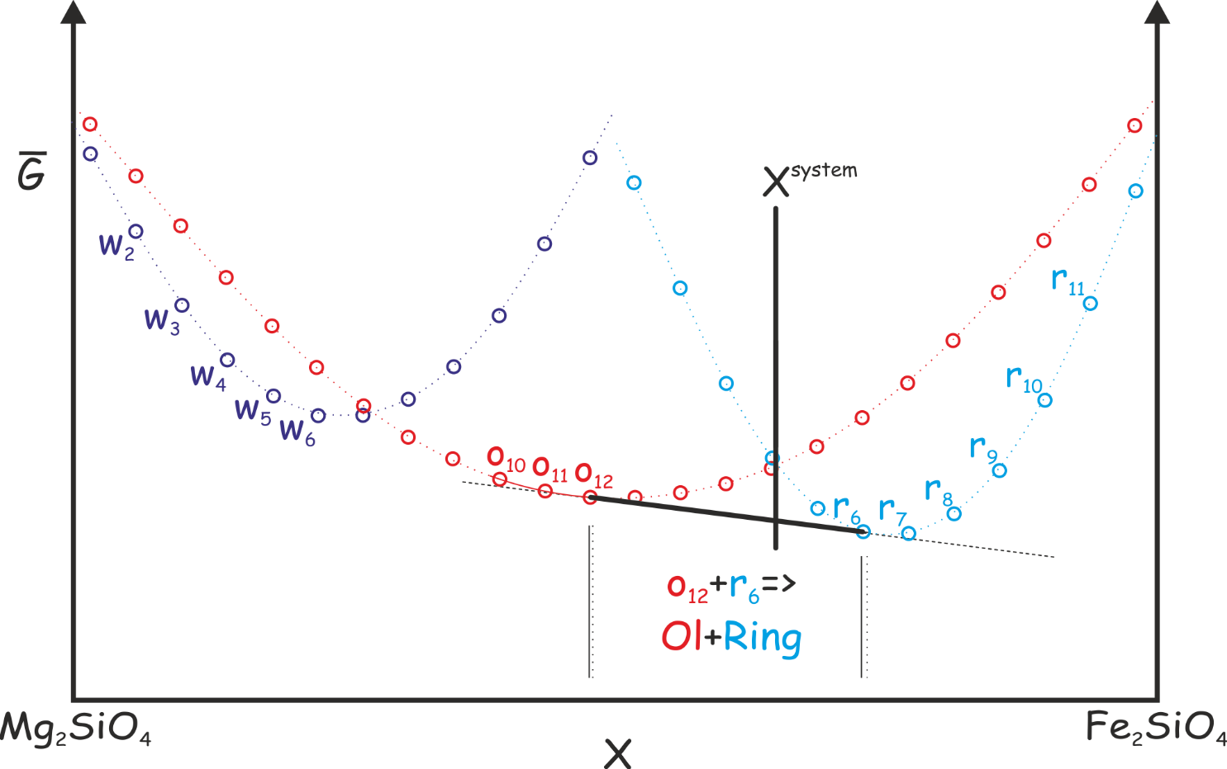
Linearized Gibbs Energy Minimization: “Pseudocompound” Approximation
Pseudocompounds
White et al., 1958; Connolly & Kerrick 1987

Slide 8
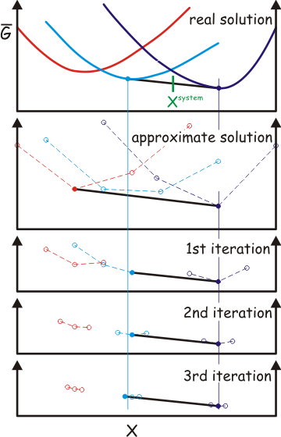
The Problem with Pseudocompounds
Iteration Scheme #1: Adaptive Minimization (Connolly 2009)
The solution => iteration
Relevant Perple_X options: initial_resolution,
final_resolution, resolution_factor, refinement_points,
reach_increment.
See: www.perplex.ethz.ch/Perple_X_why_it_often_does_not_work.html

Slide 9
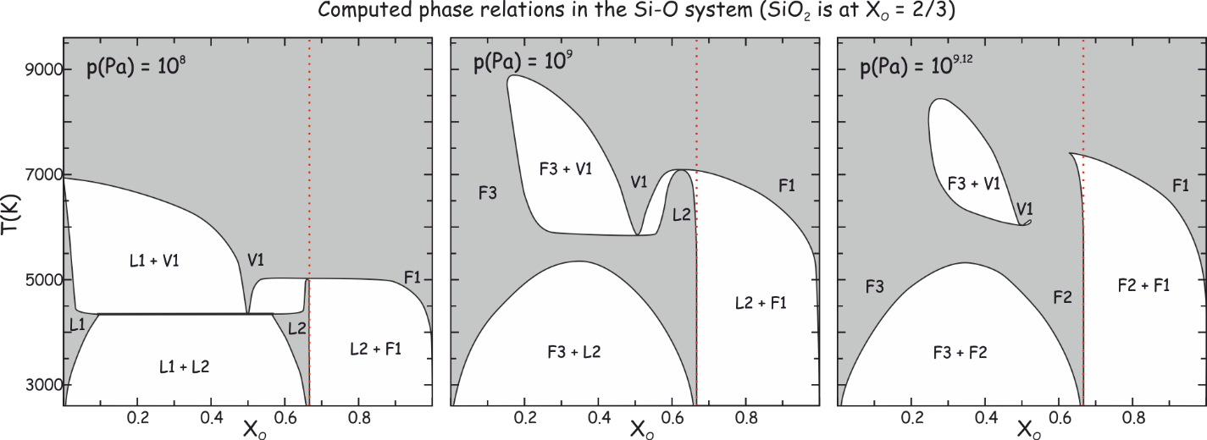
In general (c>1) phase diagrams are hyperdimensional objects.
Fortunately in many cases we require only information in 1-, 2-, or 3-dimensional phase diagram or phase diagram section.
In such cases phase diagram construction can be thought of as a mapping problem in which Gibbs energy minimization is tool used for sampling.

Slide 10
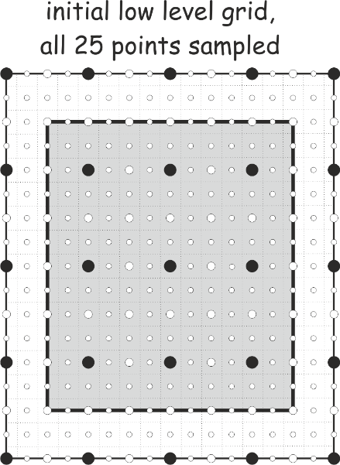
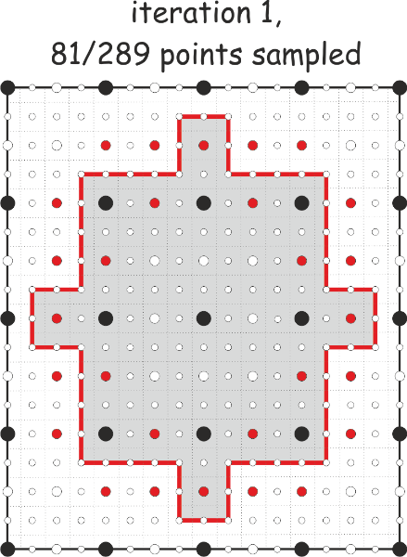
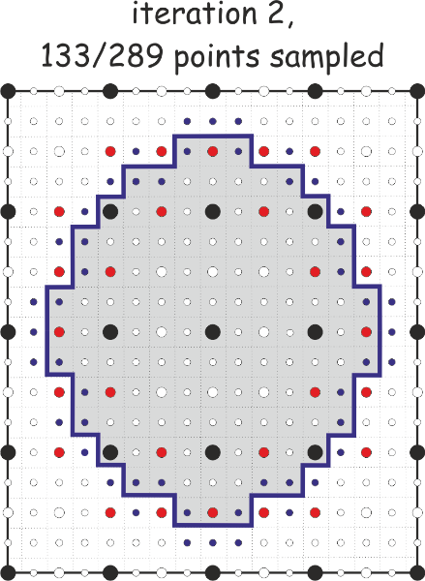
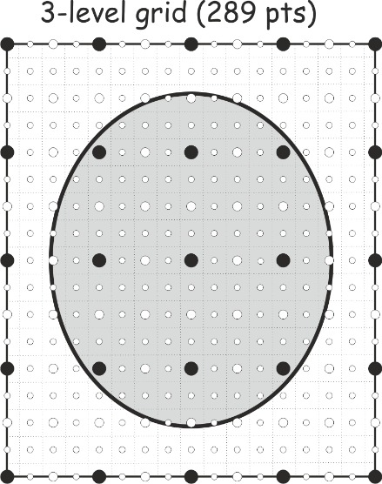
Phase diagram sections as a mapping problem
Iteration Scheme #2: Gridded Minimization (Connolly 2005)
Oval object to be mapped
The final map
The problem is analogous to mapping an oval rock exposure except that in the case of a phase field the identification of the phase assemblage at any sampling point is determined by the accuracy of the adapative minimization procedure (Iteration Scheme #1), i.e., there is no value to high resolution mapping with low resolution minimization. Balancing the resolution of both schemes is one of the many challenges to using Perple_X efficiently.
Relevant Perple_X options:
1d_path, x_nodes, y_nodes, grid_levels

Slide 11
Iteration Scheme #3: Auto-refinement
By default Perple_X does every calculation twice: a low-resolution exploratory stage and a high-resolution auto-refine stage
After the exploratory stage Perple_X:
1) eliminates unstable solution models
2) restricts the compositional range of stable solution models
3) increases the resolution of the adaptive and gridded minimization schemes*
Relevant Perple_X options: auto_refine, reach_increment_switch
*the following options have different values for the exploratory and auto-refine stage: initial_resolution, final_resolution, resolution_factor, refinement_points, reach_increment_switch, x_nodes, y_nodes, 1d_path, grid_levels
See: www.perplex.ethz.ch/Perple_X_why_it_often_does_not_work.html

Slide 12
Constrained minimization can easily be used to treat path-dependent problems such as phase fractionation and reactive-transport
An Example: Subduction Zone Decarbonation (Connolly 2005*)
Closed system models suggest carbonates in slab lithologies remain stable beyond sub-arc depths (Kerrick & Connolly, 1998, 2001a,b).
Would infiltration-driven decarbonation alter this conclusion?
*Input for this type of calculation is documented at: www.perplex.ethz.ch/Perple_X_FRAC2D.html

Slide 13
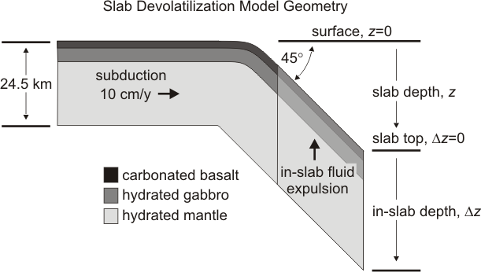
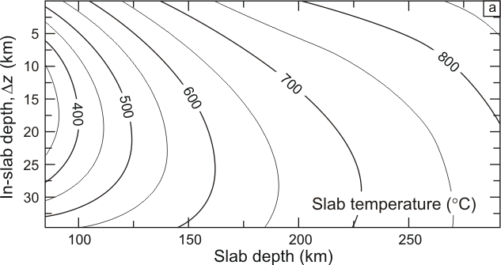

Slide 14
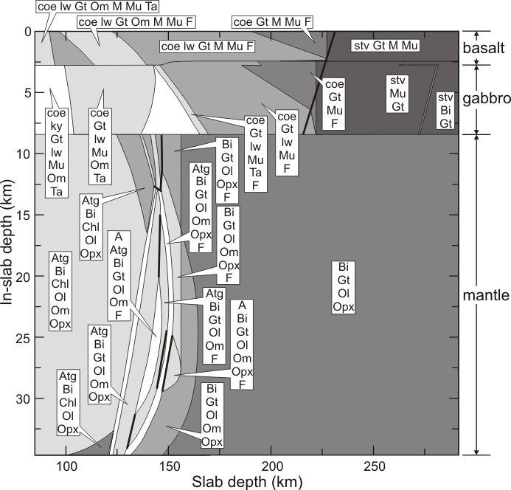

Slide 15
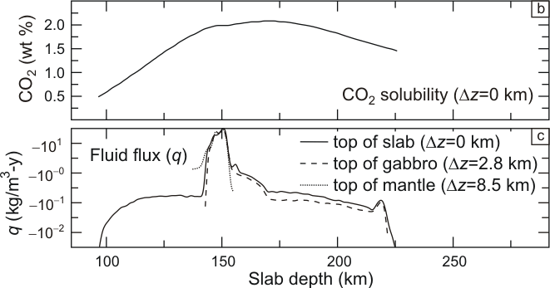
Slab fluid composition and production

Slide 16
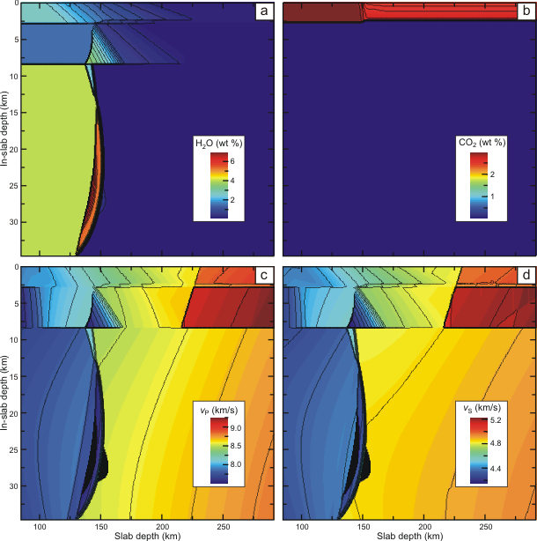
Slab Properties
Is infiltration decarbonation important?
No.
Taras Gerya is probably right!

Slide 17
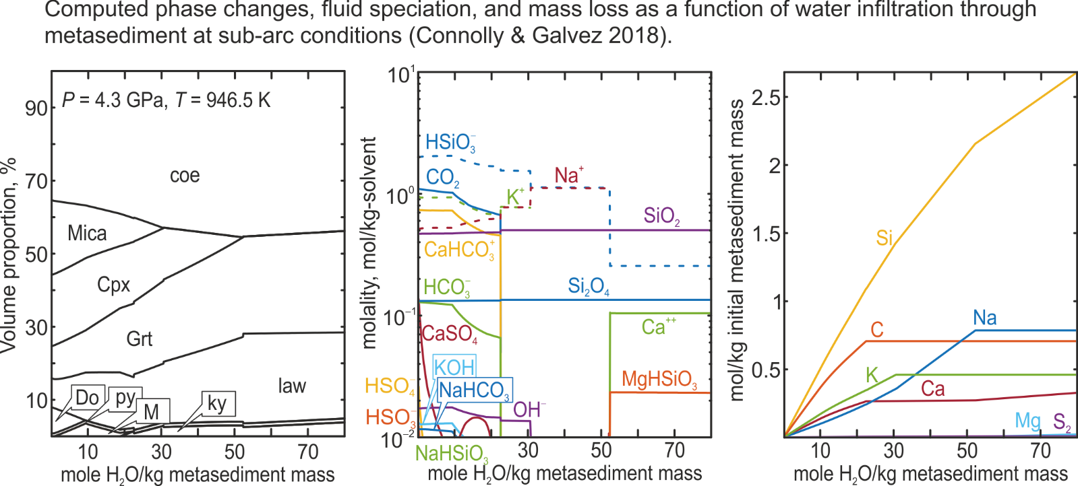
What if you add electrolytes? Maybe…
*The input for this type of calculation, 0-D infiltration/fractionation, is at: www.perplex.ethz.ch/perplex_electrolyte.html#Files_for_Connolly_2018

Slide 18
Unconstrained Gibbs Energy Minimization (Connolly 1990)*
All possible compositions of the system are optimized simultaneously
Key advantages:
No assumption of bulk equilibrium, complete solution models are not critical
Permits classical phase petrological phase diagram constructions: chemographic analysis, isopotential phase diagram sections, Schreinemakers projections
Key disadvantages:
Limited resolution, complexity
*Perple_X program CONVEX

Slide 19
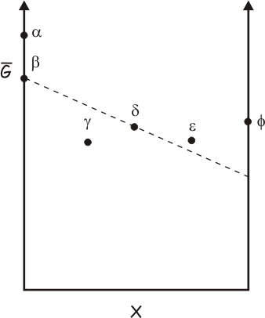
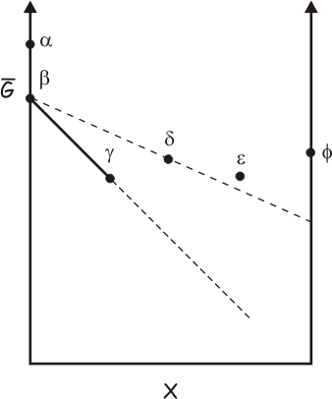
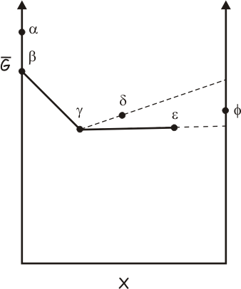
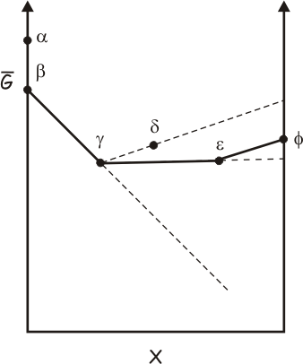
The Linear Convexhull Problem
A
B

Slide 20
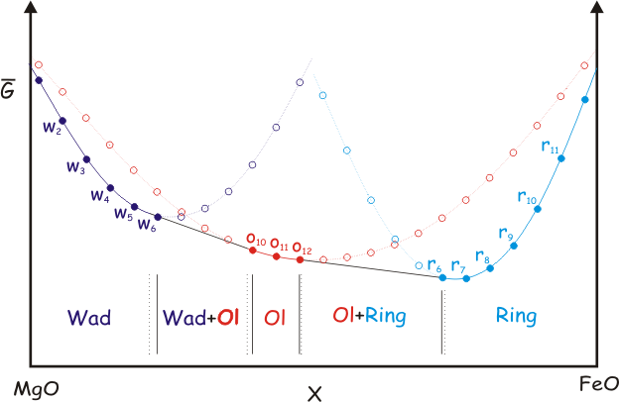
The Linearized Convexhull Problem: “Pseudocompound” Approximation
Pseudocompounds
Connolly & Kerrick 1987

Slide 21
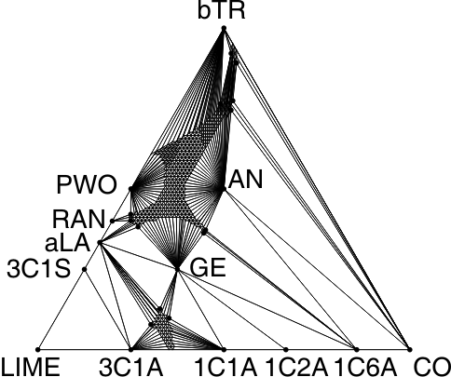
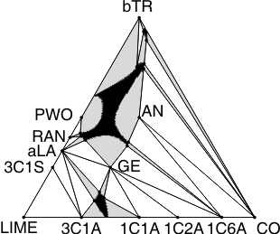
An Example: CAS after Berman & Brown (1984)
The plot on the right is the default plot from PSVDRAW, the plot on the left which shows the vertices of the convexhull (i.e., the stable pseudocompounds) is obtained from PSVDRAW, by modifying the default to plot “tielines”.

Slide 22
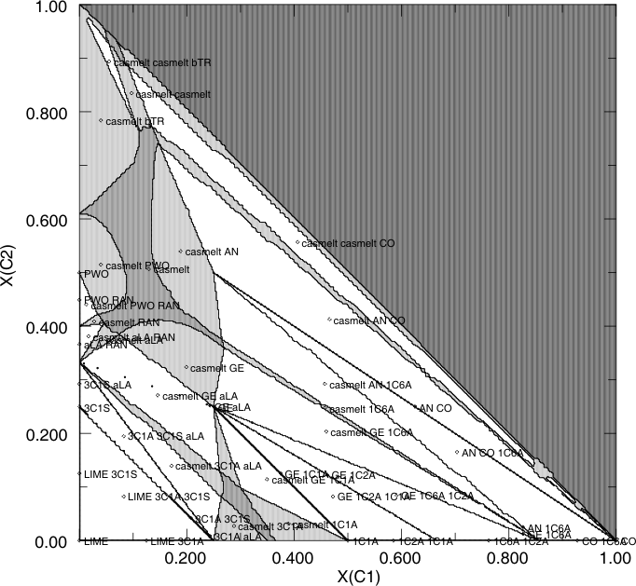
Why is there a choice?
VERTEX - Linear Programming
CONVEX - Convexhull
The plot on the right is the default plot from PSVDRAW, the plot on the left is obtained with PSSECT. Currently PSSECT offers no provision to transform the orthogonal compositional coordinates to the coordinate system of the equilateral triangle commonly used to represent ternary compositions.

Slide 23
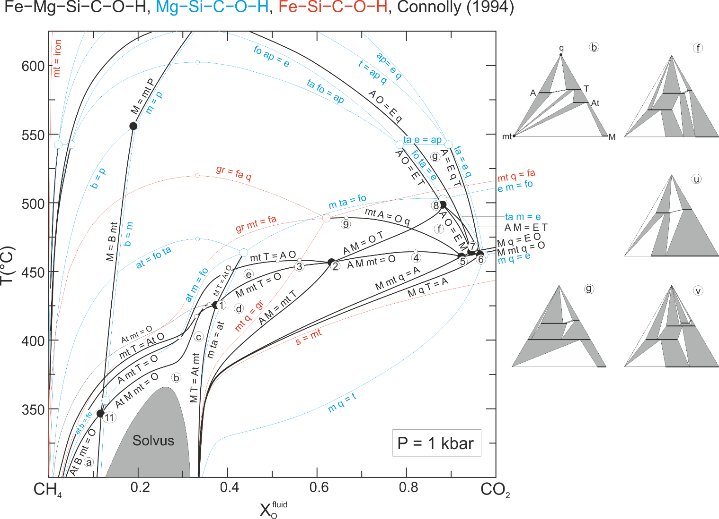
An Example: Schreinemakers Projection for C-saturated ultramafic rocks as a function of temperature and fluid composition

Slide 24
A bit of “theory”

Slide 25
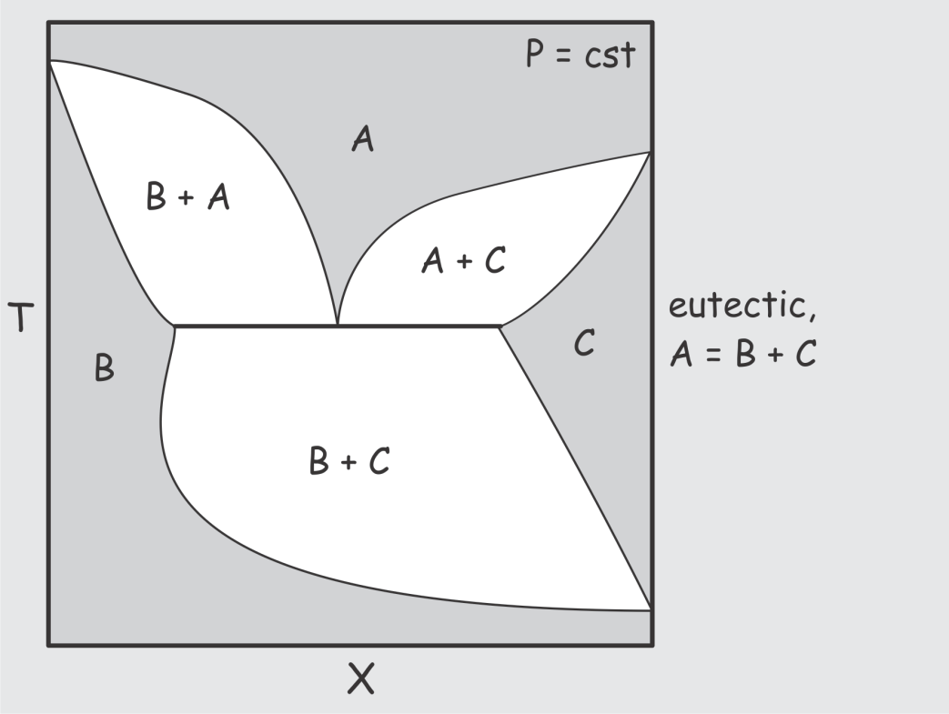
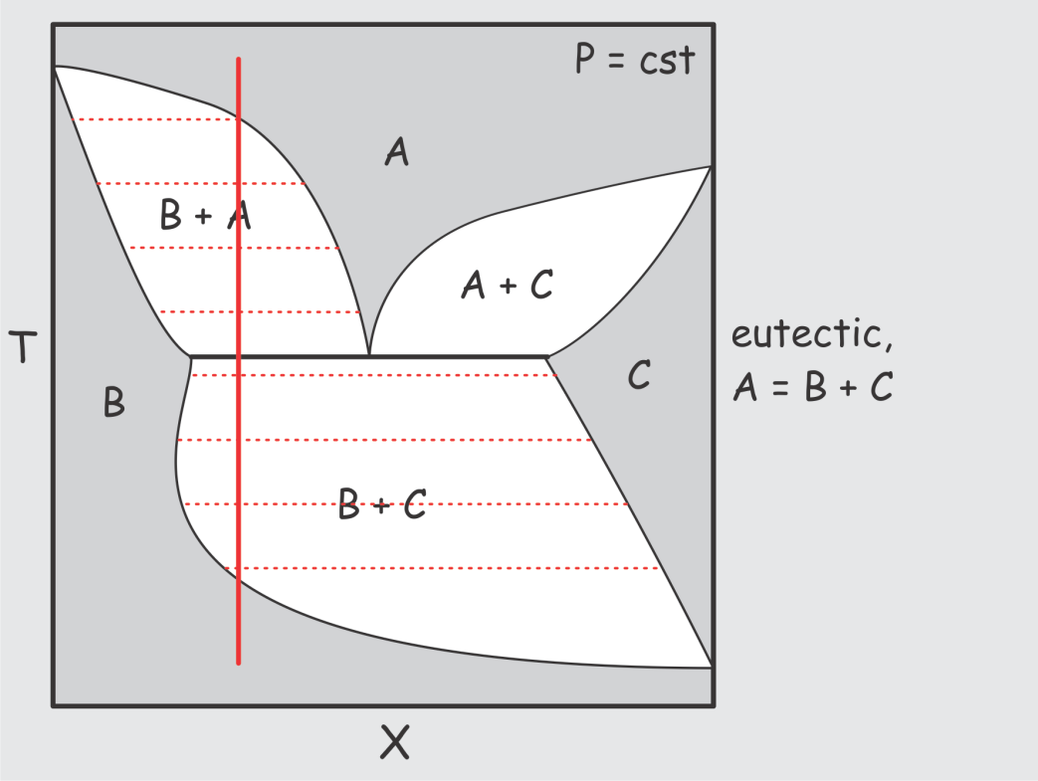
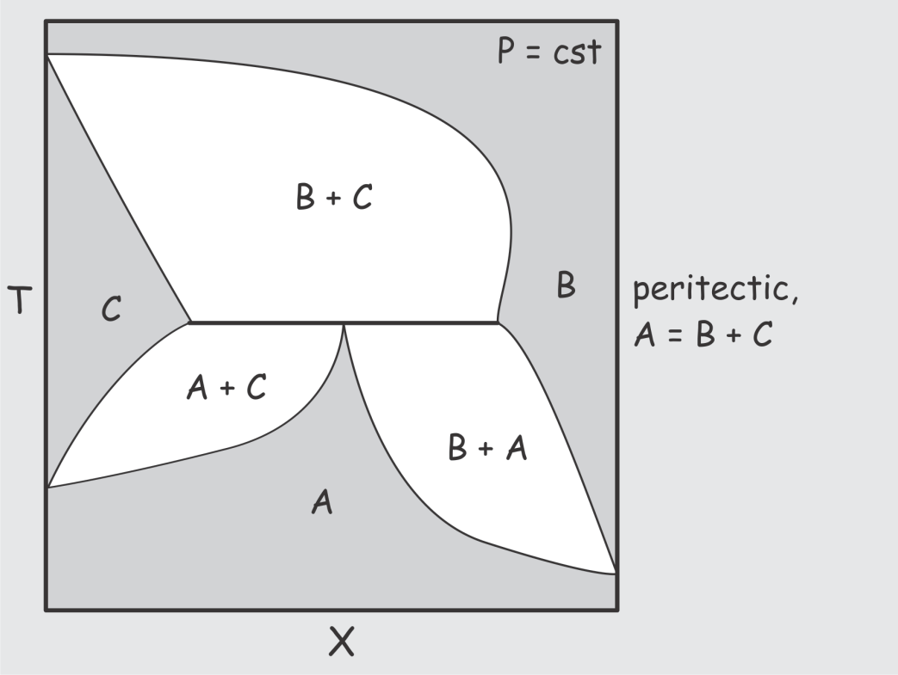
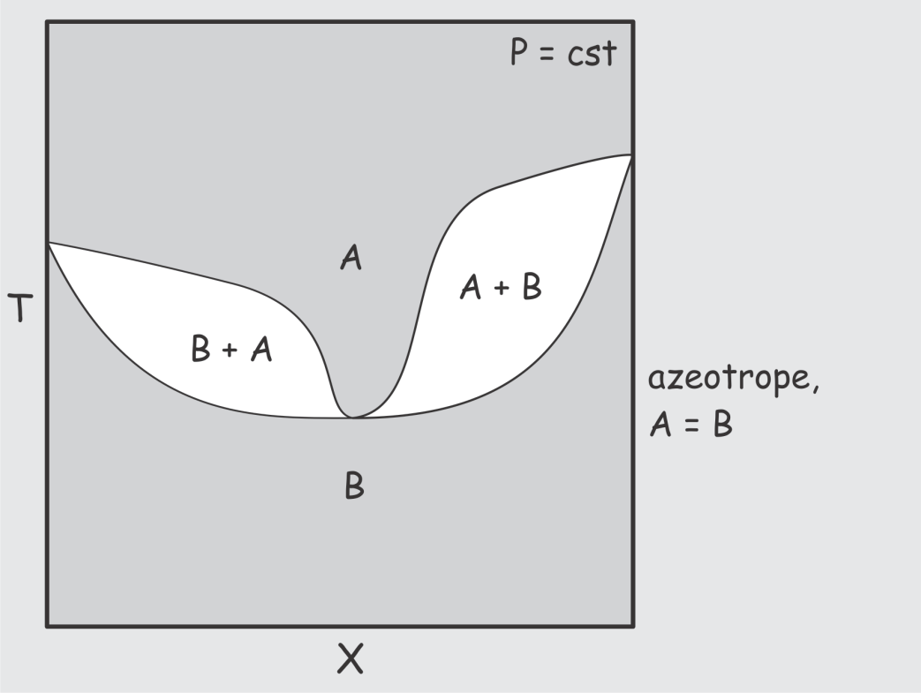
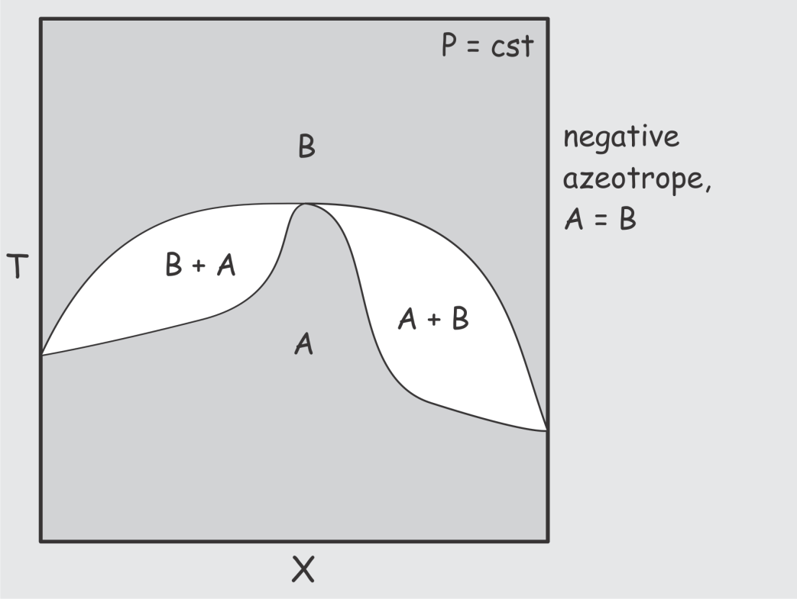
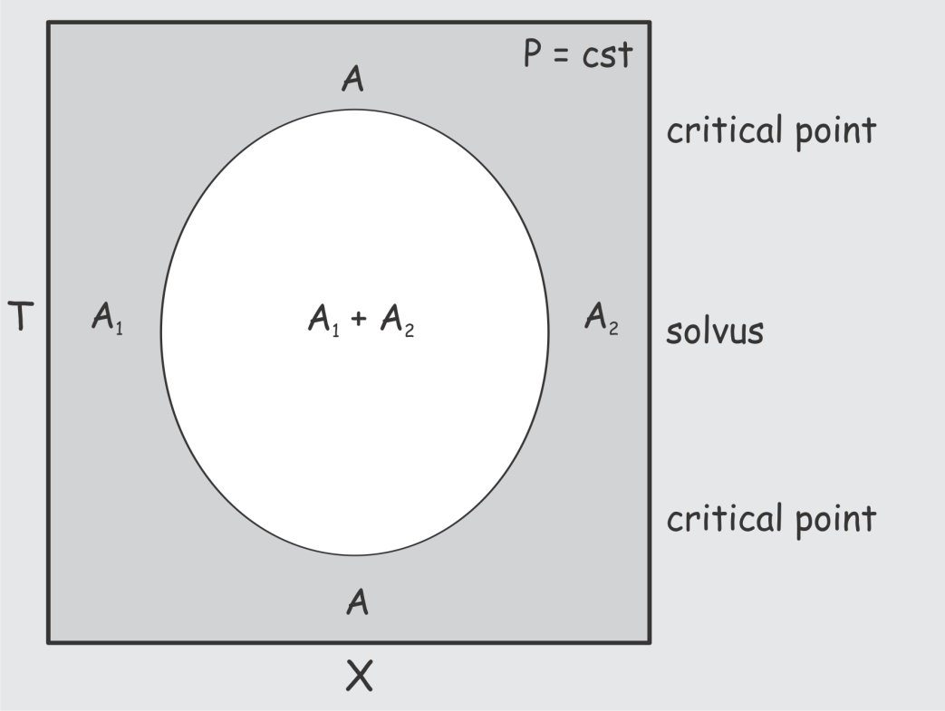
What is a phase diagram?
A phase diagram is a (real or abstract) diagram that directly defines the relative amounts and state of the phases in a thermodynamic system

Slide 26
What is state?
State is the thermal, mechanical, and chemical configuration of matter without regard to its size (extent)
In a system with k chemical kinds of mass, there are k+2 independent thermodynamic variables, but there are only k+1 independent state variables
There are two types of state variables
Potential variables - (P, T, chemical potentials*) do not differ among the coexisting phases of an equilibrium system
Specific variables - (s, v, chemical compositions) differ among the coexisting phases of an equilibrium system
The state of a p-phase system is only defined in a phase diagram with n ≥ p-1 specific variables
*Variables such as the composition of a phase (e.g., X_{CO2} in binary H2O-CO2 fluids) or the properties of a hypothetical species (e.g., f_{O2}, E_{h}, p_{H}, etc) are an indirect means of specifying chemical potentials. They are therefore classified as potential variables (Connolly 1990, Connolly & Petrini 2002).
compositions of a phase, activities, fugacities

Slide 27
Thermodynamic and Phase Diagram Variables*
*…,Tisza 1966, Callen 1981, Hillert 1986, …, Connolly 1990, …

Slide 28
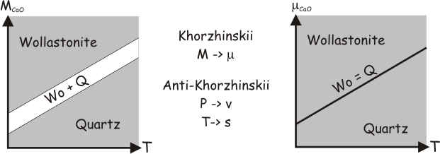
Variable Choices
 | Environment/Intensive | System/Extensive
Thermal | T (diathermal) | s (adiabatic)
Mechanical | P (inviscid) | v (isochoric)
Chemical | μ (mobile) | M (inert)
Phase diagrams are most useful when the variables of the phase diagram correspond to the determinative variables of the physicochemical system of interest. The observation of a phase assemblage that corresponds to an indefinite state (i.e., a heterogeneous reaction) in a phase diagram indicates that the variables of the phase diagram do not correspond to the determinative variables of the system. E.g., observation of the equilibrium assemblage kyanite + andalusite indicates that pressure and temperature cannot have been truly determinative variables, i.e., the reaction kyanite = andalusite must have influenced (aka buffered) pressure and/or temperature.

Slide 29
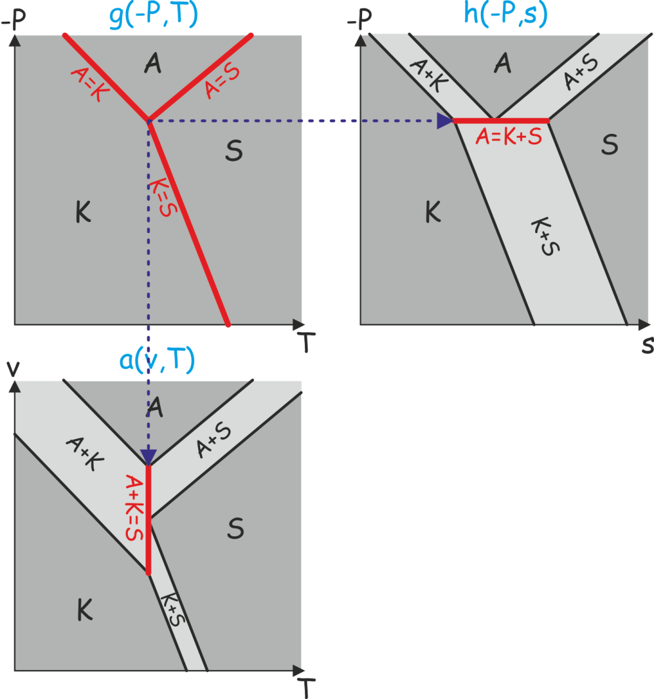
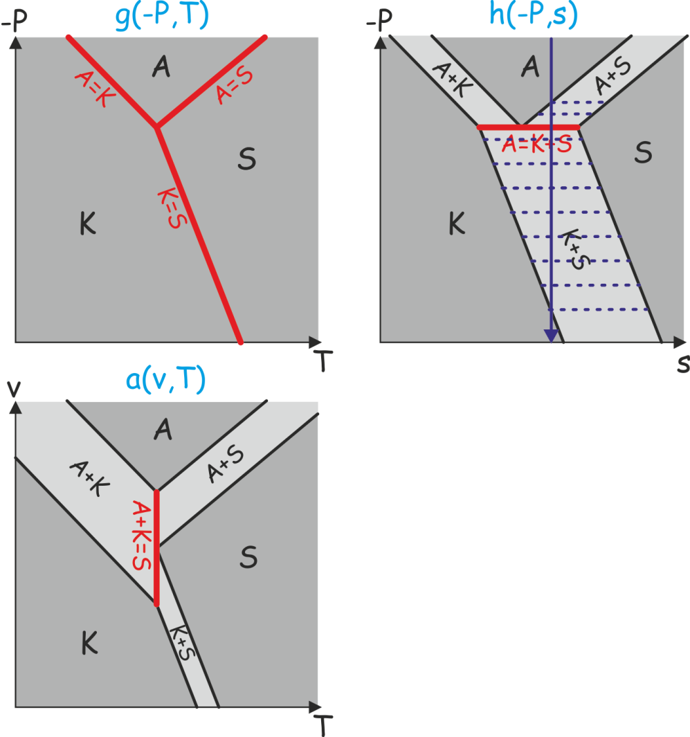
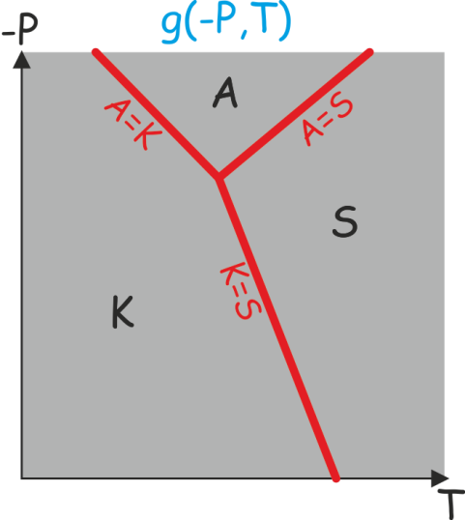
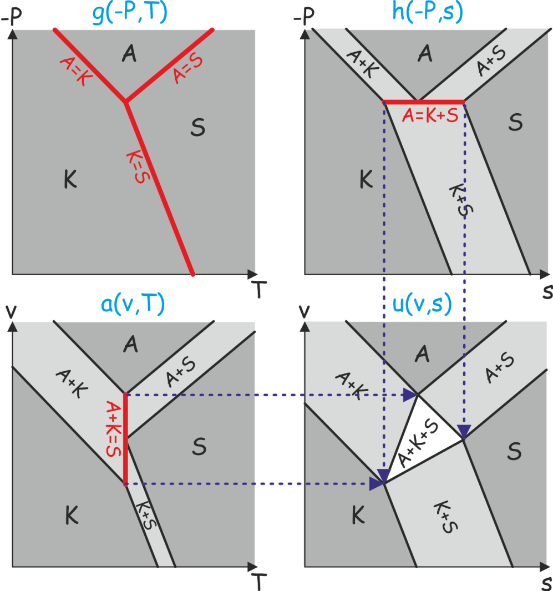
Changing Variables
P,T – state defined for p = 1
v,T – state defined for p ≤ 2
P,s – state defined for p ≤ 2
v,s – state defined for p ≤ 3
*…, Korzskii (1959), JB Thompson (the American Petrological renaissance ~1975), Hillert (1986), …, Connolly (1990), …

Slide 30
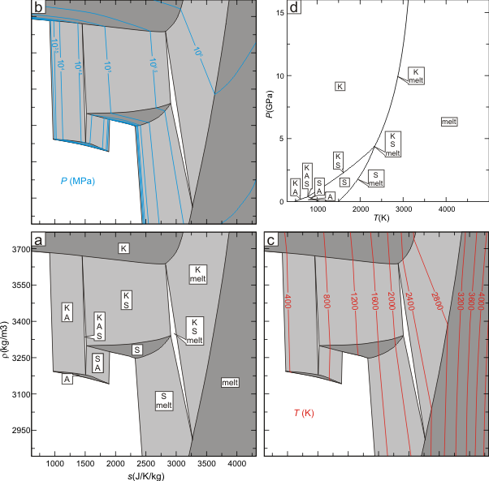
What does a calculated s-v phase diagram look like?

Slide 31
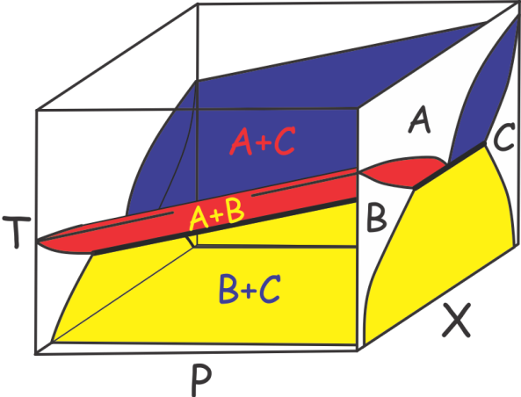
Reducing Multidimensional Phase Diagrams to 2D
Can be constructed with CONVEX

Slide 32
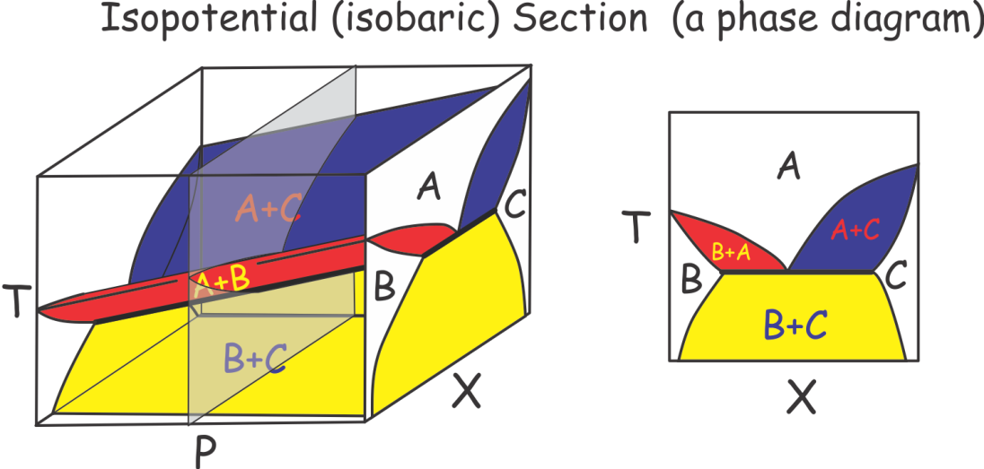
Reducing Multidimensional Phase Diagrams to 2D
AKA Mixed-variable phase diagrams
Can be constructed with CONVEX or VERTEX (can be non-linear, e.g., P(T))

Slide 33
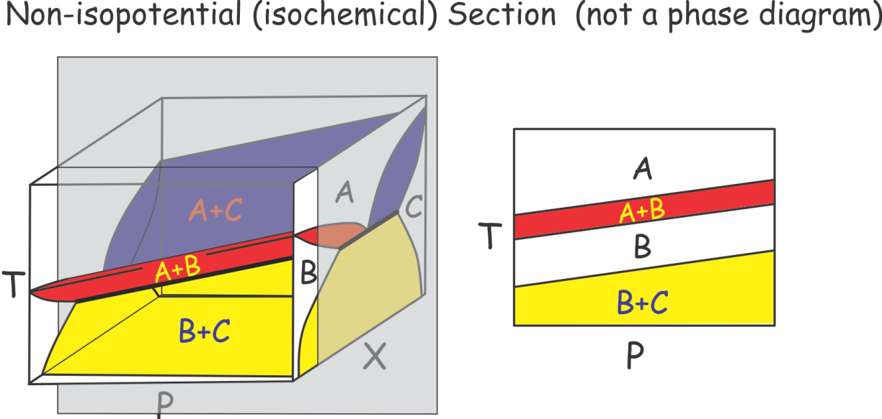
Reducing Multidimensional Phase Diagrams to 2D
AKA pseudosections (the term is nonsense, isochemical sections are pseudo-phase diagrams not pseudo-sections)
Value: defines exact phase stabilities for a specific bulk composition
Can be constructed with VERTEX

Slide 34

Reducing Multidimensional Phase Diagrams to 2D
AKA Petrogenetic grids
Value: defines absolute phase stabilities irrespective of bulk composition
Can be constructed with CONVEX
It is often suggested that the projected axes of a Schreinemakers’ Projection correspond to composition variables. There is no such constraint, i.e., the projection is identical if a compositional variable or its conjugate potential corresponds to a projected axes. Additionally, the Schreinemakers’ Projection is equally valid if pressure (or volume) or temperature (or entropy) correspond to the projected axes (Connolly 1990).

Slide 35
“Phase diagrams are the beginning of wisdom not the end of it.”
-- Sir William Hume-Rothery
If you got this far, you might as well know the truth…
Good luck!

Slide 36
“It is unworthy of great (wo)men to lose hours like slaves in the labor of calculation.”
-- Baron Gottfried Wilhelm von Leibniz
Perple_X : A Mechanical Petrologist for Geophysical Problems
What is Perple_X doing?
Geophysical inversion for mantle composition and temperature
A few thoughts about nomenclature

Slide 37
The Non-Linear Phase Equilibrium Problem
The stable state of a system minimizes its Gibbs Energy (G)

Slide 38

The Non-Linear Phase Equilibrium Problem
The stable state of a system minimizes its Gibbs Energy (G)
Brown & Skinner 1974, Saxena & Eriksson 1983, Wood & Holloway 1984, deCapitani & Brown 1987, Bina 1998, etc. etc.

Slide 39
The Problem with Pseudocompounds
Iteration Scheme #1: Adaptive Minimization
The solution => iteration
White et al. 1958, Connolly 2009

Slide 40

What if the bulk composition is known?
Pseudocompounds
White et al. 1958, Connolly 2005

Slide 41
A Problem with Pseudocompounds
A Solution: Iterative Refinement
White et al. 1958, Connolly 2009

Slide 42



Phase diagram sections as a mapping problem

Slide 43
An Example: Again CAS after Berman & Brown (1984, no comment)
Linear Programming
Convex Hull

Slide 44
What is a phase diagram?
A phase diagram is any diagram that directly defines the relative amounts and state of the phases in a thermodynamic system
Phase diagram variables vs real determinative variables

Slide 45


The advantage of LP is it permits melts of natural complexity
An example: Peridotite solidus with the pMELTS model (Ghiorso et al. 2003)

Slide 46
Conclusions for Part I
But a monkey could do that…
The beginning of wisdom?
Putting phase equilibria (g) into geophysics…

Slide 47
Equation of State, Stixrude & Bukowinski 1990
Gruneisen model for Helmoltz Energy:
Birch-Murgnahan “cold” part:
Debeye “thermal” part:
Seven parameters (
) + 3 parameters for seismic velocities
Data from Stixrude & Lithgow-Bertelloni (2005) augmented by
Post-perovskite from Oganov & Ono (2004), Ono & Oganov (2005)
Ca-perovskite from Akaogi et al. (2004), Karki & Crain (1998)
Wuestite, perovskite from Fabrichnaya (1999), Irifune (1994)
Notes:
dln(gamma)/dln(v) = q

Slide 48
Computed Pyrolite (CaO-FeO-MgO-Al₂O₃-SiO₂) Phase Relations

Slide 49

“Phase diagrams are the beginning of wisdom not the end of it.”
-- William Hume-Rothery
Pyrolite P-wave velocity

Slide 50



Enter Amir Khan:
Geophysical Inversions for Planetary Composition, Temperature and Structure
primary parameters
secondary parameters
primary data
P-wave velocities of cheese are 1.2 (Muenster)
- 2.1 (Swiss) km/s, velocities in the lunar regolith are 1.2-1.8 km/s
Ergo the moon is a mixture of Muenster and Swiss cheese
Allows joint inversion of unrelated geophysical data

Slide 51
Inversion Strategy
d=f(m) => m=g(d)?
i) Guess a physical configuration (T, c, d, …)
ii) Construct a forward model of the observed data
iii) Test against observations
iv) Generate a new configuration, go to ii)
repeat 10⁷ times

Slide 52




Searching for the Answer

Slide 53

Bayesian Inversion:
Prior Probability, Likelihood and Posterior Probability

Slide 54


Bayesian Inversion:
Prior Probability, Likelihood and Posterior Probability

Slide 55


Bayesian Inversion:
Prior Probability, Likelihood and Posterior Probability

Slide 56

The Observations
Periodic ionospheric and magnetospheric fields induce secondary magnetic fields within the earth
Transfer function between external and induced fields is a function of earth’s conductivity
Sub-European soundings (Olsen 1999) for periods of 3 h to 1 year (depths of 200-1500 km)
Earth’s mass and moment of inertia

Slide 57
What’s good about an EM inversion?
Test of ability to predict phase relations without requiring accuracy in high order derivatives necessary to calculate elastic properties
EM inversions are in principle a vastly superior method of probing planetary composition
Sensitivity of seismic (v_{p}) vs EM (σ) signals
P-T: from 1880K - 23GPa to 2750K - 100GPa
Mineral composition: 10 mol % change in Fe- or Al-content

Slide 58
What’s bad about EM inversion? The forward model.
Dependent on a poorly known transport property rather than thermodynamic properties (i.e., more difficult to measure), more sensitive to contaminants and possibly texture.
Upper mantle: conductivities after Xu et al. 2000a,b (Cpx as a proxy for C2/c & akimotoite), no correction for mineral composition or oxygen fugacity (Mo-MoO₂)
Lower mantle: Wuestite σ₀(x_{Mg}) after Dobson & Brodholt (2000a); Perovskite σ₀(x_{Al}) after Xu & McCammon (2002, Goddat et al. 1999, Katsura et al. 1998); Al-free perovskite as a proxy Ca-perovskite
Aggregate conductivity computed as the volumetrically weighted geometric mean (Duba & Shankland 1990):

Slide 59

Parameterization of the Physical Model
Spherically symmetric 1-D model
3 silicate layers (crust, upper mantle and lower mantle)
Parameterized by a composition thermal gradient and thickness
Core parameterized by density
Compositional bounds (wt %)
CaO∈[1;8]
FeO∈[5;20]
MgO∈[30;55]
Al2O3∈[1;8]
SiO2∈[20;55]

Slide 60
Mantle Mineralogy

Slide 61

Data fit I: Predicted transfer function components
Apparent resistivity
1 hour
1 day
1 year
11 years
Phase difference between magnetic and electric field

Slide 62

Data fit II: Mass (M) and Moment of Inertia (I)
1 hour
1 day
1 year
11 years
Phase difference between magnetic and electric field
~10⁶ models

Slide 63
Density and Seismic Velocities
PREM (Dziewonski & Anderson ’81) – solid white line
AK135 (Kennett et al. ’95) – dashed white line

Slide 64

Thermal models
T-z coordinates of the 410 and 660 discontinuities anticipated from phase eq expts (Ito & Takahashi ’89)
T₆₆₀~1500±250ºC
∇T~0.5±0.1ºC/km
T_{CMB}~2900±250ºC

Slide 65


Slide 66

mantle composition

Slide 67

Is there any hope of (at least) an inversion consensus?
Cammarano et al. ‘05: mantle is superadiabatic (if it’s pyrolite)
Lyon Group: Mattern et al. ‘05 revisited by Matas et al. (pers. comm. ‘06)
Khan et al. 08: travel time inversion, super-adiabatic non-pyrolitic; upper/lower mantle Mg/Si=1.05-1.20

Slide 68
Is there a 660 layer?
posterior
prior

Slide 69
Mundane Conclusion
The EM inversion results suggest a relatively homogeneous, superadiabatic mantle of chondritic composition
More generally terrestrial inversions yield low Mg/Si (1.05-1.2) and low bulk CaO and Al₂O₃

Slide 70

Mars
What is sort of known:
Composition from a set of “Martian” meteorites (e.g., McSween ’94)
Core, but only a paleo-magnetic field (e.g., Weiss et al. ‘02)

Slide 71

What is known well: 4 Scalars (Yoder et al. ‘03)
What is not known well at all:
Thermal structure, core size and state from forward models that assume the SNC mantle composition and sensitive to crustal thickness
Mean mass and moment of inertia (distribution of mass)
Second degree tidal Love number (squishyness ~ f(μ_{S}, K_{S}, ρ))
Tidal dissipation (inelasticity ~ g(μ_{S}, q_{local}))

Slide 72

Martian Mantle Composition

Slide 73

Martian Mantle Mineralogy
No significant perovskite transition

Slide 74

Core Radius and Density

Slide 75

Areotherms and the Frozen Core Dilemma
After Stewart & Schmidt ‘06

Slide 76
Martian Conclusions
The Martian mantle is Fe-rich relative to Earth, but significantly less so than inferred from the SNC meteorites (Dreibus & Wanke ’85)
The hot areotherm and large core radius preclude a Mg-perovskite phase transition in the lower mantle (bad news for super-plumes? Not really)
The martian core is far above its liquidus

Slide 77
“This is not the end, this is not even the beginning of the end, perhaps it is the end of the beginning.” –- Winston Churchill
Free energy minimization provides the basis for a general physical model that permits joint inversion of a priori unrelated geophysical data sets (seismic, gravity, electromagnetic)

Slide 78

Martian Temperature Distributions
Prior
Posterior

Slide 79
Seismic Velocities and Thermodynamic Consistency
 | ρ | K_{S} | μ_{S}
Sobolev & Babeyko ‘94 | no | no | no
Connolly & Kerrick ‘02 | yes | yes | no
Stixrude & Lithgow-Bertelloni ‘05 | yes | yes | yes
Does it really matter? Probably not, phase relations are most sensitive to integration constants and low-order derivatives, seismic velocities are most sensitive to high-order derivatives.
Non-thermodynamic issues: anelasticity, aggregate modulii

Slide 80

Core Radius and CMB Temperature

Slide 81

Martian Inversion Resolution (T at 1200 km)

Slide 82

Trade-offs

Slide 83
Mantle Conductivity Profile
Olsen (’99) inversion (model 3)

Slide 84



Resolution and Stability

Slide 85
Phase equilibrium doesn't just provide parameters, but also an equation of state (EoS) that is essential to close the governing equations of geodynamic models.
But what variables?
 | Environment/Intensive | System/Extensive
Thermal | T (diathermal) | s (adiabatic)
Mechanical | P (inviscid) | v (isochoric)
Chemical | μ (mobile) | m (inert)
Homogeneous systems =>
common EoS choices:
Khorzhinskii, k(P,T,μ)
Gibbs, g(P,T,m)
Helmholtz, a(v,T,m)
enthalpy, h(P,s,m)
internal energy, u(v,s,m)
u(s,v,m) is the only EoS for
a heterogeneous system

Slide 86

Putting g into geodynamics:
What is the geodynamic equation of state (EoS)?
Discontinuous reactions are singularities->
State changes, but the state function does not->
the Stefan problem

Slide 87

Putting g into geodynamics:
What is the geodynamic equation of state (EoS)?
Discontinuous reactions are singularities->
State changes, but the state function does not->
the Stefan problem

Slide 88

Putting g into geodynamics:
What is the geodynamic equation of state (EoS)?
Discontinuous reactions are singularities->
State changes, but the state function does not->
the Stefan problem

Slide 89

Optimization of exotic free energy functions: example h(s,P)
We need h(s,P), we have g(T,P)…

Slide 90
Phase Diagrams: What, How, and, Maybe, Why by J.A.D. Connolly, ETH
Phase diagram principles and nomenclature (Hillert 1986, Connolly 1990)
Linearized solution of the phase equilibrium problem (Perple_X, Connolly 2009)
Phase diagram applications in geophysics (Khan et al. 2006)

Slide 91

Optimization of exotic free energy functions: example h(s,P)
We need h(s,P), we have g(T,P)…
A hidden virtue of linearization:
Discretization of h(T,P) for individual phases yields h(s,P) for the system, likewise u(T,P) yields u(s,v).

Slide 92
What does a calculated s-v phase diagram look like?

Slide 93
How do we put u(s,v) into geodynamic models?
*Mechanical work associated with the Post-Perovskite transition is 5 times its Latent heat effect.

Slide 94

Computational Cycle

Slide 95


Look-up Tables Instead of Direct Calculation

Slide 96
A morsel of wisdom?
Don’t put g(P,T), or any f(P,T) equation of state, into geodynamics
Use u(s,v), it is easier than g and eliminates 1st order phase transformations and thereby the Stefan problem

Slide 97
Forward Geodynamic Modelling: Subduction Zone Decarbonation
Closed system models suggest carbonates in slab lithologies remain stable beyond sub-arc depths (Kerrick & Connolly, 1998, 2001a,b).
Would infiltration-driven decarbonation alter this conclusion?

Slide 100
Slab fluid composition and production

Slide 101
Slab Properties
Is infiltration decarbonation important?
No.
Taras Gerya is probably right!

Slide 102
Mapping Strategy

Slide 103
Free Energy Minimization by Linear Programming and Applications to Geophysical Inversion for Composition and Temperature
Free Energy Minimization – a method for predicting the thermodynamic (elastic) properties of rocks as a function of environmental variables (typically pressure and temperature)
A forward model for rock properties: Geodynamic and Inversion calculations.
A robust and efficient method.
Some thoughts about cultural differences and data
Two inversions for planetary composition and temperature

Slide 104

Optimize what when? And an Unexpected Virtue of the Linearized Solution
Thermodynamics provides stability criterion (i.e., an extremal function) for any choice of variables among the conjugate pairs P-V, T-S, μ-n
G(P,T,n) – inviscid, known temperature
A(V,T,n) – known strain rate, temperature
H(P,S,n) – inviscid, known heat flux
U(S,V,n) – known strain rate and heat flux
G(P,T,n) –> A, H, U as a f(P,T,n)
Stefan Problem

Slide 105



Some thoughts about cultural differences and data
D” and the Fe-Mg-Al Post-perovskite transition
Geophysics/Mineral physics
Limited data, lots of theory
Individual minerals and phase transitions
“A good experiment ****s any computation” D. Yuen, 2005
Pro: Amenable to simple parameterization for geodynamic models
Con: Ignores strong autocorrelation of thermodynamic parameters
Petrology
Lots of data, little theory
Global average
Pro: Objectivity, single mega-parameter
Con: Difficult to: assess uncertainty; separate first and second order affects; modify without access to primary data

Slide 106
How do we put u(s,v) into geodynamic models?
The energy (aka temperature) equation as an example

Slide 107
Putting g into geodynamics:
What is the geodynamic equation of state (EoS)?

Slide 108
Putting g into geodynamics:
What is the geodynamic equation of state (EoS)?

Slide 109
Putting g into geodynamics:
What is the geodynamic equation of state (EoS)?

Slide 110
Linking Mineral Physics to Geophysics
Mineral Physics:
Mineral Properties
Geophysics:
Earth Properties

Slide 111
Linking Mineral Physics and Geophysics
Petrology:
Rock Properties
Mineral Physics:
Mineral Properties
Geophysics:
Earth Properties

Slide 112
The Non-Linear Phase Equilibrium Problem
The stable state of a system minimizes its Gibbs Energy (G)

