Slide 1
Thermobarometry as an inverse problem with incomplete information*
Uninformed review of classical vs modern thermobarometry
Describe the inversion strategy (Khan et al., 2021)
Synthetic and real applications
*A tale of two Khans (Amir, geophysics, and Dean, petrology) .

Slide 2
Classical thermobarometry
GASP, Grt-Bio, AvPT, TWEEQU, etc
Invert for P-T conditions directly from observation
Pros:
No bulk equilibrium assumption
Multiple events can be recovered from a single sample
Con:
Thermodynamically inconsistent

Slide 3
Modern (phase diagram-based) thermobarometry
Bulk equilibrium and a complete thermodynamic model
Invert for P-T conditions by finding the best match between observed and predicted mineralogy
Pro:
Thermodynamically consistent
Cons:
Often require estimates of unmeasured chemistry (e.g., Fe³⁺/Fe²⁺, volatile content)
Labor intensive and subjective (cf., Nerone et al, Cawood & Mackay-Champion)

Slide 4
Post-Modern Thermobarometry as of 09:00 April 10, 2025*
AvPT+
Eleanor & Roger
MC_fit
Dean & me
TBA
Tobermory et al
local equilibrium
local or bulk equilibrium
bulk equilibrium
best fit
best fit or pseudo-Bayesian
Bayesian
local minimizer
global minimization
global minimization
Much to my embarassement, when I prepared this slide I forgot to include Bingo-Antidote by Duesterhoeft & Lanari (2020). Bingo-Antidote pioneered the use of global Gibbs energy minimization for thermobarometric inversion. The characteristics of Bingo-Antidote are:
bulk equilibrium
best fit
global minimization

Slide 5
What is an Inverse Problem?
mineralogy = f(thermodynamic data, P, T, X₁, X₂, …, X_{c})
observational data = f(known and unknown parameters)
=>
{P, T, X₁} = g(thermodynamic data, X₂, …, X_{c}, mineralogy)
unknown parameters = g(known parameters, observational data)
Inversion strategy
i) Guess unknown parameters
ii) Construct a forward model of the observational data
iii) Compare to the observational data
iv) Generate a new guess of the unknown parameters , go to ii)
repeat 10⁷ times and choose the “best” result

Slide 6
An objective function: Misfit

Slide 7
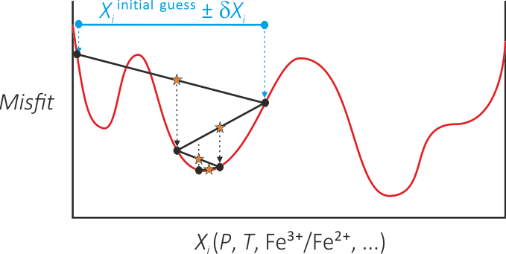
Minimizing Misfit: the Nelder-Meade algorithm
Hastings-Metropolis algorithm
Searches for models that fit data within uncertainty
Ergodic sample
Randomly generate a lot of initial guesses and hope for the best.

Slide 8
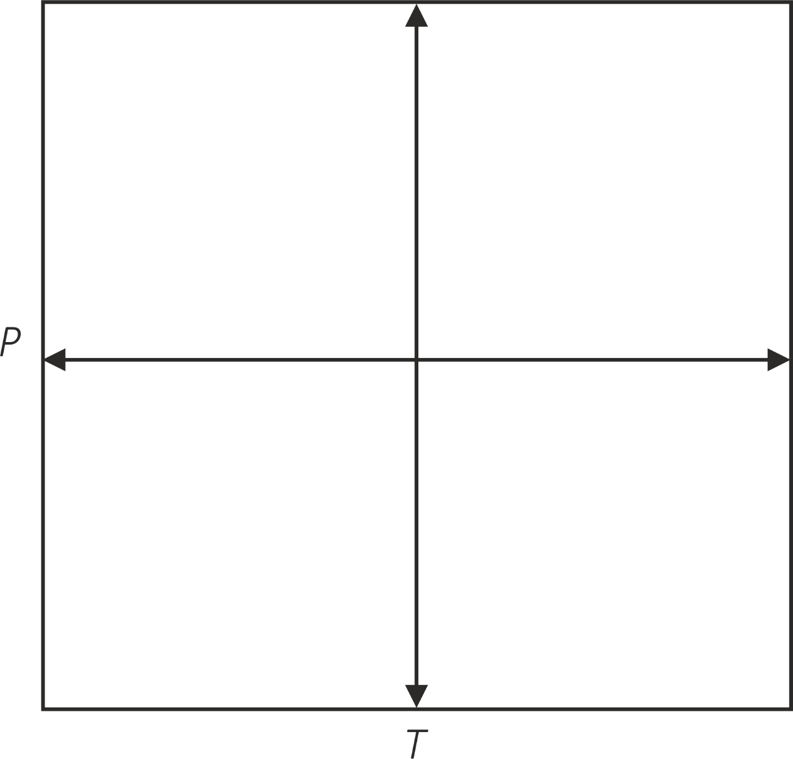
About those guesses
Ranges on unknown parameters imply prior knowledge.

Slide 9
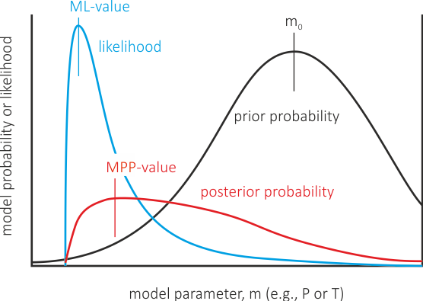
What is the “best” result?
The Bayesian Argument:
Likelihood = -exp(Misfit)
=>
The maximum likelihood model is not the best fit model, it is the most frequent model that fits the data
=>
Neither the maximum likelihood model nor maximum posterior probability model is guaranteed to predict the observed assemblage
Non-Bayesian alternatives:
Minimize Misfit
Minimize pseudo-Bayesian score: exp(Misfit) * prior_probability
Notes:
A serious flaw in Bayesian methods may be no real model that corresponds to either the ML-value or the MPP

Slide 10
What is observational data
inversion works best with raw data as you get it from, e.g., the microprobe or XRF
tampering with that data by introducing estimates for unmeasured quantities leads to bias
normalization is unnecessary
phase_name cAmph(G)
begin_comp
SiO2 55.20 0.05
Al2O3 1.95 0.08
FeO 21.73 0.18
MnO 0.78 0.13
MgO 9.12 0.13
CaO 1.77 0.17
Na2O 5.94 0.10
end_comp
phase_name cAmph(G)
begin_comp
SiO2 57.44 0.20
Al2O3 6.60 0.12
FeO 11.38 0.40
MnO 0.52 0.04
MgO 13.03 0.21
CaO 1.00 0.12
Na2O 6.96 0.04
end_comp

Slide 11
Synthetic test – a problem with a known answer.
Metabasalt thermodynamic forward model (Green et al., 2016):
T = 1000 K
P = 10000 bar
molar compositions:
Na2O MgO Al2O3 K2O CaO TiO2 FeO O2 H2O SiO2
Amph 0.39847 2.02243 1.52871 0.02213 1.69447 0.13901 2.01110 0.10814 0.93050 5.92024
Cpx 0.05283 0.54883 0.02868 0.00000 0.85342 0.00000 0.46010 0.02476 0.00000 1.97463
Grt 0.00000 0.37089 0.88811 0.00000 1.11889 0.00000 1.73399 0.05594 0.00000 3.00000
Fsp 0.31611 0.00000 0.67673 0.00715 0.35346 0.00000 0.00000 0.00000 0.00000 2.64654
sph 0.00000 0.00000 0.00000 0.00000 1.00000 1.00000 0.00000 0.00000 0.00000 1.00000
qtz 0.00000 0.00000 0.00000 0.00000 0.00000 0.00000 0.00000 0.00000 0.00000 1.00000
T = [700, 1100] K
P = [1, 15] kbar
n_{O2} = [0, 0.25 n_{FeO}] mol
1000 randomly generated starting guesses
100 perturbations for uncertainty analysis

Slide 12
Does it work?
Try 92, this is the best result so far.
Initial coordinates: 11718.0 1040.03 0.633495 0.575230 0.141357
Final coordinates: 10006.3 999.651 0.203299 0.999879 0.077621
The following observed phases are predicted:
vol % Na2O MgO Al2O3 CaO FeO O2 SiO2
Cpx
predicted* 92.841 0.0134 0.1392 0.0073 0.2164 0.1167 0.0063 0.5008
observed* 0.0135 0.1401 0.0073 0.2178 0.1174 0.0000 0.5039
residual 0.0001 0.0009 0.0001 0.0014 0.0008 -0.0063 0.0031
composition score: 0.397269E-04
Grt
predicted* 7.158 0.0000 0.0516 0.1239 0.1562 0.2420 0.0078 0.4185
observed* 0.0000 0.0522 0.1249 0.1573 0.2438 0.0000 0.4218
residual 0.0000 0.0005 0.0010 0.0011 0.0018 -0.0078 0.0033
composition score: 0.620168E-04
The following predicted phases are not observed:
vol % Na2O MgO Al2O3 CaO FeO O2 SiO2
q 0.000 0.0000 0.0000 0.0000 0.0000 0.0000 0.0000 1.0000

Slide 13
What else do you get?
Effective Bulk* Chemical Potentials (J/mol)
Na2O 13.481 -777464.
MgO 144.093 -641651.
Al2O3 17.011 -1655300.
CaO 229.979 -745771.
FeO 136.329 -320392.
O2 6.929 -442342.
SiO2 536.608 -891255.
*normalized molar units
What does the effective bulk of a local equilibrium mean?
Not much, except that It demonstrates the method is not voodoo
What do the chemical potentials mean?
They are characteristic of the local equilibrium, e.g., you can calculate f_{O2} and with f_{O2} and 25 cents you can buy a cup of coffee

Slide 14
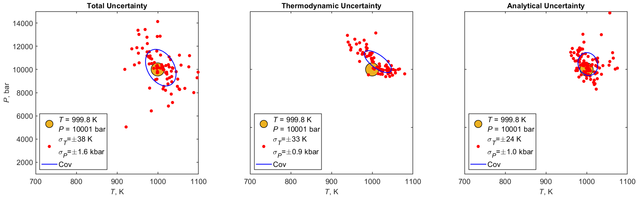
How uncertain is the best fit model?

Slide 15
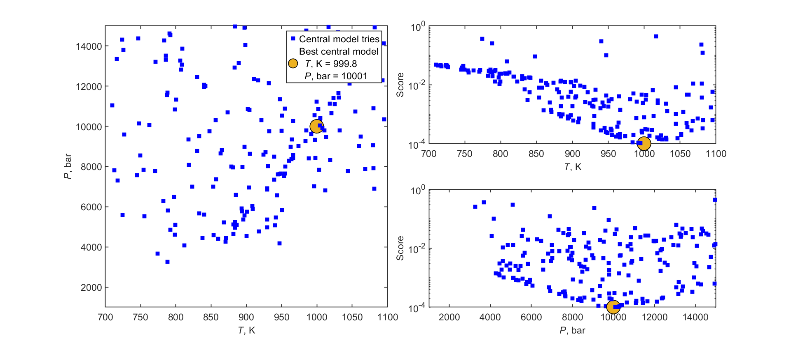
Is the problem well-conditioned?

Slide 16
Eclogite, NE India, Vipfezol Kiso et al (IISc)
Matrix: Cpx + Grt + Ep + Chl + Mica + ru + q + ….

Slide 17
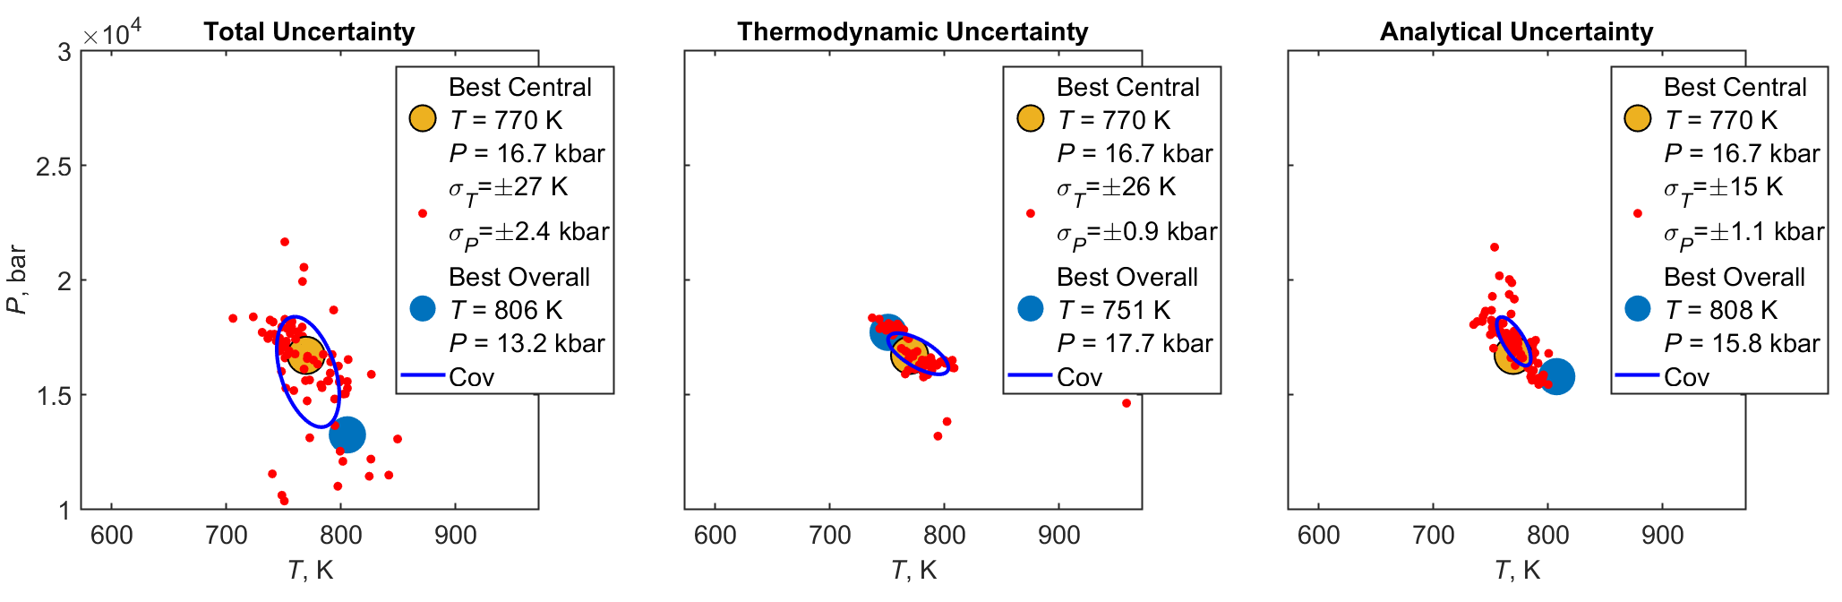
Best Central Model and Uncertainty
Notes:
For a Bayesian the best overall might end up being best due to ergodic hypothesis, but the ergodic hypothesis doesn’t apply to observational error.

Slide 18
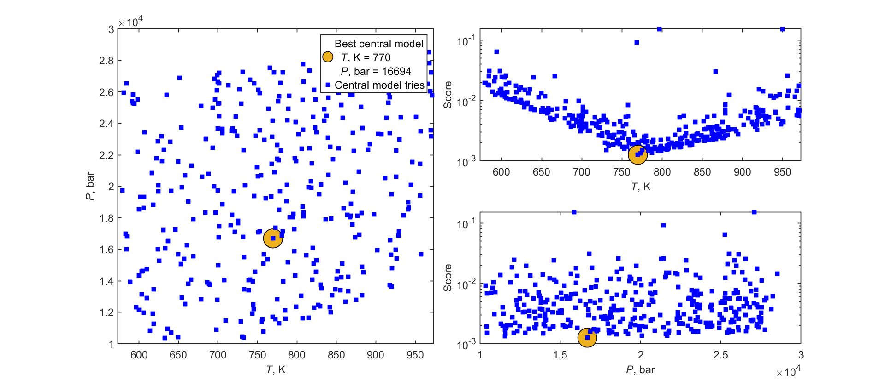

Central Models and Scoring

Slide 19
Metapelite, S Alps, Andrea Galli et al (ETH)
Pl + Grt + Bio + Mus + St + Ilm [+ ky + q]
Fe³⁺/Fe²⁺ and H2O unmeasured
Inversion with bulk composition almost invariably finds rutile rather than ilmenite
Inversion assemblage-based variants:
Complete (Pl + Grt + Bio + Mus + St + Ilm) vs partial (Pl + Grt + Bio) mineralogy
Complicated vs simplified (neglect minor oxides: TiO₂, MnO, Fe₂O₃)

Slide 20
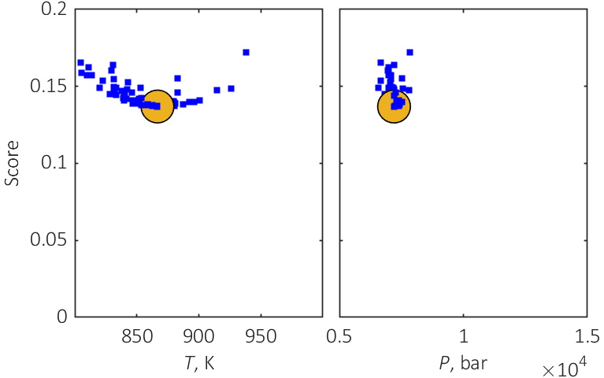
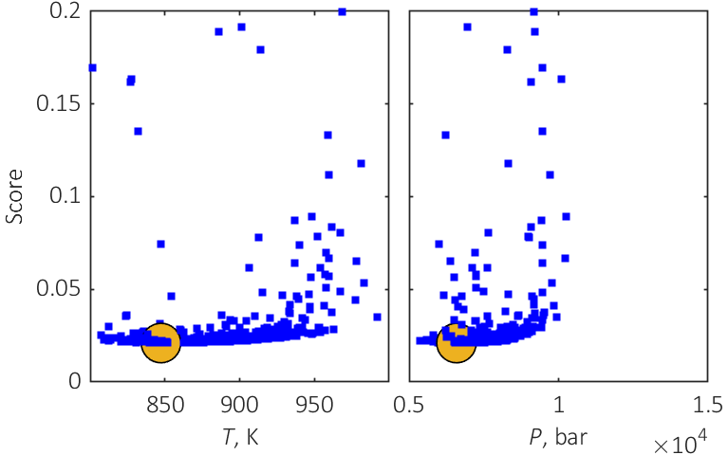
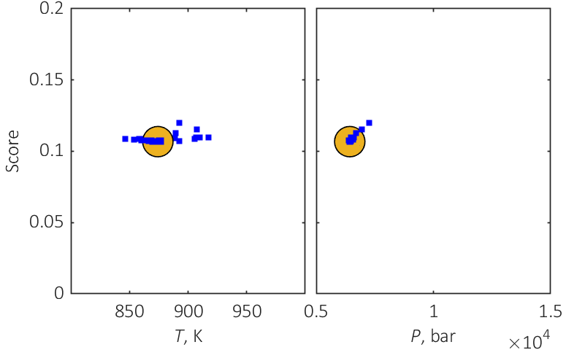
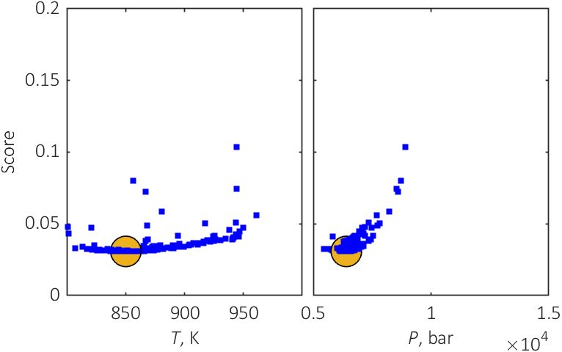
Conditioning for the 4 model variants
Grt+Bio+Pl+St+Mu+Ilm
Grt+Bio+Pl
Grt+Bio+Pl+St+Mu no {TiO₂, MnO, O₂}
Grt+Bio+Pl no {TiO₂, MnO, O₂}

Slide 21
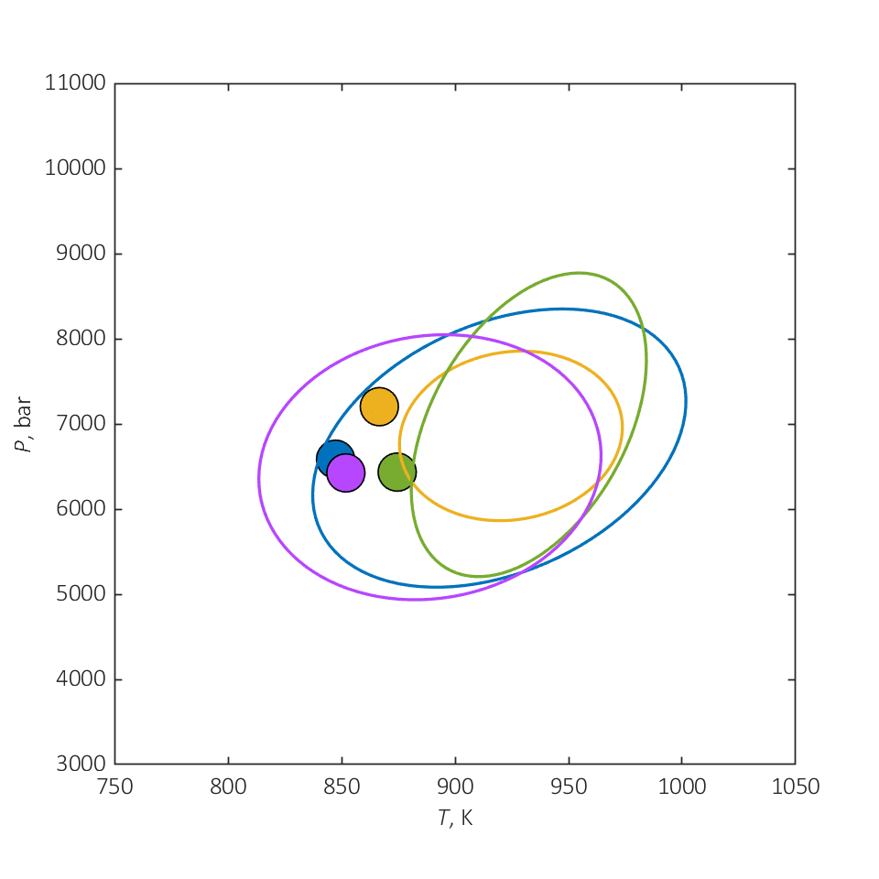
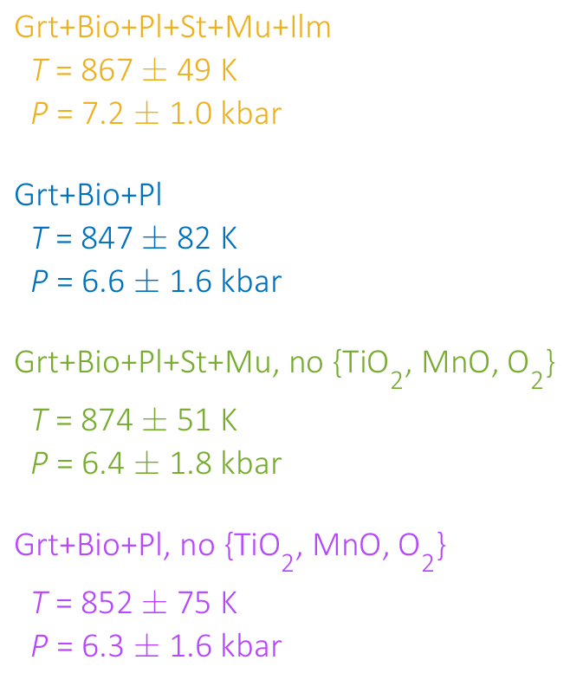
P-T and uncertainty for the 4 variants

Slide 22
What else can you learn?
vol % Na2O CaO TiO2 K2O FeO MnO MgO H2O SiO2 Al2O3
Mica
predicted* 36.070 0.0158 0.0010 0.0000 0.0664 0.0037 0.0000 0.0036 0.1654 0.5026 0.2414
observed* 0.0104 0.0000 0.0000 0.0845 0.0112 0.0000 0.0135 0.0000 0.6000 0.2805
residual -0.0055 -0.0010 0.0000 0.0181 0.0075 0.0000 0.0099 -0.1654 -0.0974 0.0391
composition score: 0.075
Gt
predicted* 22.940 0.0000 0.0210 0.0000 0.0000 0.3271 0.0321 0.0484 0.0000 0.4285 0.1428
observed* 0.0000 0.0205 0.0000 0.0000 0.3219 0.0342 0.0548 0.0000 0.4247 0.1438
residual 0.0000 -0.0004 0.0000 0.0000 -0.0052 0.0021 0.0064 0.0000 -0.0039 0.0011
composition score: 0.001
Pl
predicted* 8.734 0.0975 0.0518 0.0000 0.0015 0.0000 0.0000 0.0000 0.0000 0.6982 0.1509
observed* 0.0916 0.0516 0.0000 0.0014 0.0000 0.0000 0.0000 0.0000 0.6945 0.1609
residual -0.0059 -0.0002 0.0000 -0.0002 0.0000 0.0000 0.0000 0.0000 -0.0037 0.0100
composition score: 0.001
Bio
predicted* 7.144 0.0000 0.0000 0.0242 0.0678 0.2009 0.0006 0.1209 0.1114 0.3462 0.1280
observed* 0.0000 0.0000 0.0214 0.0670 0.1845 0.0014 0.1695 0.0000 0.4160 0.1403
residual 0.0000 0.0000 -0.0028 -0.0008 -0.0164 0.0008 0.0486 -0.1114 0.0697 0.0123
composition score: 0.038
St
predicted* 5.644 0.0000 0.0000 0.0052 0.0000 0.1451 0.0017 0.0308 0.0887 0.3327 0.3957
observed* 0.0000 0.0000 0.0073 0.0000 0.1310 0.0038 0.0229 0.0000 0.3863 0.4485
residual 0.0000 0.0000 0.0021 0.0000 -0.0140 0.0021 -0.0079 -0.0887 0.0536 0.0529
composition score: 0.022

Slide 23
Granulite, Antarctica, Koyomi Abe, M Satish Kumar, et al (Niigata)
CO₂-Scapolite + Pl + Cpx + Grt + q
Scp-rich (50% Scp, 10% Pl) and Scp-poor (5% Scp, 60% Pl) domains (ca 10 cm) attributed to protolith calcite
Bulk compositions known except Fe³⁺/Fe²⁺
Inversion yields > 200 K temperature difference between domains attributed to poorly constrained properties of Na-Scp endmember
Joint Inversion:
Assume unknown P, T, and Na-Scp endmember properties are common to both domains
Assume unknown domainal Fe³⁺/Fe²⁺ are independent

Slide 24
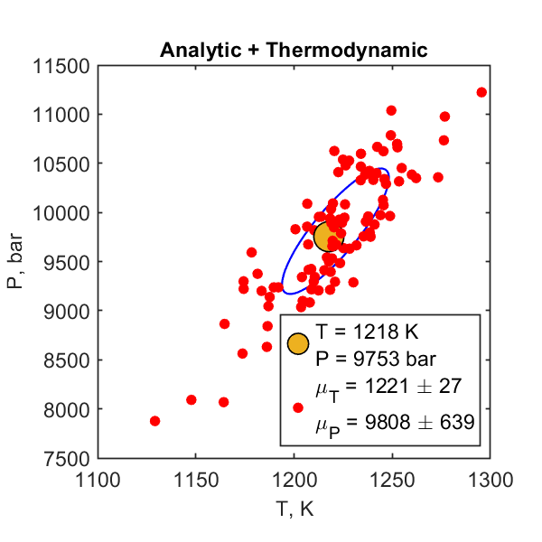
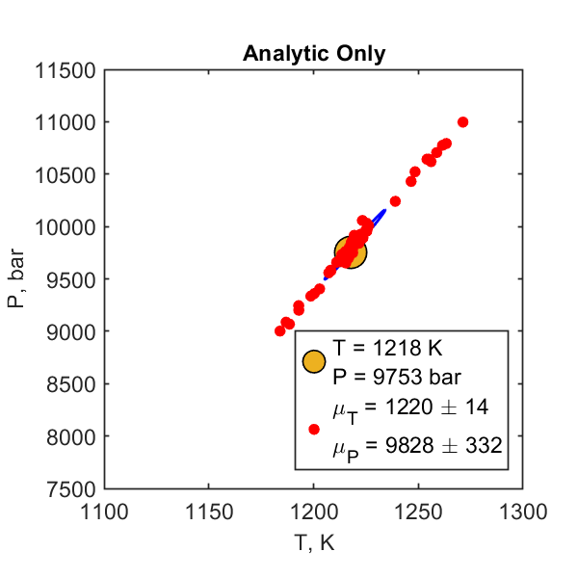
Best Central Model P-T and Uncertainty

Slide 25
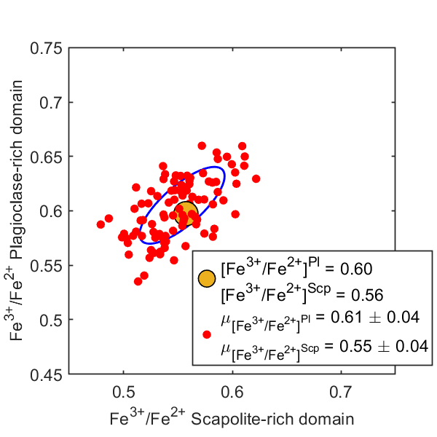
Central Model Fe³⁺/Fe²⁺ and uncertainties

Slide 26
Conclusions
Is inversion better than “classical” thermobarometry? If you like complete thermodynamic models, yes, otherwise no
Inversion is better than “modern” phase diagram-based thermobarometry
The strategy requires no bulk equilibrium assumption, is general with respect to the choice of known and uknown parameters, and is transparent with respect to both conditioning and uncertainty

Slide 27
Classical vs Inverse Thermobarometry
Classical – given observational data, estimate P-T conditions; inconsistent because the thermodynamic model does not predict the observational data
Inverse – given observational data, find the thermodynamic model that most closely the data
Inversion is not necessarily better, it requires a complete thermodynamic model
Inversion works best with raw data; tampering with that data by introducing estimates for unmeasured quantities (e.g., volatile-content) leads to bias
Inversion is transparent;

Slide 28
Eclogite, NE India, Vipfezol Kiso et al (IISc)
Matrix: Cpx + Grt + Ep + Chl + Mica + ru + q + ….
T = [573, 973] K
P = [10, 30] kbar
n_{O2} = [0, 0.25 n_{FeO}] mol
n_{Cpx} = [0, 1] mol
n_{Grt} = [0, 1] mol
1000 randomly generated starting guesses
100 perturbations for uncertainty analysis

Slide 29
Synthetic test – a problem with a known answer.
Metabasalt thermodynamic forward model (Green et al., 2016):
T = 1000 K
P = 10000 bar
molar compositions:
Na2O MgO Al2O3 K2O CaO TiO2 FeO O2 H2O SiO2
Amph 0.39847 2.02243 1.52871 0.02213 1.69447 0.13901 2.01110 0.10814 0.93050 5.92024
Cpx 0.05283 0.54883 0.02868 0.00000 0.85342 0.00000 0.46010 0.02476 0.00000 1.97463
Grt 0.00000 0.37089 0.88811 0.00000 1.11889 0.00000 1.73399 0.05594 0.00000 3.00000
Fsp 0.31611 0.00000 0.67673 0.00715 0.35346 0.00000 0.00000 0.00000 0.00000 2.64654
sph 0.00000 0.00000 0.00000 0.00000 1.00000 1.00000 0.00000 0.00000 0.00000 1.00000
qtz 0.00000 0.00000 0.00000 0.00000 0.00000 0.00000 0.00000 0.00000 0.00000 1.00000
T = [700, 1100] K
P = [1, 15] kbar
n_{O2} = [0, 0.25 n_{FeO}] mol
n_{Cpx} = [0, 1] mol
n_{Grt} = [0, 1] mol
1000 randomly generated starting guesses
100 perturbations for uncertainty analysis

Slide 30
The “bad” actors (hydroxylated silicates) in order of badness:
Chlorite, Mica (Fe/Mg)
Staurolite, Epidote
Biotite, Clinoamphibole

Slide 31
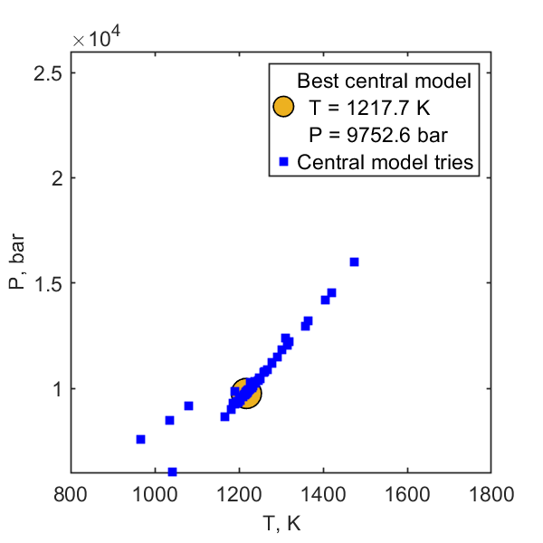
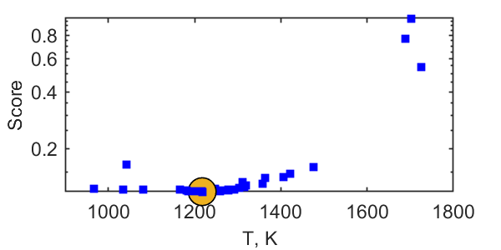
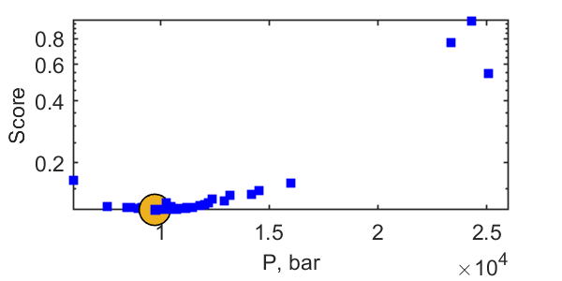
KA dual inversion central model

Slide 32
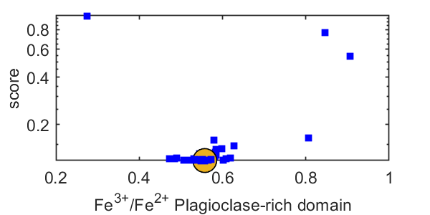
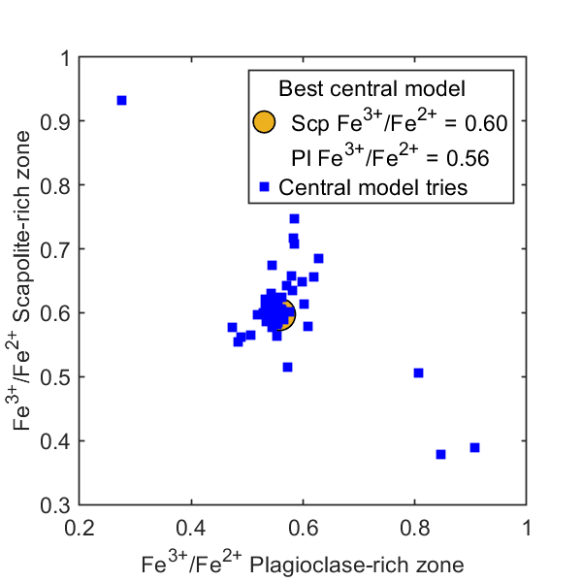
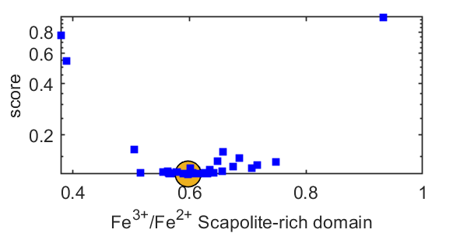
Fe³⁺/Fe²⁺ Central Models

Slide 33
So far this has all been D Khan et al. (2021)
Khan et al. implemented the strategy for thermodynamic data inversion via a Matlab script that called the pointwise minimizer MEEMUM
The strategy is now implemented in a program called MC_fit
MC_fit has an interface designed to treat both thermobarometry and thermodynamic data inversion
MC_fit can treat problems in which multiple observed phases are predicted by a
Does it work?

Slide 34
About those guesses
Ranges on unknown parameters implies prior knowledge.
For a Bayesian, the most probable model is the product of this prior knowledge and Likelihood (-exp(Misfit))
Bayesian’s apply a penalty to models that are from midpoint of the unknown parameter space

Slide 35
Quantifying results: Misfit

Slide 36
Central Model Fe³⁺/Fe²⁺ and uncertainties

Slide 37
AG Best Complete Assemblage and Chemistry Model
--------------------------------------------------------------------------------
Central model Try 56 converged.
Try 56, successes so far = 10
Objective function evaluations this try = 163
Objective function value this try OBJ = 0.130047
Best OBJ so far = 0.130047 obtained on try 56
Scaled parameter SSP = 2.85104
Bayes score SSP * OBJF = 0.370768
Best Bayes score so far = 0.354697 obtained on Try 15
Initial normalized coordinates: 0.675285 0.158465 0.348141 0.614182
Initial coordinates: 11752.9 831.693 0.348141 0.614182
Final coordinates: 8314.01 922.832 0.811199E-02 0.923495
Components of the Likelihood Score
Predicted compositions: 0.11854834
Extraneous predicted phases: 0.11498507E-01
Missed observed phases: 0.0000000
The following observed phases are predicted:
vol % Na2O CaO TiO2 K2O FeO MnO MgO H2O O2 SiO2 Al2O3
Mica(W)
predicted* 0.012 0.0172 0.0019 0.0000 0.0645 0.0040 0.0000 0.0049 0.1652 0.0000 0.5024 0.2399
observed* 0.0104 0.0000 0.0000 0.0845 0.0112 0.0000 0.0135 0.0000 0.0000 0.6000 0.2805
residual -0.0068 -0.0019 0.0000 0.0200 0.0072 0.0000 0.0087 -0.1652 -0.0000 0.0976 0.0405
composition score: 0.648403E-01 low is good
Gt(W)
predicted* 0.569 0.0000 0.0249 0.0000 0.0000 0.3009 0.0362 0.0671 0.0000 0.0002 0.4283 0.1424
observed* 0.0000 0.0205 0.0000 0.0000 0.3219 0.0342 0.0548 0.0000 0.0000 0.4247 0.1438
residual 0.0000 -0.0044 0.0000 0.0000 0.0210 -0.0020 -0.0123 0.0000 -0.0002 -0.0037 0.0014
composition score: 0.462927E-02 low is good
feldspar
predicted* 27.321 0.0939 0.0592 0.0000 0.0016 0.0000 0.0000 0.0000 0.0000 0.0000 0.6908 0.1546
observed* 0.0916 0.0516 0.0000 0.0014 0.0000 0.0000 0.0000 0.0000 0.0000 0.6945 0.1609
residual -0.0022 -0.0076 0.0000 -0.0002 0.0000 0.0000 0.0000 0.0000 0.0000 0.0037 0.0063
composition score: 0.132559E-02 low is good
Bio(TCC)
predicted* 21.631 0.0000 0.0000 0.0239 0.0676 0.1720 0.0008 0.1519 0.1112 0.0004 0.3471 0.1251
observed* 0.0000 0.0000 0.0214 0.0670 0.1845 0.0014 0.1695 0.0000 0.0000 0.4160 0.1403
residual 0.0000 0.0000 -0.0026 -0.0006 0.0124 0.0006 0.0176 -0.1112 -0.0004 0.0688 0.0153
composition score: 0.191809E-01 low is good
St(W)
predicted* 6.350 0.0000 0.0000 0.0059 0.0000 0.1305 0.0023 0.0453 0.0887 0.0002 0.3325 0.3947
observed* 0.0000 0.0000 0.0073 0.0000 0.1310 0.0038 0.0229 0.0000 0.0000 0.3863 0.4485
residual 0.0000 0.0000 0.0015 0.0000 0.0005 0.0016 -0.0224 -0.0887 -0.0002 0.0538 0.0539
composition score: 0.285723E-01 low is good
The following phases are in equilibrium with the observed assemblage as determined
by the component saturation constraints:
vol % Na2O CaO TiO2 K2O FeO MnO MgO H2O O2 SiO2 Al2O3
ky 2.195 0.0000 0.0000 0.0000 0.0000 0.0000 0.0000 0.0000 0.0000 0.0000 0.5000 0.5000
q 41.850 0.0000 0.0000 0.0000 0.0000 0.0000 0.0000 0.0000 0.0000 0.0000 1.0000 0.0000
The following predicted phases are not observed:
vol % Na2O CaO TiO2 K2O FeO MnO MgO H2O O2 SiO2 Al2O3
ru 0.072 0.0000 0.0000 1.0000 0.0000 0.0000 0.0000 0.0000 0.0000 0.0000 0.0000 0.0000
Effective Bulk* Chemical Potentials (J/mol)
Na2O 23.731 -776362.
CaO 15.162 -754847.
TiO2 7.251 -930695.
K2O 17.139 -850239.
FeO 54.713 -313526.
MnO 0.659 -468553.
MgO 41.529 -638579.
H2O 34.152 -291628.
O2 0.111 -490491.
SiO2 727.752 -886565.
Al2O3 112.063 -0.163578E+07
*normalized molar units
Inversion coordinates for uncertainty analysis:
8314.01 922.832 0.811199E-02 0.923495
--------------------------------------------------------------------------------

Slide 38
Experimental Studies of the Permeability (k) and Viscosity (ζ) of Crystal Mushes
Max Schmidt (ETH)
Melanie Forien (Frankfurt)
Guilio Solferino (ETH)
Nick Bagdassarov (Frankfurt)
Sharzad Manoocheri (ETH)
Guiliano Kraettli (ETH)
Notes:
Many processes generate pervasively distributed fluid

Slide 39
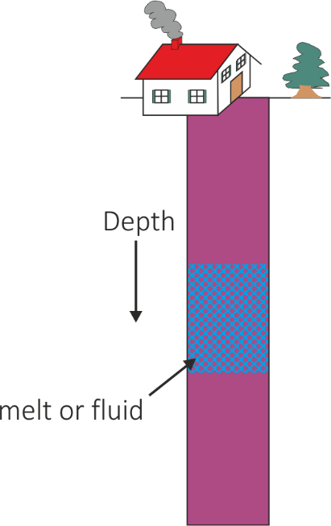
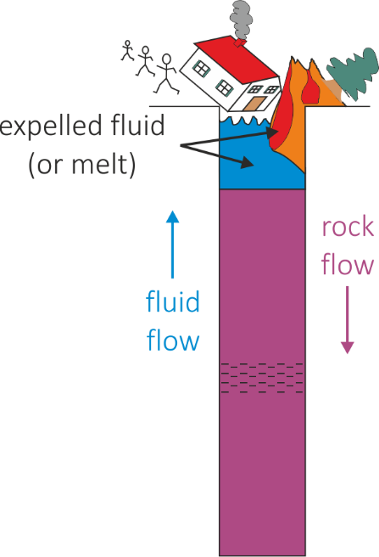
Should you care about crystal mushes?
You should care about fluid expulsion
k – matrix permeability
ζ – matrix bulk viscosity
McKenzie 1984, etc
Notes:
Many processes generate pervasively distributed fluid

Slide 40
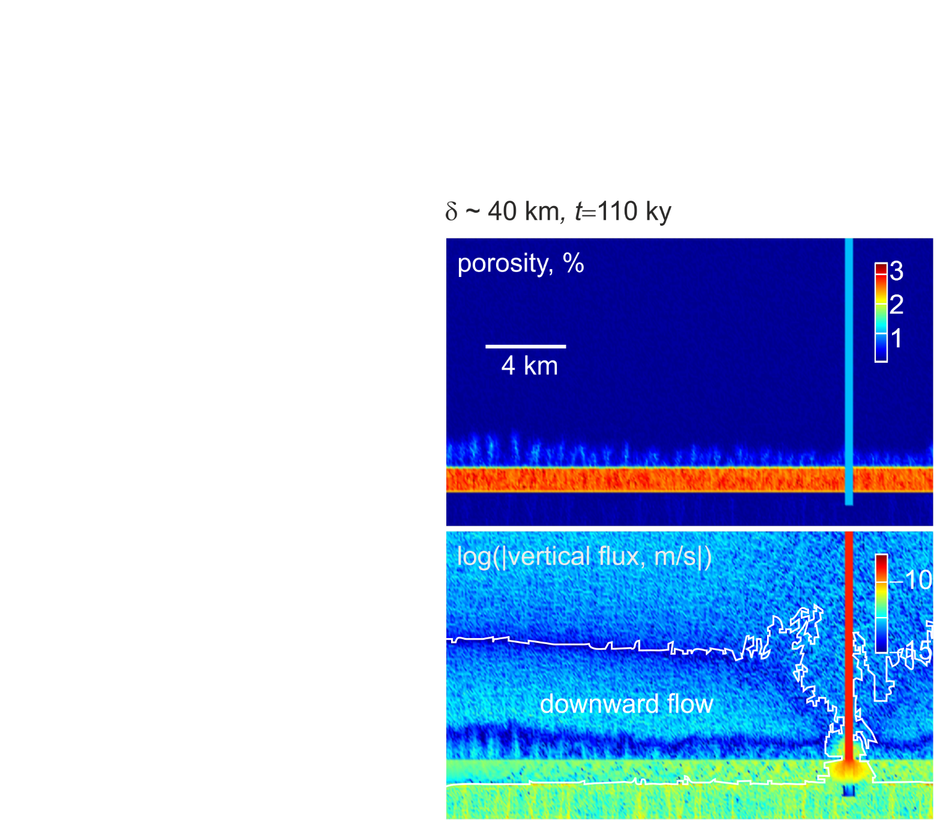
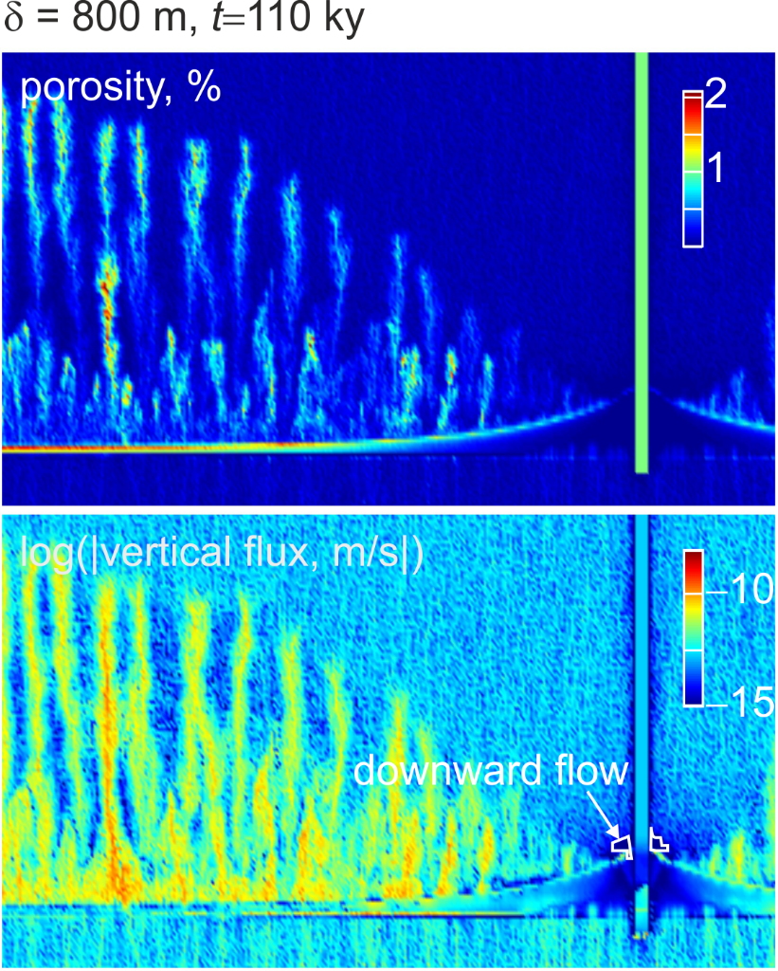
A numerical illustration: fluid flow above a metamorphic dehydration reaction
high viscosity
low viscosity
Connolly, Elements, 2011

Slide 41
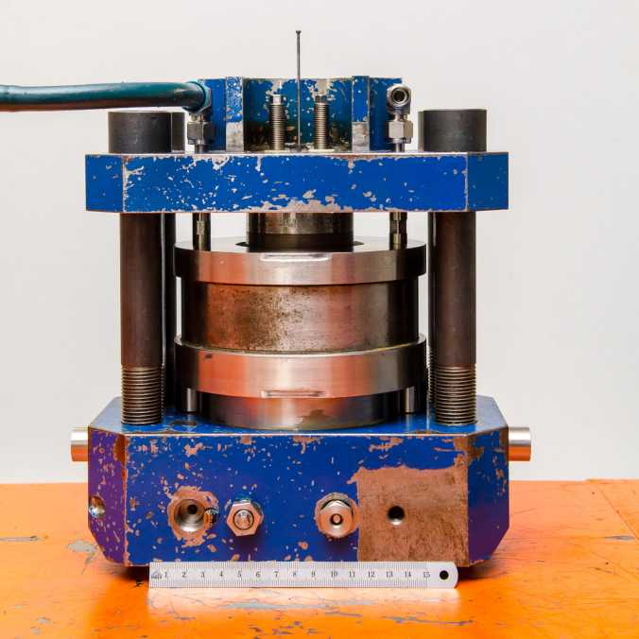
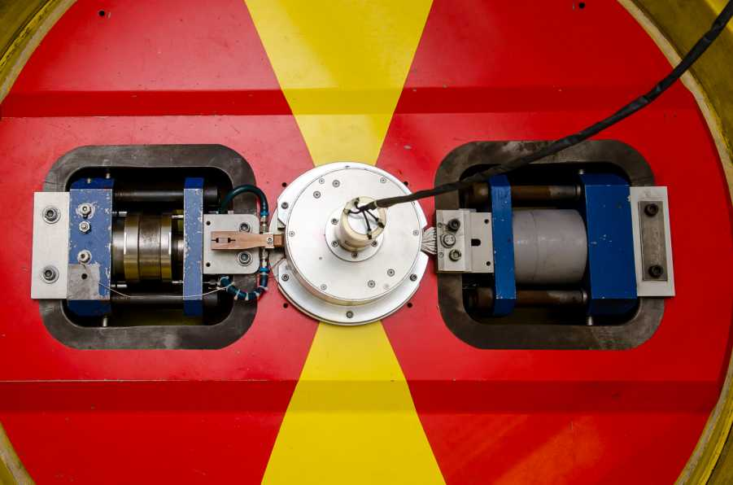
Outline
The two imiting compaction scenarios
Corresponding compaction experiments and analysis thereof
Implications
The centrifuge – 1.4 m diameter table, 1 ton, outer edge rotating at 800 km/h
Schmidt, Connolly, Guenther, & Bogaerts; Science, 2006

Slide 42
Limiting (Self-)Compaction Regimes
What causes compaction?
p_{e} = p_{total} − p_{fluid}
φ₀
pressure
p
porosity
φ
h₁, t₁
h₀ << δ₀
rheologically-limited
fluid flux negligible
observation constrains ζ
h₂, t₂
t₀
concave
h₀
z
p_{fluid}
p_{total}
z
z
φ₀
pressure
p
porosity
φ
hydraullically-limited
p_{e} negligible
observation constrains k
h₁, t₁
h₀ >> δ₀
h₂, t₂
p_{e} » 0
p_{total} = p_{fluid} = p_{solid}
convex
z
z
Notes:
Instantaneously sedimented self-compacting column
1) Top porosity doesn’t change with time, concave profile
2) Only smooth solution is that the column drains from the bottom up. Convex profile. Why? Max entropy production.

Slide 43
Part I: Hydraulically-limited (k) Centrifuge Experiments
The idea:
Permeability increases exponentially with porosity (φ) ->
Low porosity experiments will be hydraulically-limited and isolate permeability
The details:
Cylindrical (h = 2 mm, r = 1 mm) olivine-basalt-liquid charges, liquid fraction 5-12%
Annealed 24 h prior to centrifuging
Centrifuged 4-10 h at 400-700g to induce compaction, 1300°C, 0.9-1.4 GPa, post-run grain size 21±9 μm
Connolly, Schmidt, Solferino, & Bagdassarov; Nature 2009

Slide 44
The results:
No crystal-free zone at the top -> compaction is not hydraulically-limited
Connolly, Schmidt, Solferino, & Bagdassarov, Nature 2009

Slide 45
The story:
original theory c_{k} = 220
McKenzie 1984: c_{k} = 50-1000
Analysis of Renner et al. (2003) Ol-MORB experiment: c_{k} ~ 500
Connolly, Schmidt, Solferino, & Bagdassarov; Nature 2009
Notes:
If linear profile with no separation: the profile pivots on the barycenter of the sample
4 unknowns, set diff(pe) = 0 this corresponds to the max fluid pressure possible

Slide 46
Part II: Rheologically-limited (ζ) centrifuge experiments
Basalt liquid-crystal suspensions centrifuged at 400-700g to induce settling and compaction, 1300°C, 0.1-1 GPa, annealed grain size 10-15 μm
3 projects
Olivine – Schmidt, Forien, Solferino, & Bagdasarov (EPSL 2012)
Chromite – Manoocheri & Schmidt (CMP 2014)
Plagioclase – Kraettli & Schmidt (CMP 2021)
Connolly & Schmidt; JGR 2022

Slide 47
Macroscopic viscous rheology
Pure solids: shear viscosity (η), no bulk viscosity (ζ)
Porous granular solids:
macroscopic Newtonian bulk viscosity (ζ) due to compaction of grain-scale porosity (φ)
accomplished by microscopic shear -> ζ = f(η_{solid}, φ)
microscopically Newtonian?

Slide 48
The microscopic comedy of macroscopic Newtonian rheology
Newtonian creep – geodynamics
Diffusion creep – rock mechanics
solid deforms as a fluid
dislocation creep ->
non-linear stress dependence
solid is rigid
deformation by diffusive mass transfer
grain-boundary diffusion creep
ζ = f(η_{solid},φ) => φ → 0, ζ → ∞
ζ = f(η_{solid},φ) => φ → 0, ζ → η_{solid}

Slide 49
What’s supposed to happen (without compaction):
t₀
t₁
The sedimentary porosity, φ_{sed}, is identical to the disaggregation porosity, φ_{d}.
φ_{sed} is a proxy for grain coordination number (CN):
CN » 14 Þ φ_{sed} » 36%
CN » 5 Þ φ_{sed} » 60%
φ_{sed} is preserved at the top of the sediment column even if compaction is turned on
φ_{sus}
φ_{sed}
Grain contact area is a f(φ/φ_{d}):
φ/φ_{sed} ® 0 Þ ξ ® ξ_{solid}
φ/φ_{sed} ® 1 Þ ξ ® 0
It is identical to the matrix disaggregation porosity (φ_{d}) and it is going to be path dependent
φ ® φ_{sed} Þ ξ ® 0, the initial stage of compaction must be hydraulically-limited
Grain contact area (Takei & Holtzman 2013)
Notes:
Settling of a uniform suspension, the sedimentary pile grows from the base upward, while a crystal-free zone grows from the top downward.
The sedimentary porosity is of interest because it’s the threshold between a coherent solid matrix, something with strength, and a suspension.

Slide 50
The Experiments: A result
Olivine, annealed 24 h, centrifuged 5 h @ 1500g, p_{e} ≈ hΔρa ≈ .03 bar = 3 kPa
flattened grain contacts
residuals suggest a concave profile
Schmidt, Forien, Solferino, & Bagdasarov; EPSL 2012

Slide 51
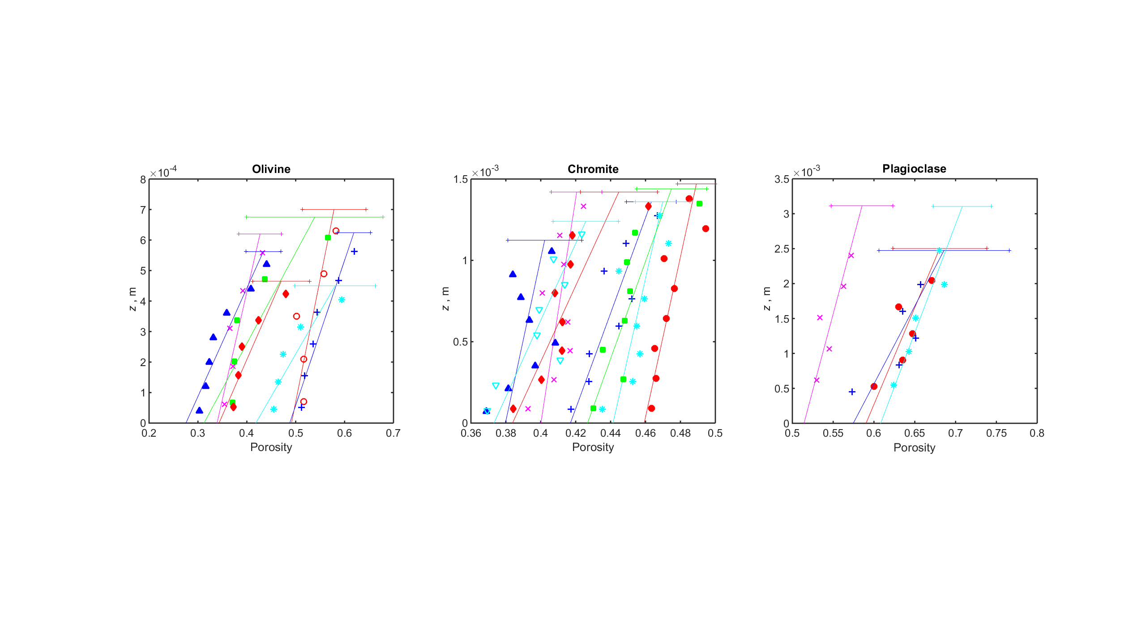
More (19) results
They all compact. Olivine profiles consistently concave; plagioclase and chromite don’t resolve curvature
Compaction is time-dependent (aka viscous)
Profiles don’t extrapolate to the sedimentary porosity (φ_{sed})
Connolly & Schmidt; JGR 2022

Slide 52
Is the mechanism melt-assisted grain-boundary diffusion controlled (GBD) creep?
Compaction is undetectable in “failed” olivine + sulfide-melt experiments (φ = 20-40%, Solferino 2008)
=>
silica solubility is negligible in sulfide liquids
diffusion through the melt is essential to the compaction mechanism
the mechanism cannot be dislocation creep or bulk diffusion

Slide 53
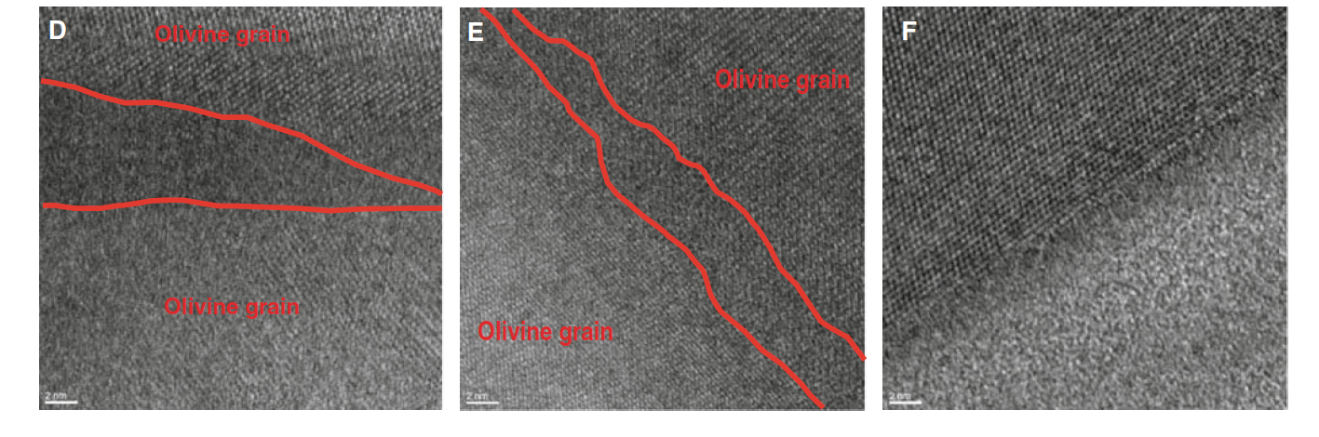
If creep is grain-boundary diffusion-controlled, grain boundaries must be melt-free
=>
Olivine
Melt
Schmidt et al. (2012)
The mechanism is not simply fast diffusion through the melt
Schmidt, Forien, Solferino, & Bagdasarov; EPSL 2012

Slide 54
What do the experiments tell us?
Final state
Viscous mechanism
What we don’t know:
Initial state
Effective pressure
The experiments cannot be interpreted without a model

Slide 55
Model Part I: ζ(φ) for the grain-boundary diffusion mechanism:
Cooper & Kohlstedt (1984) [rock mechanics]:
Takei & Holtzman (2009), Rudge (2018) [mathematics]:
0
1
If φ → φ_{sed}, ζ → 0: initial stage cannot be rheologically-limited
Notes:
Screams of empiricism

Slide 56
Model Part II: Rheologically-limited compaction
Governing equation:
GBD porosity dependence:
Problem:
1d compaction:
Constitutive relation:
=> Optimize for unknown φ_{sed}
Manipulation:

Slide 57
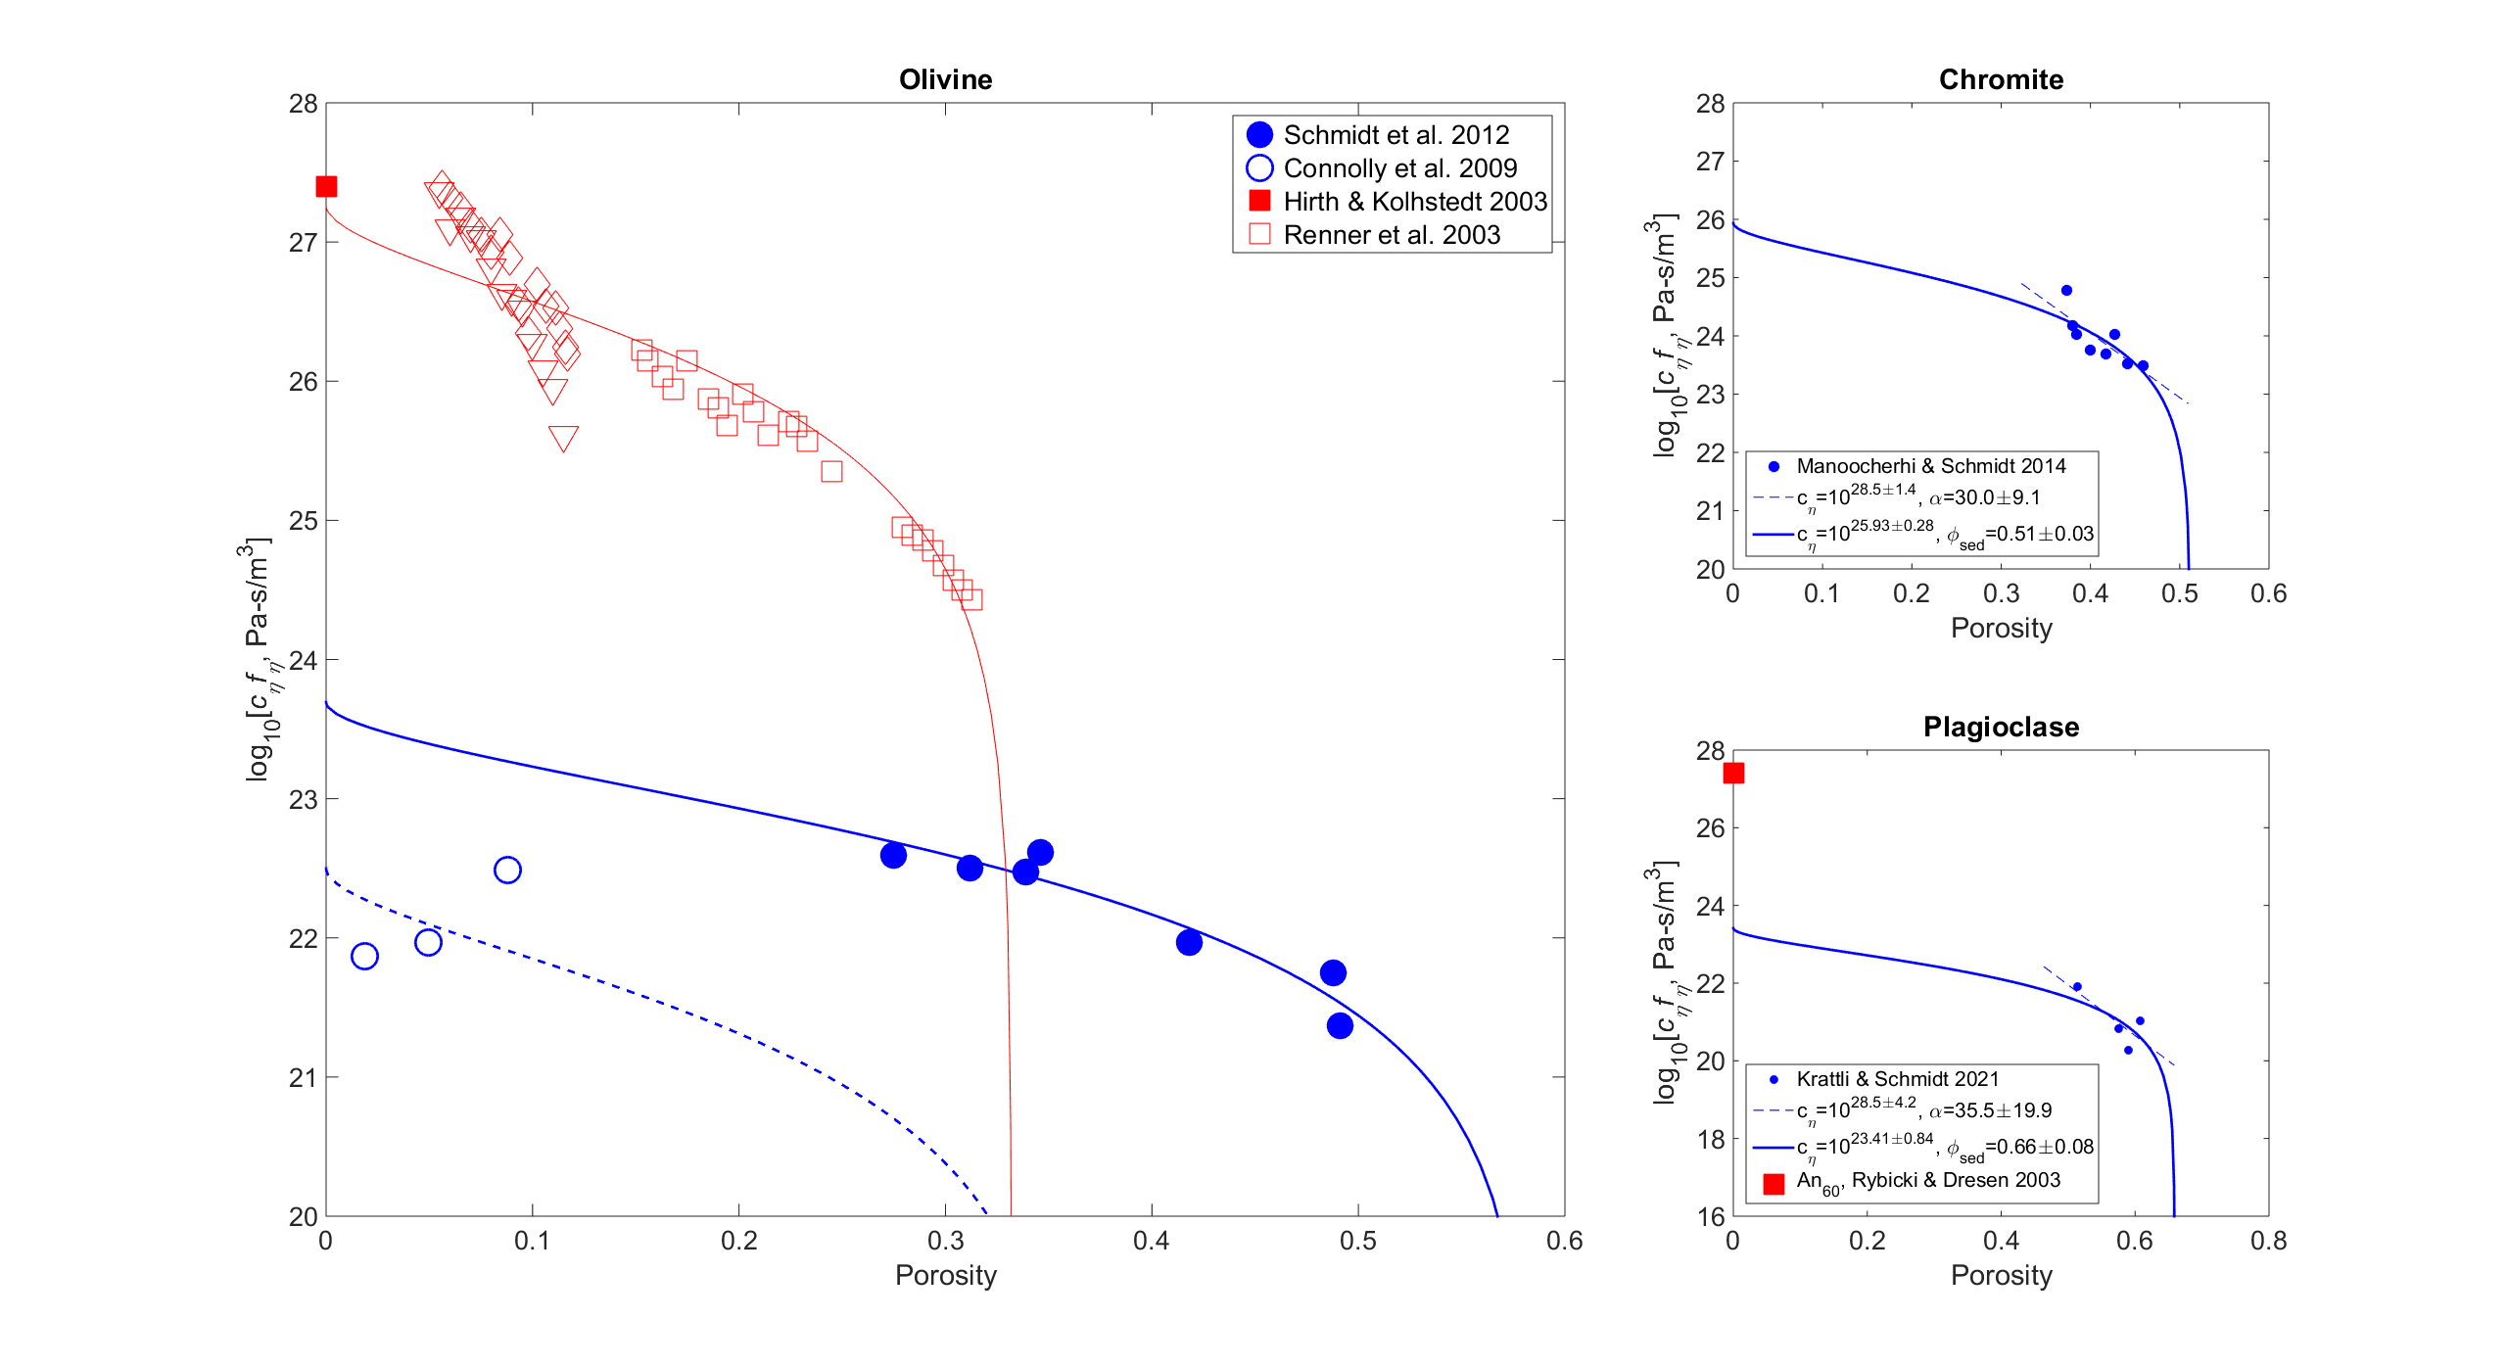
Results
Notes:
Centrifuge results in solid blue,
vertical axis is regularized viscosity,
the curves are the fit to the takei and holtzman model,
extrapolate to the matrix shear viscosity at zero porosity and the sedimentary porosity on the porosity axis
So for the ol expts eta 10^24 Pa-s, phis 58%
Dashed curve/open circles are the earlier “permeability” expts, about an order of magnitude too low
Red symbols from an amazing set of expts by Renner, direct obs of compaction rate at pe ~ 5-50 MPa. Didn’t receive much attention but essentially in perfect agreement with the consensus rheology of H&K, which represents a large body of low-porosity.
There is no way the 4 orders of magnitude discrepancy can be explained by experimental error.
It has been suggested that despite the evidence for GBD that dominance of a repacking rheology can explain the discrepancy.
Repacking would be primarily grain shape dependent, that the chromite viscosities are 3 orders of magnitude higher than olivine viscosities is inconsistent with this hypothesis.
The plag results are also shown, in both rock mechanics and in the centrifuge o & p have similar rheologies and again the same discrepancy persists.

Slide 58
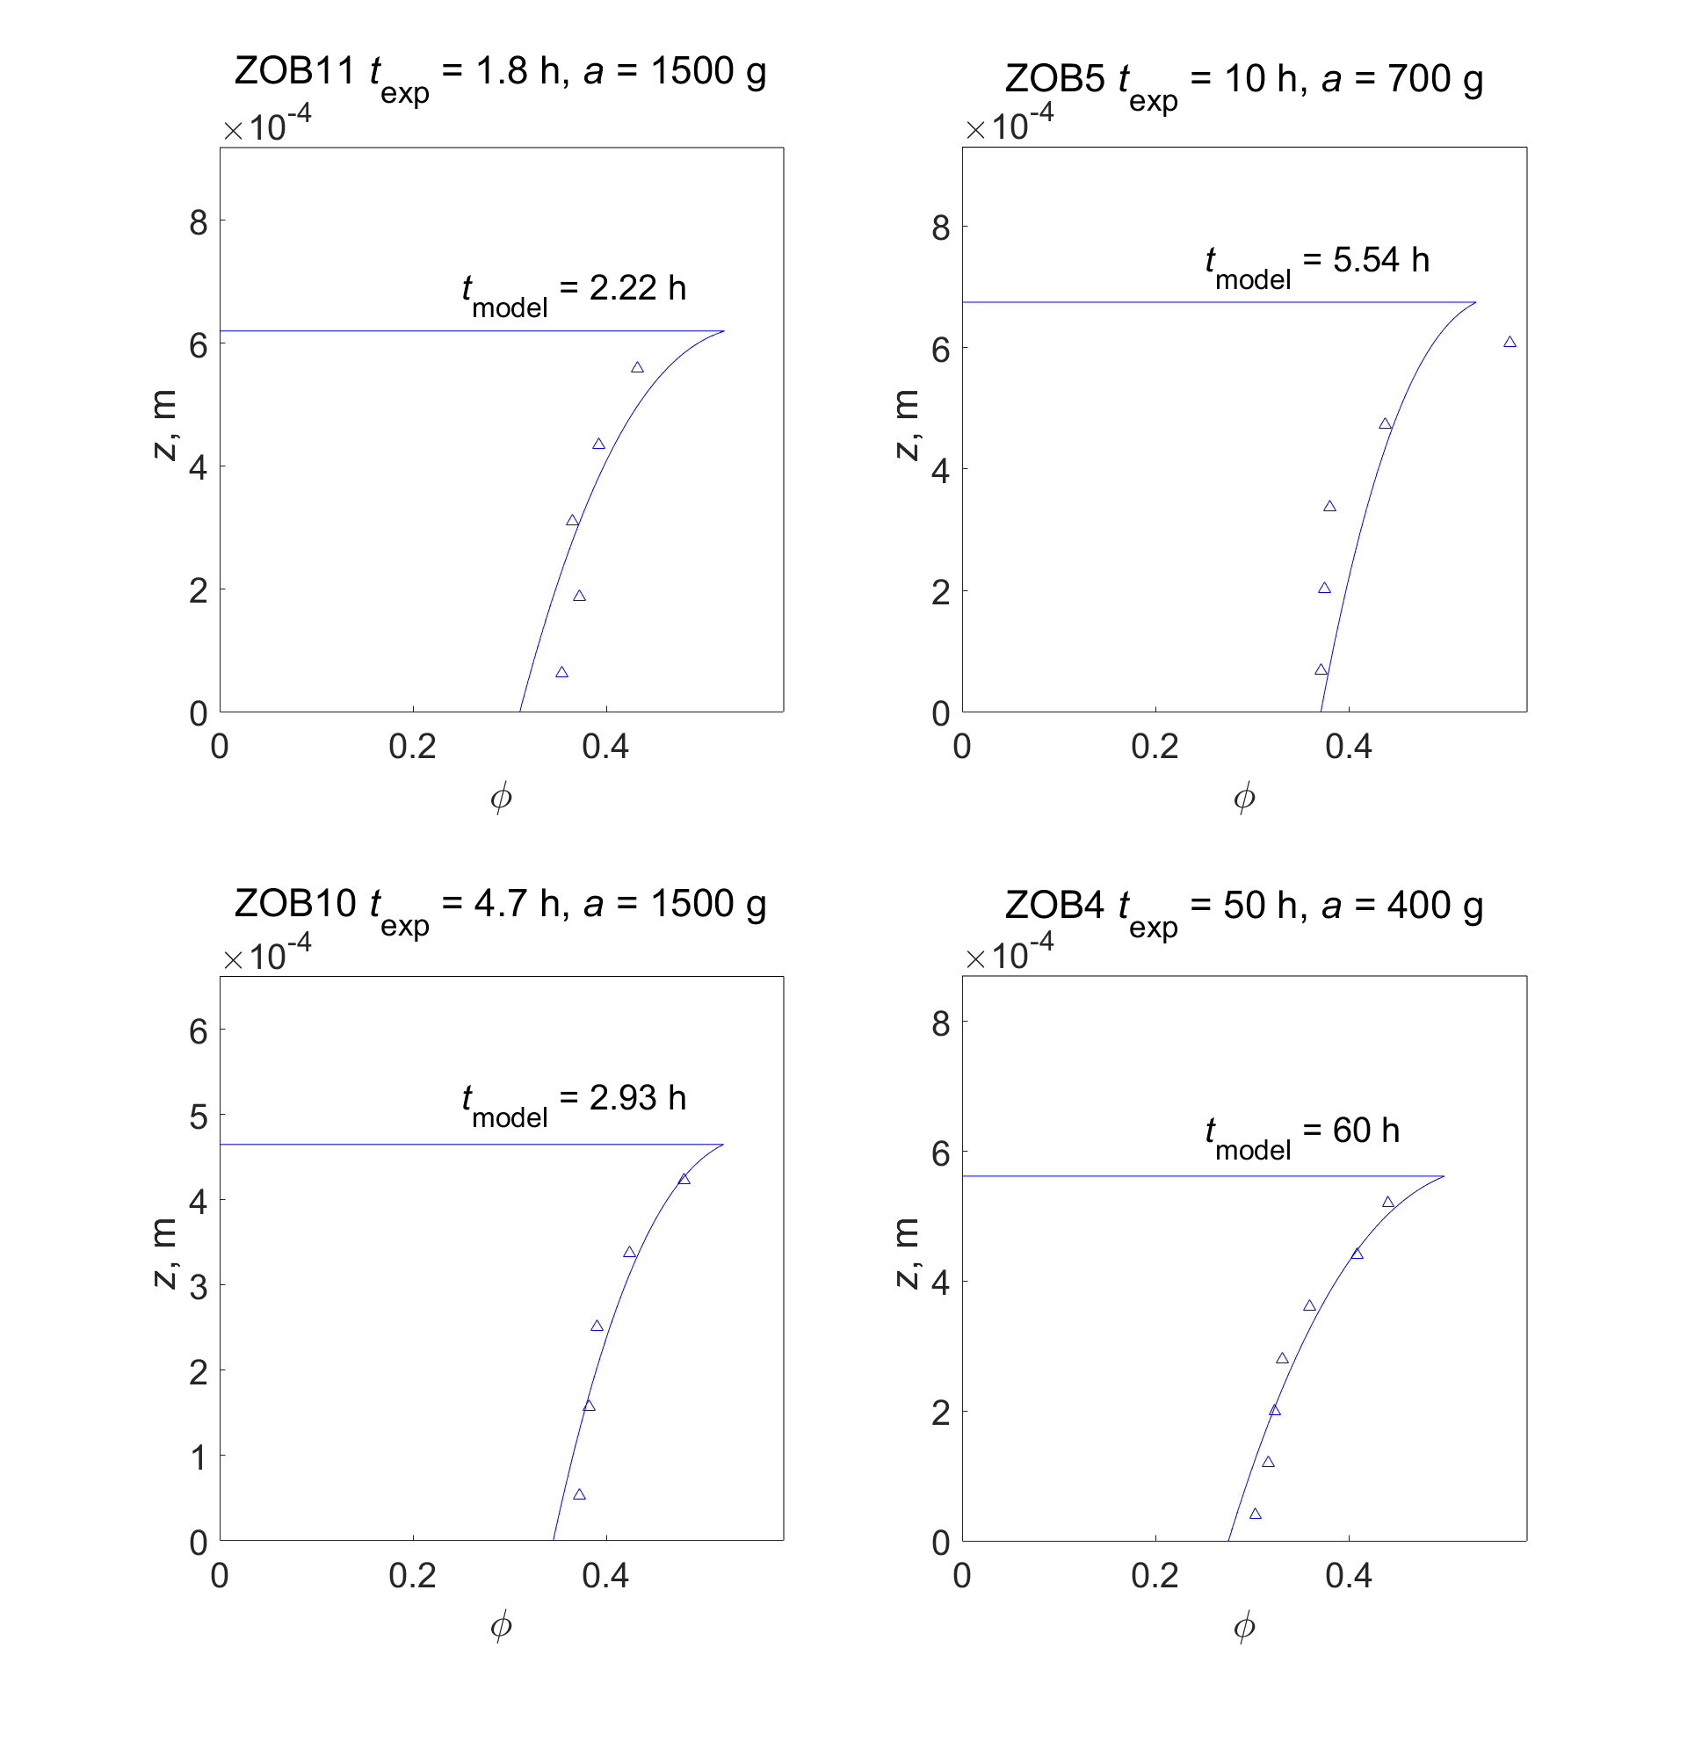
Back-calculated profiles for the
4 most compacted olivine experiments
Can it be right? Self-consistency test I:
Surface compaction induced by accounting for the pressure variation due to finite grain size
Notes:
Models calculated to match the average porosity of the experiment…
The analysis uses only the basal porosity.

Slide 59
Can it be right? Self-consistency test II:
Assumption #1: settling is instantaneous,
Assumption #2: hydraulically-limited phase is short,
Assumption #3: hydraulically-limited compaction is minor,
hydraulic regime
Assumption #4: h/δ corresponds to the assumed regime
rheologic regime

Slide 60
What does nature have to say?
Viscosities inferred for partially molten crust and mantle by geophysical inversion* are 10¹⁶-10¹⁸ Pa-s
Centrifuge**: 10¹⁶-10¹⁷ Pa-s
Rock mechanics: 10¹⁹-10²¹ Pa-s
*Morgan & Smith 92, Selway et al 20, Vergnolle et al 03, Jones & Maclennen 05, Yamasaki & Kobayashi 18, etc
**d = 2 mm, T = 1373 K

Slide 61
Is diffusion creep viable in the mantle?
Diffusion creep is dominant at length scales of < 25 km

Slide 62
Compaction half-time – the time to reduce the porosity of a molten layer/region by half:
Dimensionless numerical results
Does the viscosity matter?
dimensional time scales directly with viscosity
Does it’s porosity dependence matter? Or the Melosh-Stevenson-McKenzie essential physics effect:
1-2 orders of magnitude isn’t chicken feed or is it?

Slide 63
Layered Igneous Intrusions
Compaction lengths (δ) are 1-10 km >> layer thickness (1-30 m)
-> cumulate compaction is rheologically-limited
Olivine t_{1/2} ∼ 10³ y < t_{cooling} ∼ 10⁴ y
Silicate bulk viscosities ~ 10¹⁵-10¹⁶ Pa-s
Previously ~ 10¹⁹-10²⁰ Pa-s
Estimates from nature* (10¹²-10¹⁷ Pa-s) are 1-2 orders of magnitude too low
*Shirley 86, Boudreau & Philpots 02, Tegner et al. 09, McKenzie 11.

Slide 64
Conclusion
Everything happens faster in a centrifuge
An order of magnitude lower permeability, 4 orders of magnitude lower matrix viscosity
Something’s wrong, odds are it’s in the centrifuge experiments, but I can’t find it
The centrifuge numbers are consistent with models based on natural observations
Repacking (strain-hardening) happens and in nature and materials science it can be rate-limiting; however the notion that it is rate-limiting in the centrifuge experiments verges on the ludicrous

Slide 65
Conclusion
The centrifuge compaction profiles identify compaction regime (rheologically-limited)
The resulting viscosities are wildly discrepant with previous experimental results (>3 orders of magnitude) but consistent with estimates inferred from nature

Slide 66
Hydraulically-limited compaction (h/δ > 1)
Convex!

Slide 67
Rheologically-limited compaction, h/δ < 1
Convex
Convex-ish
Concave

Slide 68
Compaction half-time – the time to reduce the average porosity by half: does the porosity dependence matter?

Slide 69
Is diffusion creep viable in nature?
Diffusion creep is dominant at length scales of < 25 km

Slide 70
George Bergantz

Slide 72
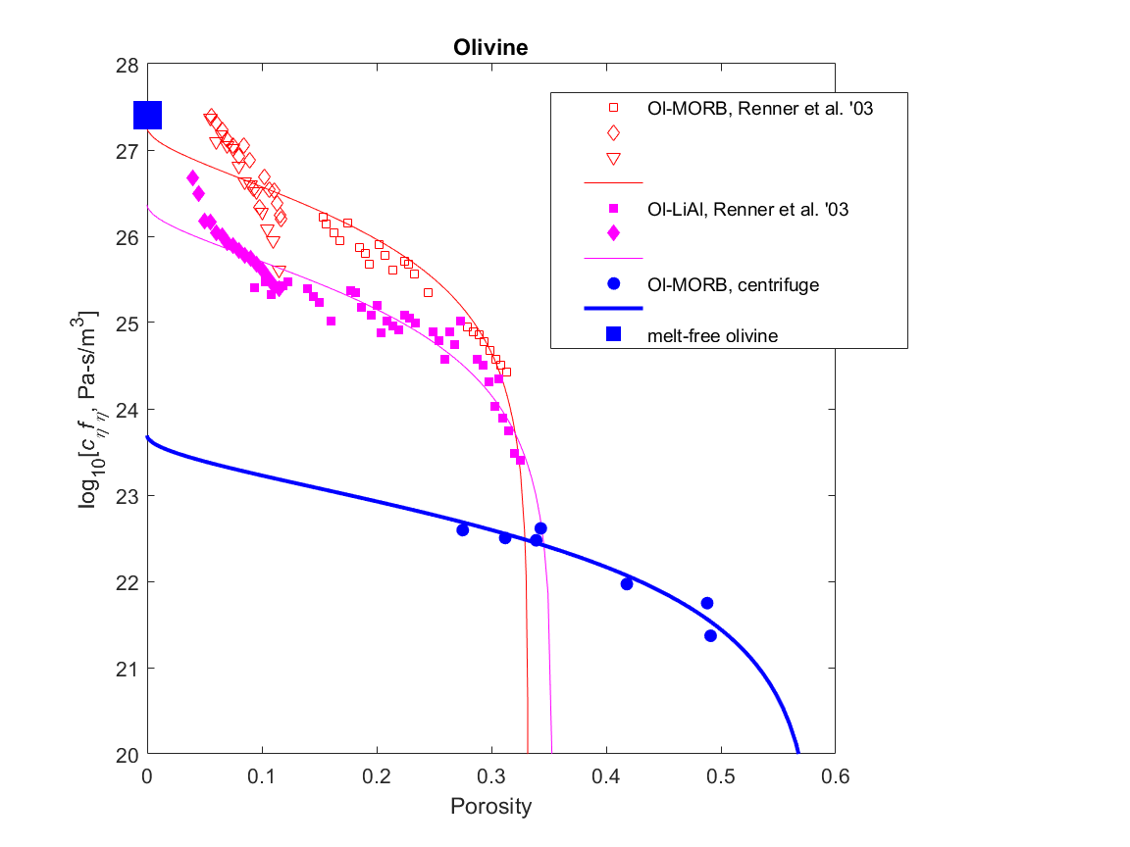
What is really fit: log(viscosity) = log[c_{η}f_{η}(φ)]
φ → 0, f_{η}(φ) → 1, c_{η}f_{η} → c_{η}
φ → φ_{sediment,} c_{η}f_{η} → 0

Slide 73
Mechanism: macroscopic rheology
Elasticity: instantaneous reversible deformation -> strains are too small to be effective
Plasticity: instantaneous irreversible deformation ->
grain crushing and rotation (repacking), strain-hardening
low temperature and/or high porosity (sedimentary basins, layered intrusions)
during uni-directional loading (sedimentation) pseudo-viscous or pseudo-elastic
Viscosity: time-dependent reversible deformation ->
high temperature and/or low porosity (metamorphism, partial melting)
how?

Slide 74
What’s supposed to happen (without compaction):
t₀
t₁
φ_{sed} is a proxy for grain coordination number, it is identical to the matrix disaggregation porosity (φ_{d})
φ_{sus}
Grain contact area (Takei & Holtzman 2013)
φ_{sed}
φ ® φ_{sed} Þ ξ ® 0, the initial stage of compaction must be hydraulically-limited

Slide 75
What causes the effective pressure (p_{e})? Static pressure gradient ∝ density (ρ)
φ₀
pressure
p
porosity
φ
rheologically-limited
h₀ << δ₀
fluid flux negligible
observation constrains ξ
h₁, t₁
h₂, t₂
t₀
h₀
z
p_{fluid}
p_{solid}
z
z
φ₀
pressure
p
porosity
φ
hydraullically-limited
h₀ >> δ₀
p_{e} negligible
observation constrains k
h₁, t₁
h₂, t₂
p_{e} » 0
p_{total} = p_{fluid} = p_{solid}
z
z

Slide 76
Mechanism: Macroscopic rheology
Elastic solids: independent shear (G) and bulk modulus (K)
Viscous solids: shear viscosity (η), no bulk viscosity (ξ)
Porous solids:
macroscopic bulk viscosity (ξ) due to compaction of grain-scale porosity (φ)
accomplished by microscopic shear -> ξ = f(η_{solid}, η_{fluid}, φ)
Newtonian?
Because η_{solid} (> 10⁸ Pa s) >> η_{fluid} (< 10² Pa s), assume ξ = ξ_{solid} = f(η_{solid}, φ)

Slide 77
Viscosity of partially molten crystal mushes
J.A.D. Connolly & M.W. Schmidt, ETH
Why should you care?
expulsion is by irreversible compaction
its time-scale is determined by rock viscosity

Slide 78
Outline
The viscous compaction mechanism
Some unusual compaction experiments and analysis thereof
Implications

Slide 79
Mechanism: Macroscopic rheology
Elastic solids: independent shear (G) and bulk modulus (K)
Viscous solids: shear viscosity (η), no bulk viscosity (ξ)
Porous solids:
macroscopic bulk viscosity (ξ) due to compaction of grain-scale porosity (φ)
accomplished by microscopic shear -> ξ = f(η,φ)
Newtonian?

Slide 80
Plagioclase & Chromite

Slide 81
The microscopic comedy of macroscopic Newtonian rheology
Newtonian creep - geodynamics
Diffusion creep – rock mechanics
Driving force is effective pressure, p_{e}
solid deforms as a fluid
dislocation creep ->
non-linear stress dependence
solid is rigid
deformation by diffusive mass transfer
grain-boundary diffusion creep
ζ = f(η_{solid},φ) => φ → 0, ζ → ∞
ζ = f(η_{solid},φ) => φ → 0, ζ → η_{solid}
ξ = bulk viscosity
η = shear viscosity

