Slide 1
How do fluids get out of the lower crust? (or porosity waves ad nauseum) J.A.D. Connolly, ETH Zurich Provide an idealized model for lower crustal fluid expulsion Consider the influence of realistic rheology and lithological heterogeneity

Slide 2
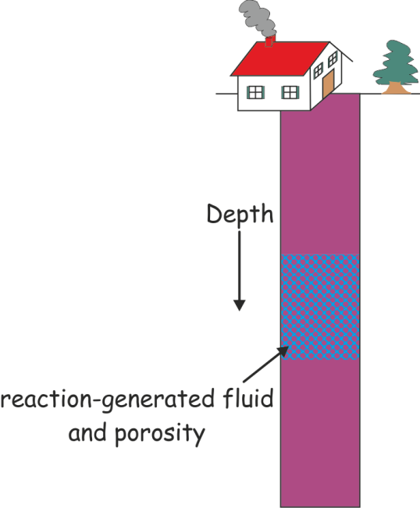
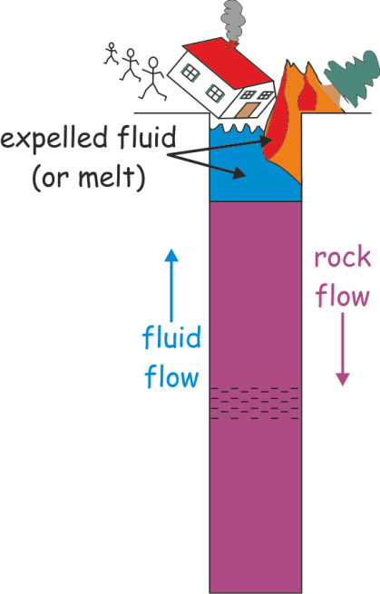
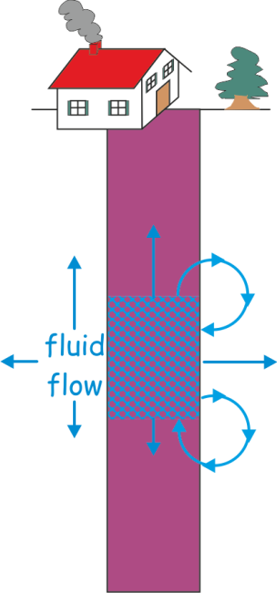
The Process
Classical school:
rocks have no strength
Modern school:
rocks have infinite strength
compaction-driven flow
p_{fluid} = p_{total}
flow in only one direction (up)
no physics
p_{fluid} ≠ p_{total}
circulation, not expulsion
τ_{compaction} » τ_{fluid flow}
What happens next?
Real world => finite strength => porosity waves?

Slide 3
Assumption #1: Permeability (k) is a strong function of porosity (φ) k = cφ^{n}, n ~ 3

Slide 4
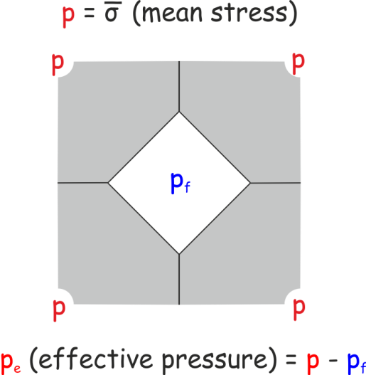
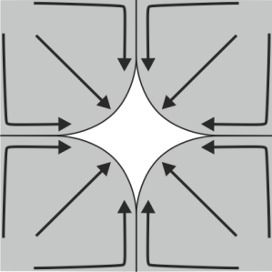
Assumption #2: Viscous (ductile) bulk rheology Compaction rate ∝ total pressure – fluid pressure or η – shear viscosity (linear viscous) A – coefficient of viscous flow (non-linear viscous) n_{σ} – stress exponent

Slide 5
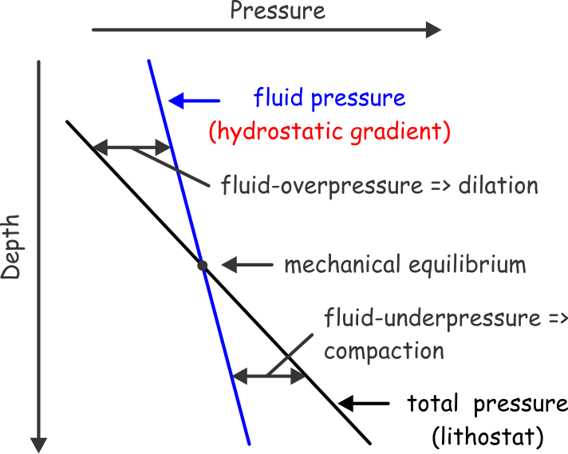
Assumption #3: Darcy’s Law Fluid flux ∝ p_{f} gradient – hydrostatic gradient q = k/μ (dp_{fluid}/dz - ρ_{fluid}g) ρ_{f}, μ – fluid density, viscosity
dp_{fluid}/dz = qμ/k + ρ_{fluid}g

Slide 6
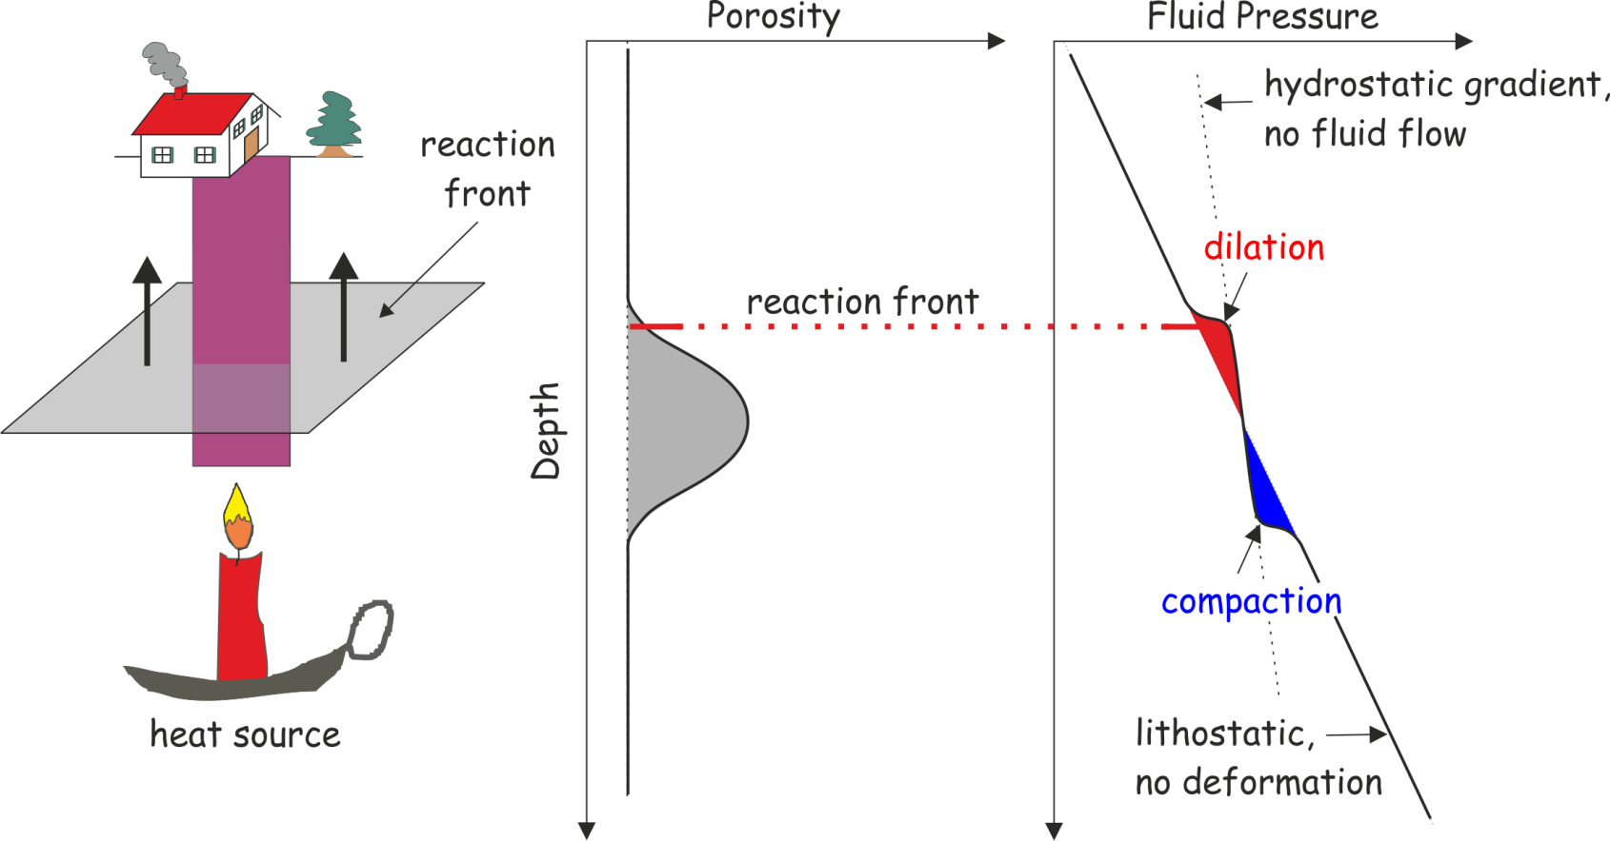
A Minimal Model, ΔV_{reaction} = 0

Slide 7
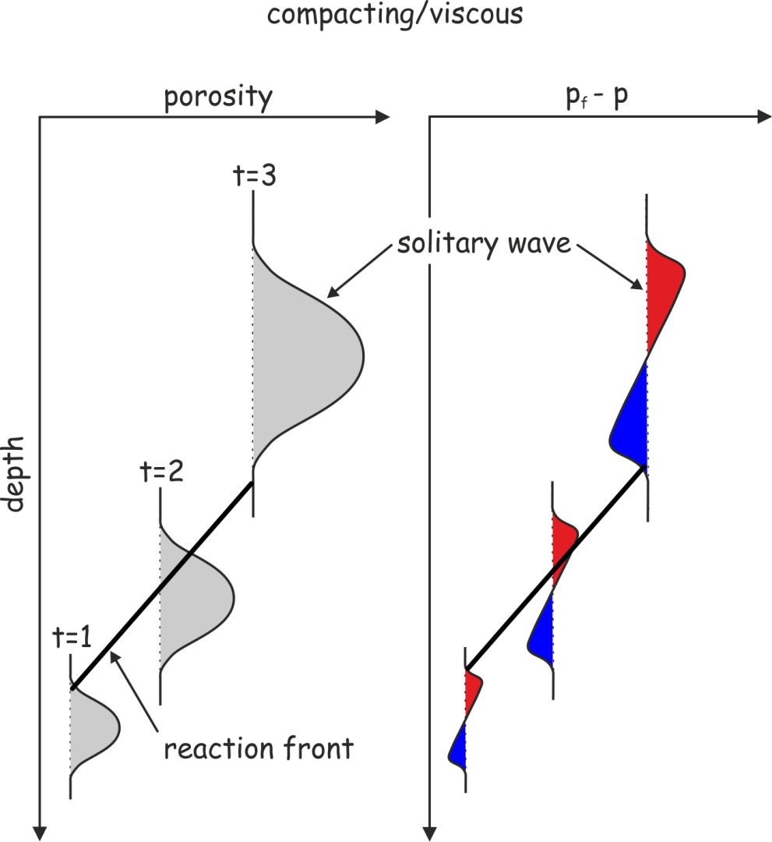
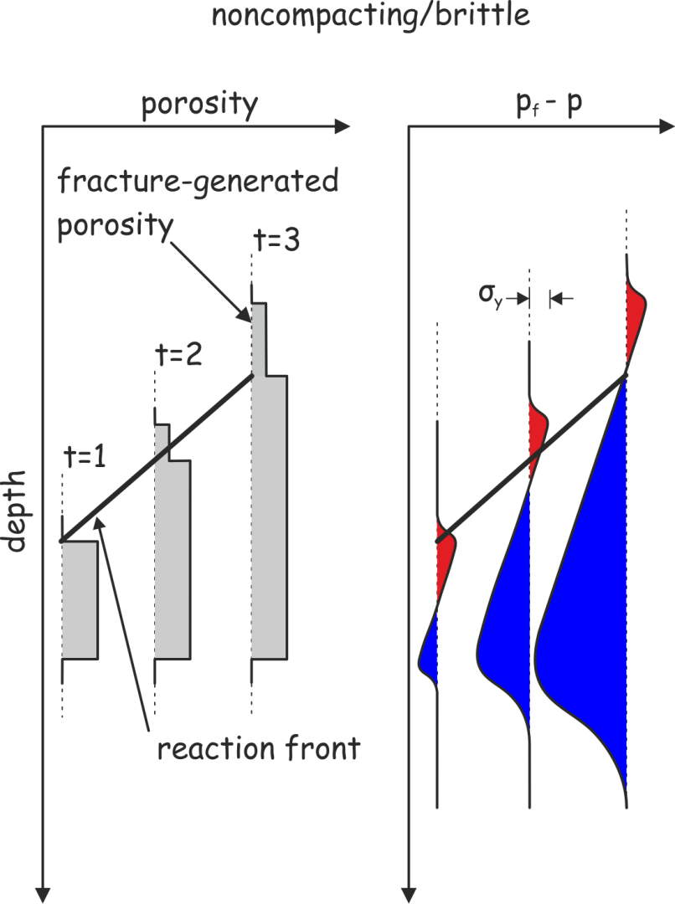
Time Evolution
*Scott & Stevenson ’84, Richter & Mckenzie ’84, Fowler ‘84

Slide 8
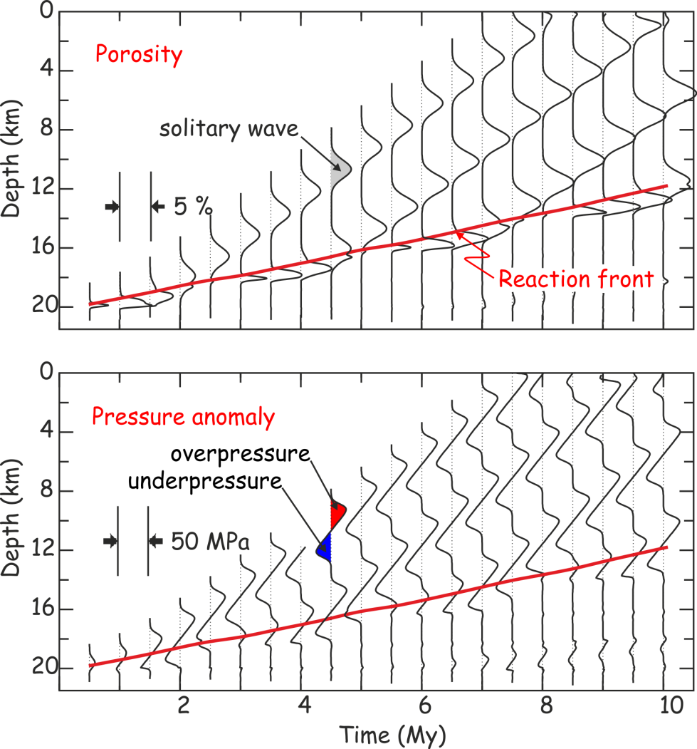
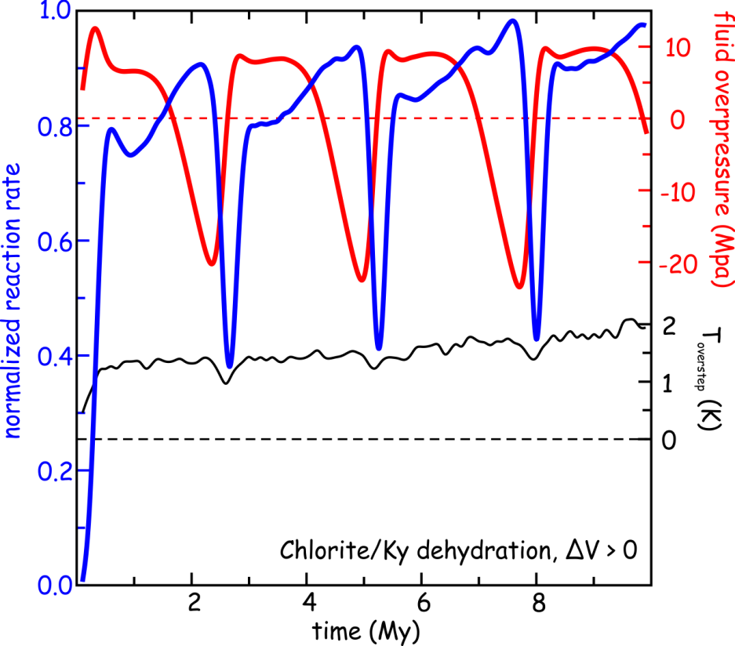
Numerical model of metamorphic devolatilization
flux greater than the time-averaged vertically integrated fluid production
steady state solutions to the compaction equations
Connolly ‘97
Notes:
Fully coupled kinetics for DV>0 dehydration
Quantitative details unimportant
Excess flux carried by waves greater than the fluid production -> periodicity

Slide 9
How big are porosity waves? = What is the length scale for non-uniform (e.g., lateral or downward) fluid flow?
or
The compaction length scale,
=>
fluid pressure variations are ~ ±δ∆ρg
time scale τ ~ δ/v
=>
If short duration (10³-10⁵ y) of fluid-rock interaction during amphibolite grade (T > 500ºC) metamorphism* is indicative of τ, then δ is plausibly ~ 0.1-1 km
*Young & Rumble 1994, van Haren et al 1996, Graham et al 1998

Slide 10
More Realistic Temperature-Dependent Viscous Rheology

Slide 11
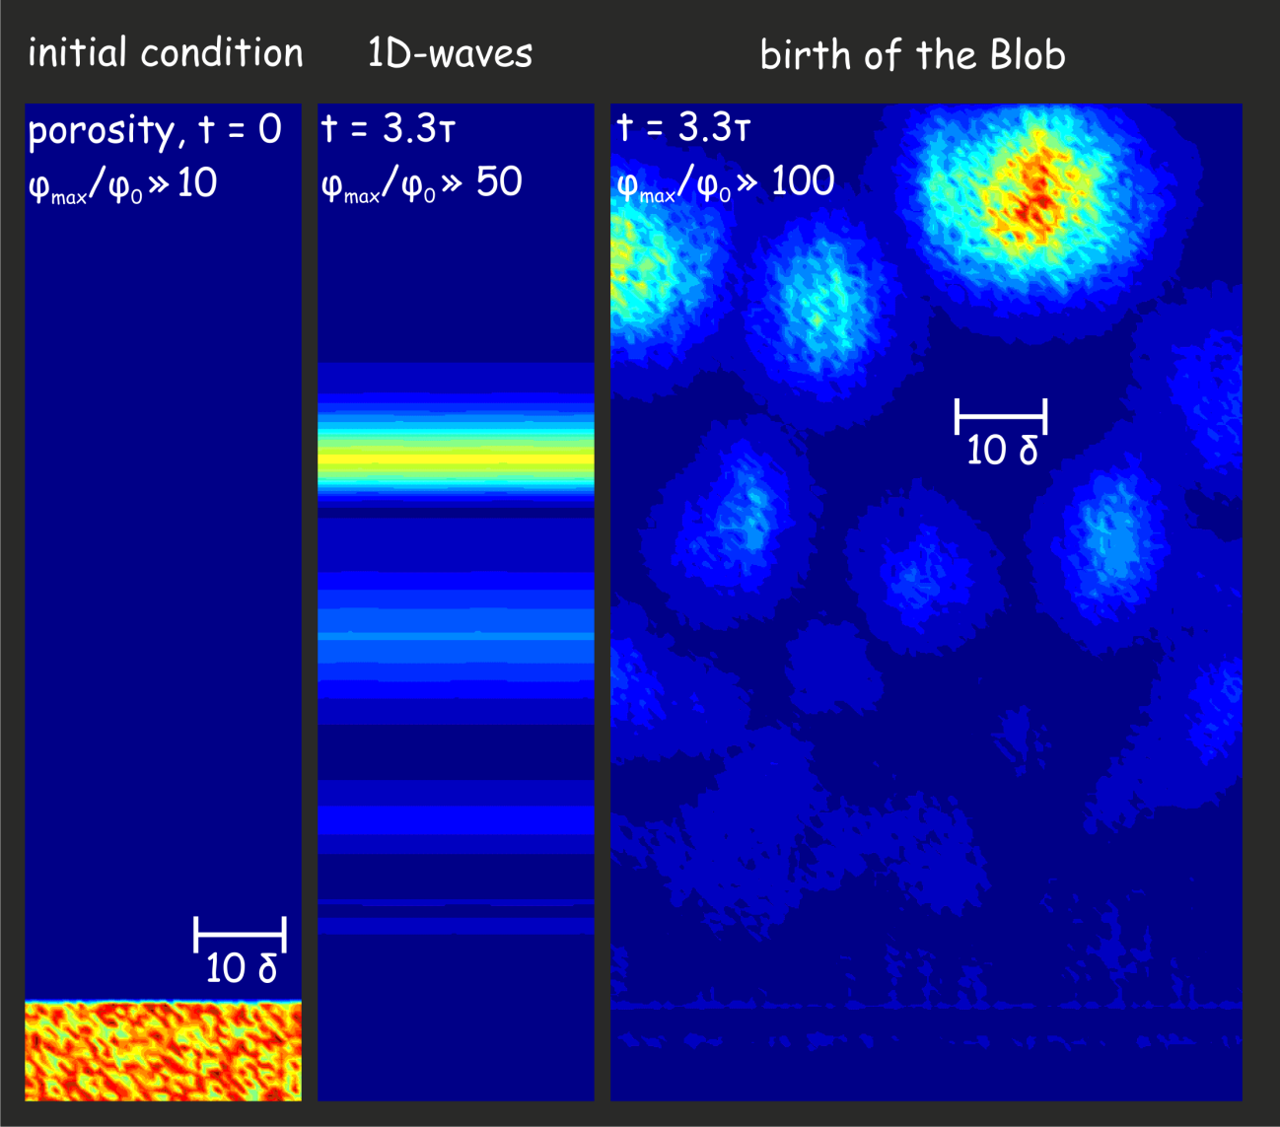
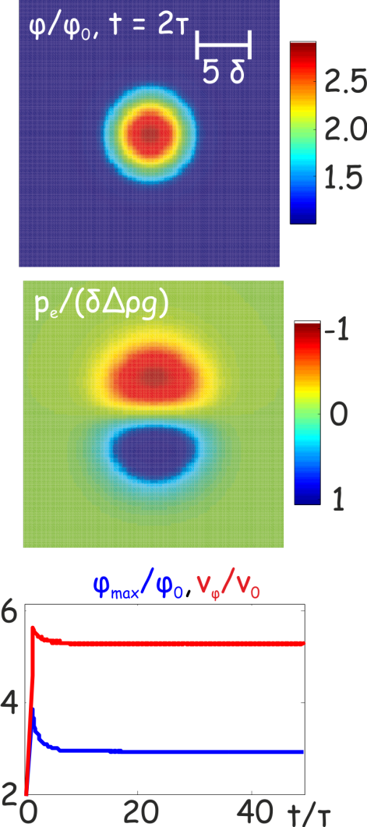
A baby step toward reality: 2/3D flow in a constant viscosity matrix
Scott & Stevenson ’86, Wiggins & Spiegelman ‘95

Slide 12
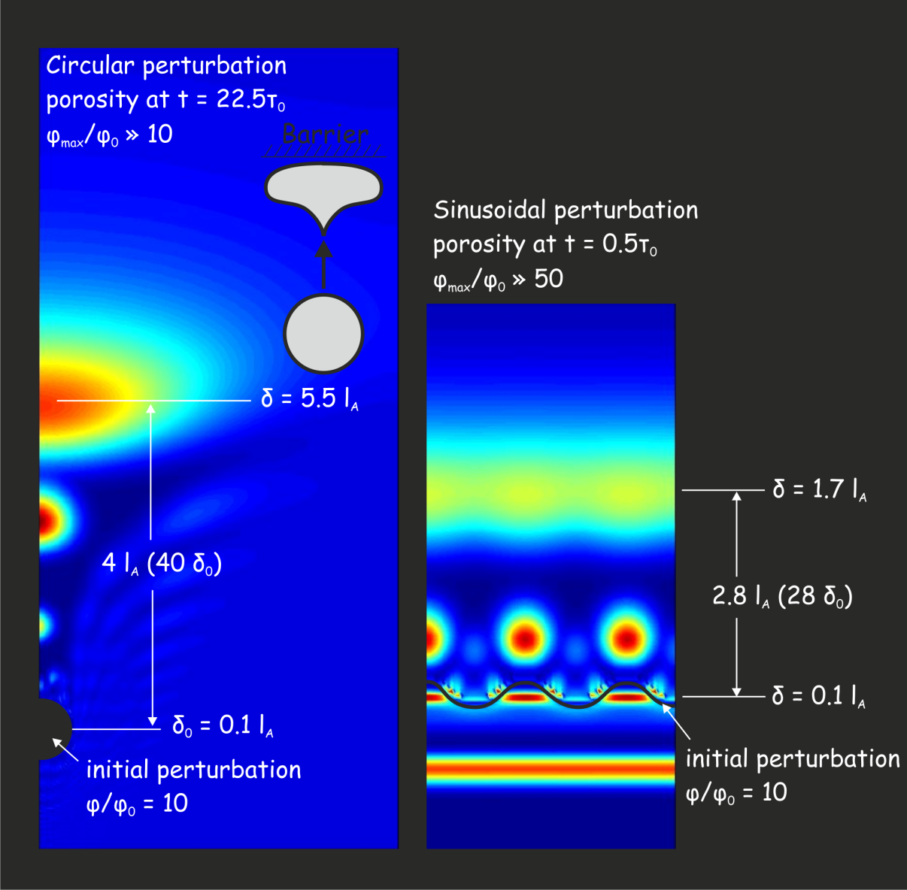
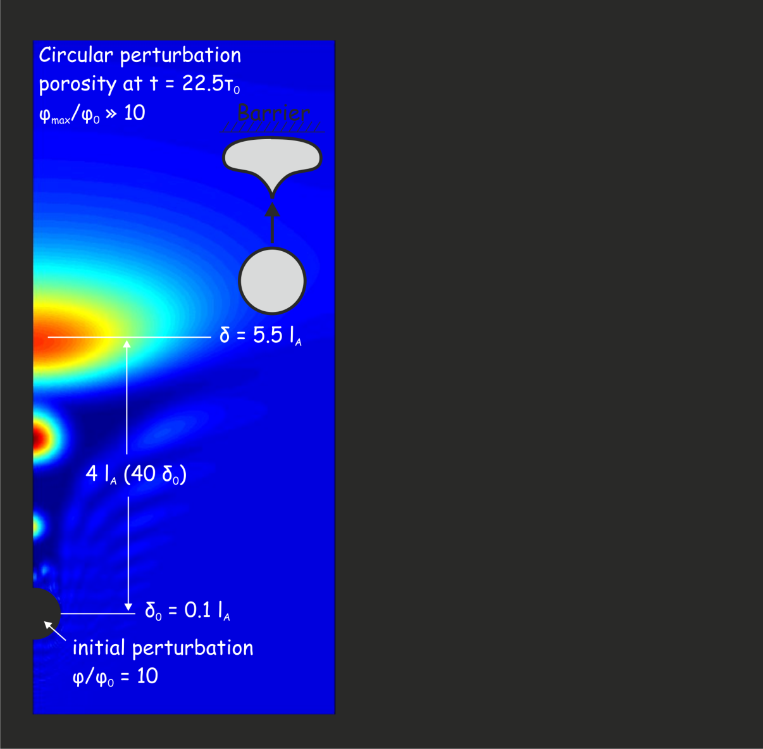
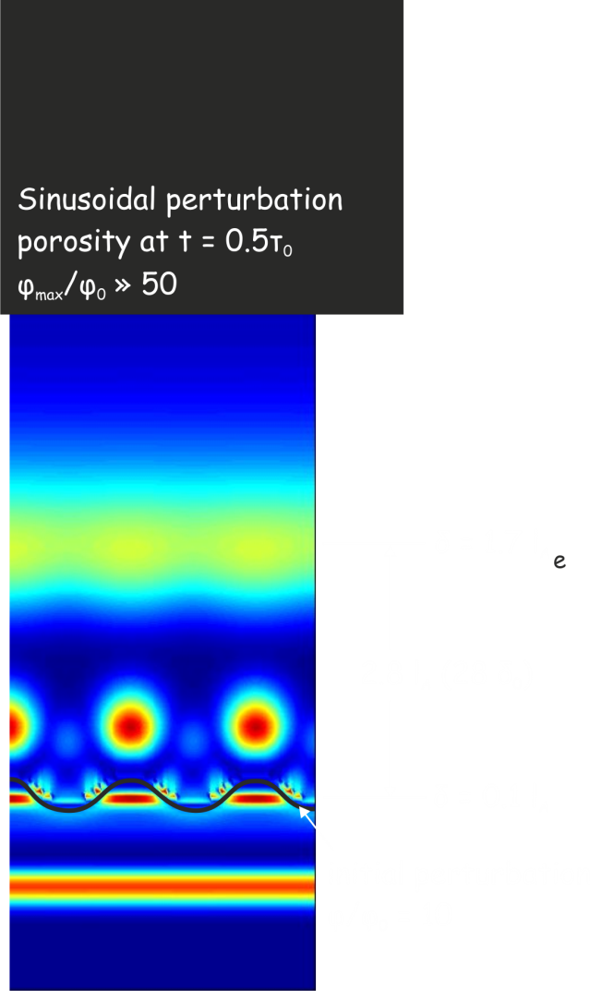
Thermal Activation: Death of the Blob
Connolly & Podladchikov ‘98

Slide 13
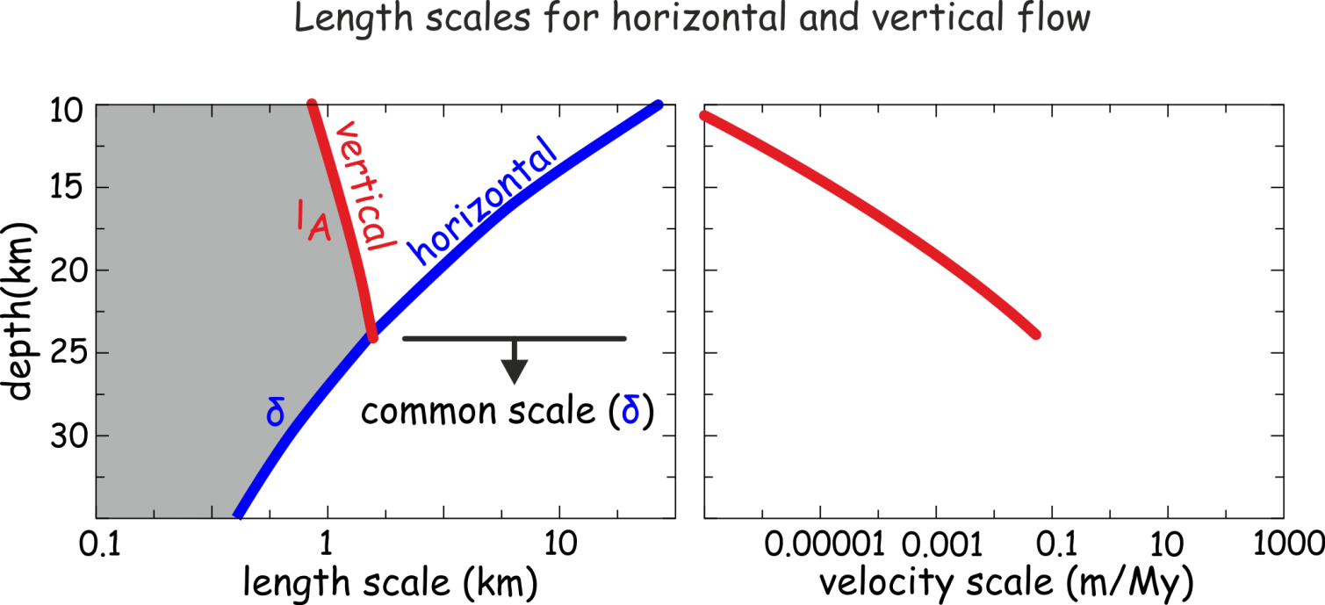
In the absence of other deformation mechanisms, the mid-crust is a graveyard for lower crustal porosity waves
The existence of graveyards is supported by geophysical evidence* for sub-horizontal accumulations of fluid beneath the brittle-ductile transition
*e.g. Suetnova et al ’94, Hammer & Clowes ’99, Ozel et al ’99, Liotta & Ranalli ’99, Makovsky & Klemperer ’99, Vanyan & Gliko ’99, Stern et al ’01, Jiracek et al ’07

Slide 14
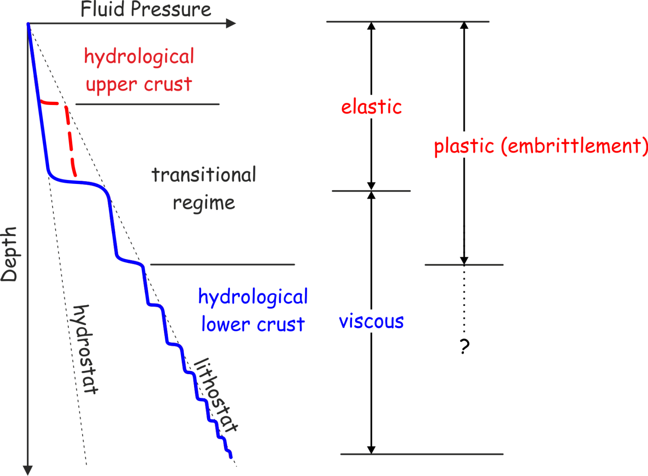
Non-Viscous Compaction Rheology

Slide 15
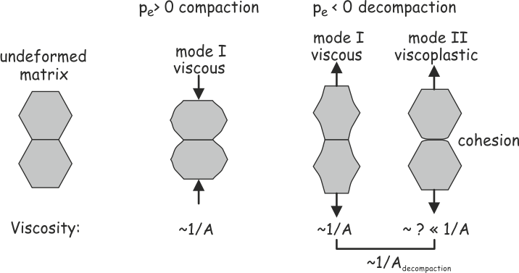

Slide 16
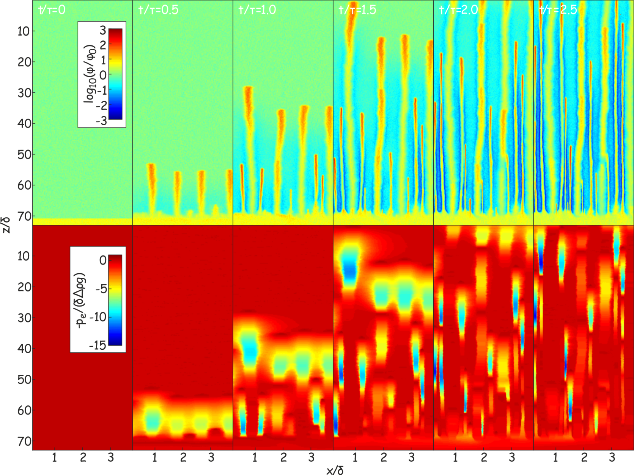
Flow through a decompaction-weakening matrix from a high porosity source
Strong spatial focusing, channel spacing ~ δ, channel width ~ σ_{y}/Δρg, τ = τ_{viscous}width/δ
Connolly & Podladchikov ‘07

Slide 17
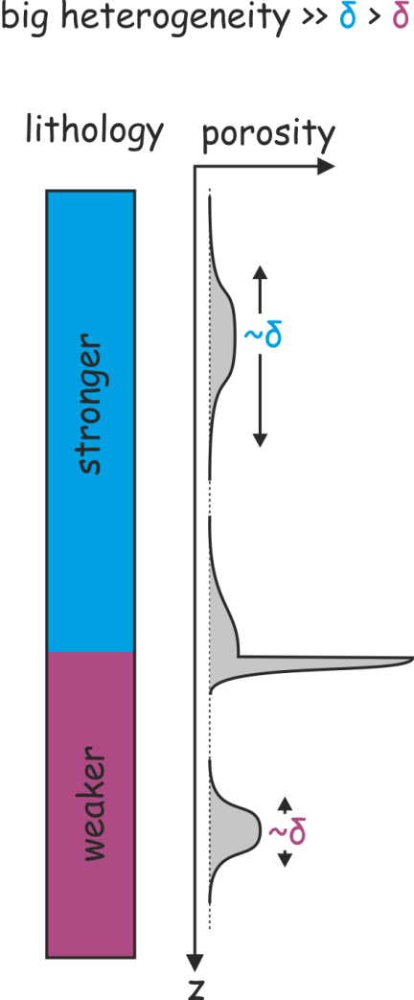
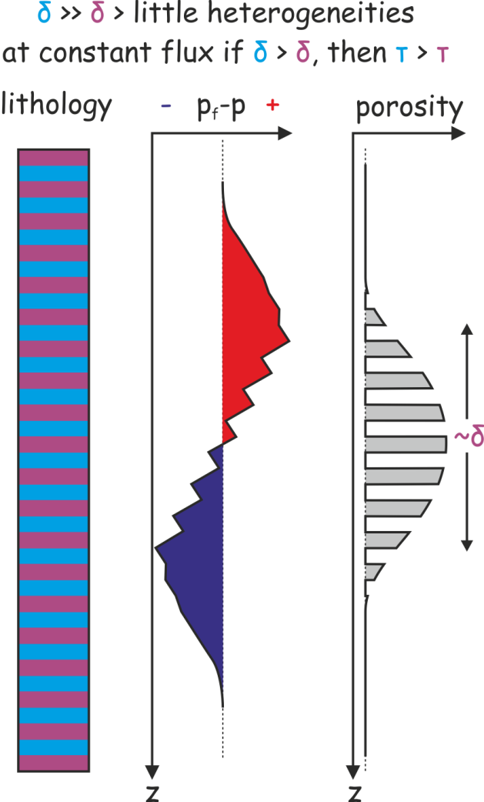
Lithological Heterogeneity

Slide 18
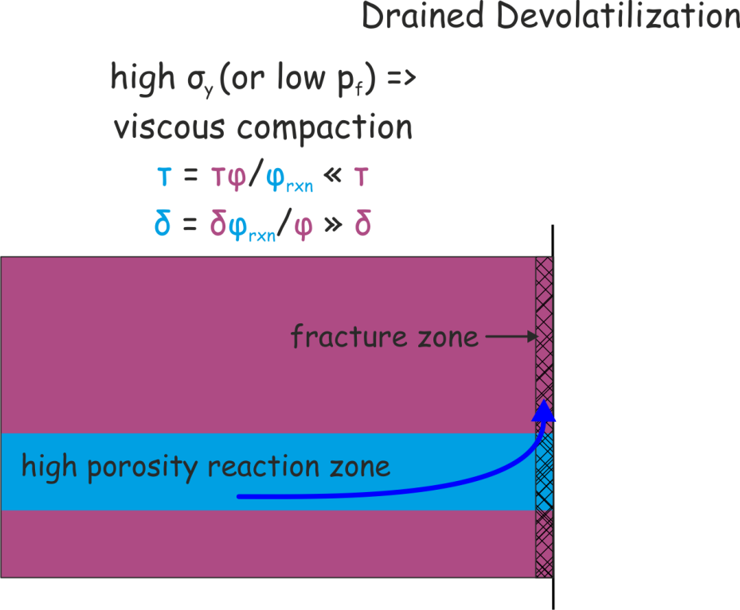
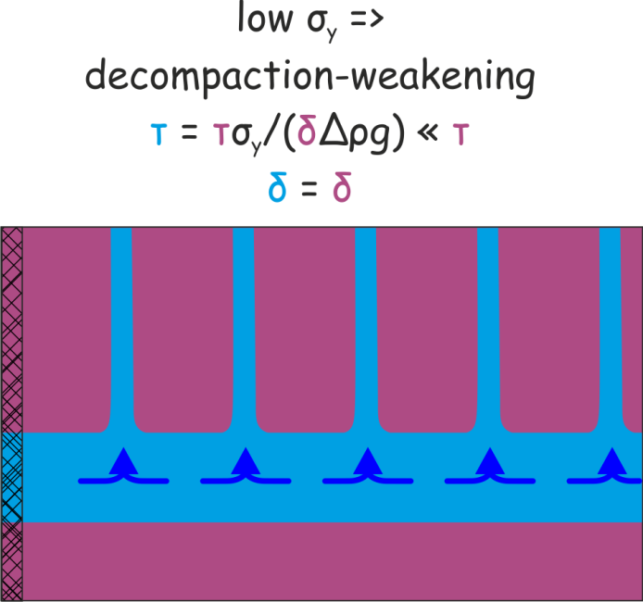
Lateral Fluid Flow Lateral flow is toward low p_{f}, i.e., a drain (except in metamorphic petrology where fluids flow “up-” or “down-temperature”)

Slide 19
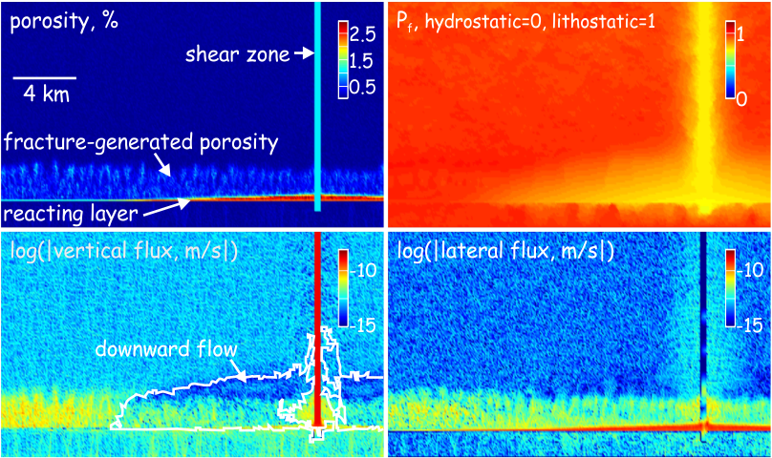

Slide 20
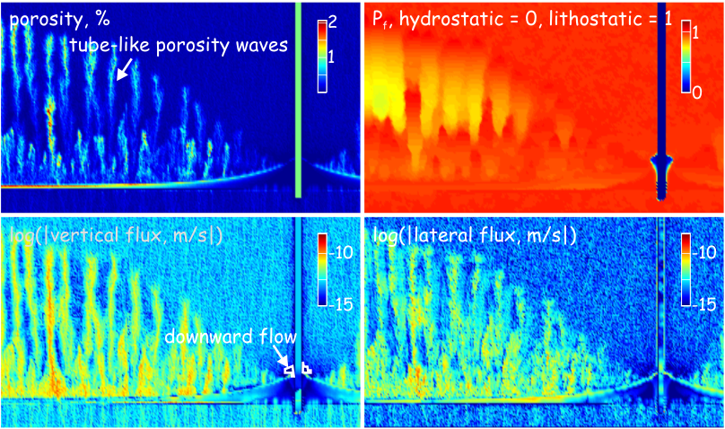
Connolly ‘10

Slide 21
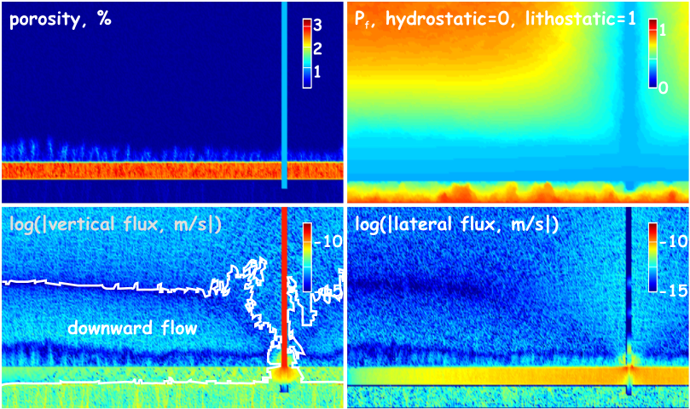
Noncompacting, t = 110 ky

Slide 22
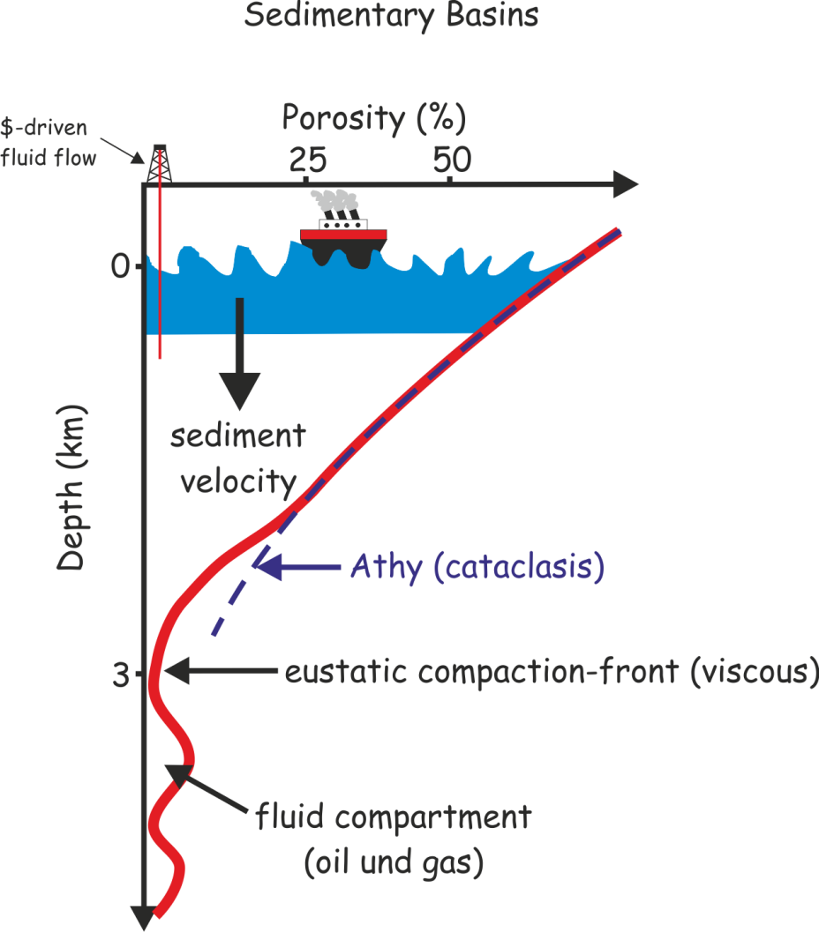
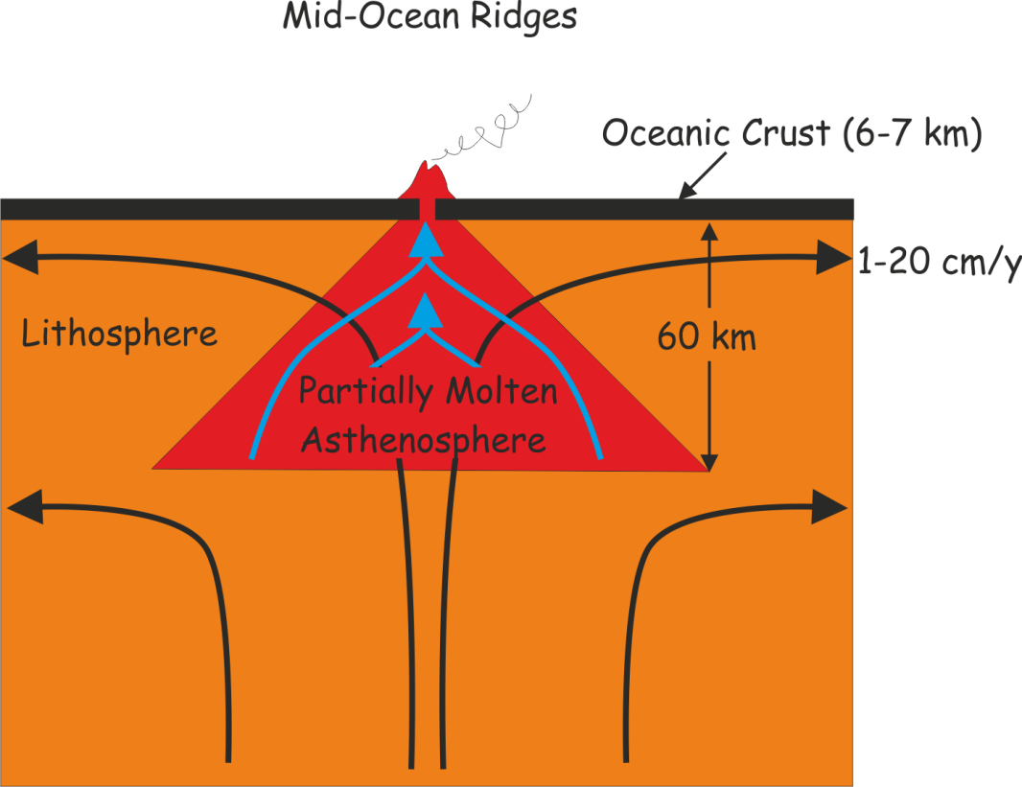
Has anyone ever seen a porosity wave?

Slide 23
Conclusions
Less is known about the initial state than the about possible hydrodynamic perturbations (e.g. devolatilization)
Porosity waves are an inescapable consequence of 3 assumptions:
Darcy’s Law
Viscous compaction
Porosity-dependent Permeability.
If you don’t like porosity waves, then reject an assumption, but which?
Lower crustal fluid flow is inherently episodic and self organizes on spatial and temporal scales that are determined by the viscous compaction length δ:
δ ―› 0 => classical school, p_{fluid} = p_{total}, uni-directional (up) flow
δ ―› ∞ => modern school, p_{fluid} ≠ p_{total}, heterogeneity controlled flow
Ignoring compaction in lower crustal fluid flow is fair enough, but the compaction length and time scales should be used to check the feasibility of rigid models
viscous
High p_{f}
Darcy
isostatic

Slide 24
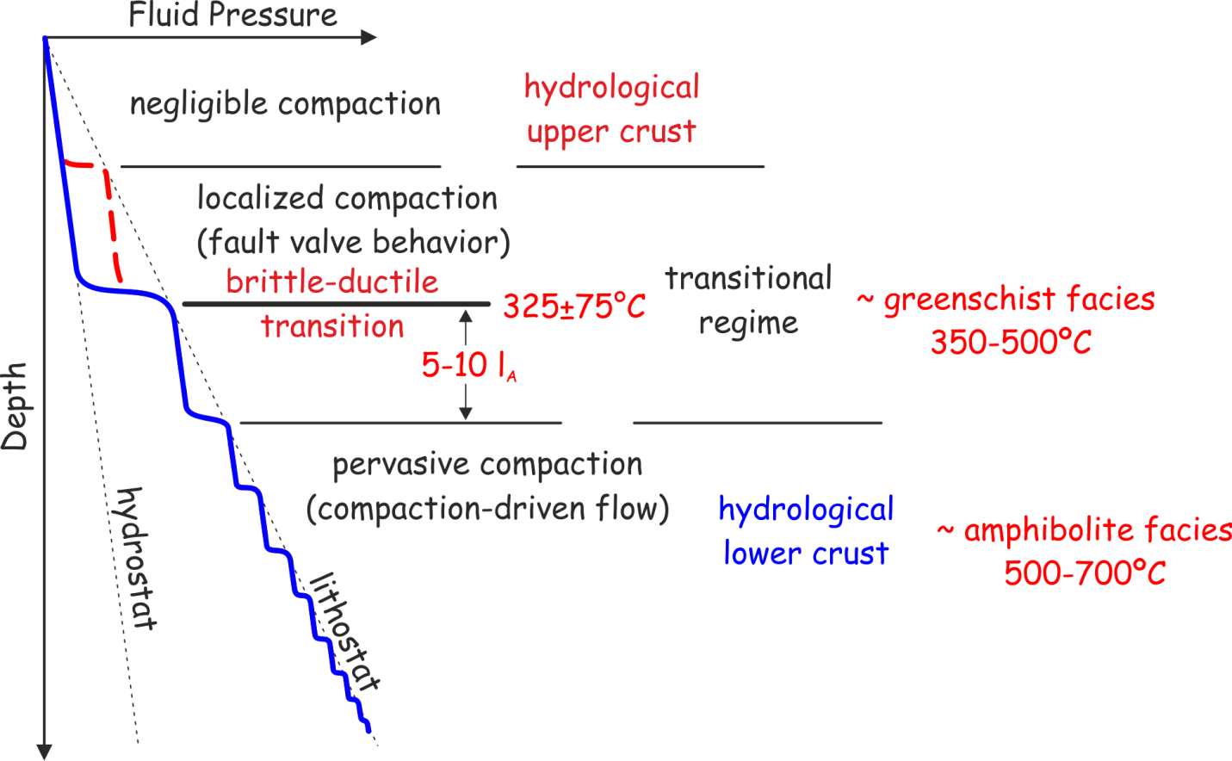
Initial Conditions?
Rubey & Hubbert ’58, Brace & Kohlstedt ’80, Etheridge et al ’84, Sibson ’86, Zoback & Townend ’01, Tenthorey & Cox ‘06

Slide 25
Concluding Remarks
Less is known about the initial state than the about possible hydrodynamic perturbations (e.g. devolatilization)
Compaction is fast relative to metamorphic fluid production at temperatures > 500 C, and it cannot be much slower than metamorphism in general
Can I make a useful prediction?
I don’t know, but I have a hypothesis that ignores neither compaction nor rock strength and has intrinisic time and spatial scales
Ignoring compaction in models of lower crustal fluid flow is fair enough, but the compaction length and time scales should be used to check the feasibility of rigid models
viscous
High p_{f}
Darcy
isostatic

Slide 26
A Hydromechanical Model for Fluid Flow in the Lower Crust J.A.D. Connolly an attempt to reconcile elementary mechanics and petrology

Slide 27
The Process
Classical school:
rocks have no strength
Modern school:
rocks are rigid/brittle
finite strength
=>
porosity waves?
compaction-driven flow
flow in only one direction (up)
circulation, not expulsion
τ_{compaction} » τ_{fluid flow}
What happens next?

Slide 28
p_{fluid} = p_{total}, metamorphic mythology?
Phase petrology
Lateral fluid flow
Deformation style and fluid inclusions
=>
Fluid pressure may not be lithostatic, but it is certainly above hydrostatic
=>
Assumption #1: Metamorphic systems are poorly drained, i.e. fluid expulsion is limited by the permeability of the surroundings

Slide 30
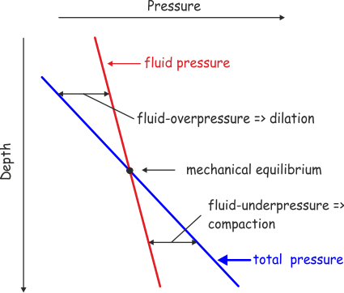
What causes the pressure difference?
Static pressure gradient ∝ density (ρ)

Slide 31
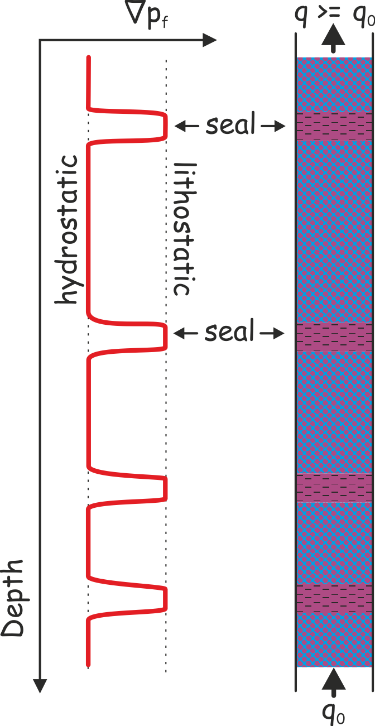

Slide 32
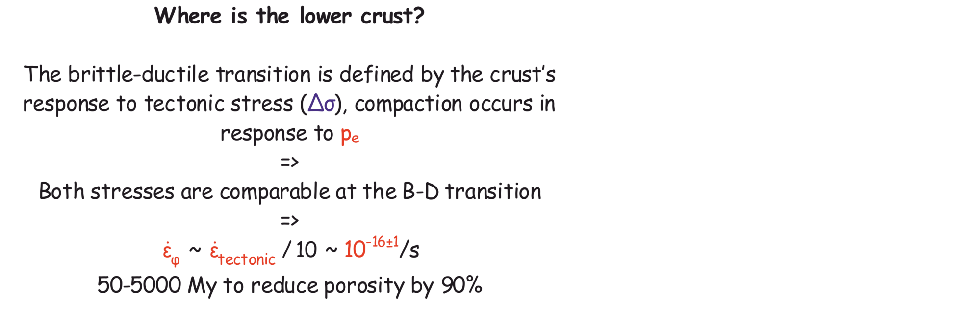
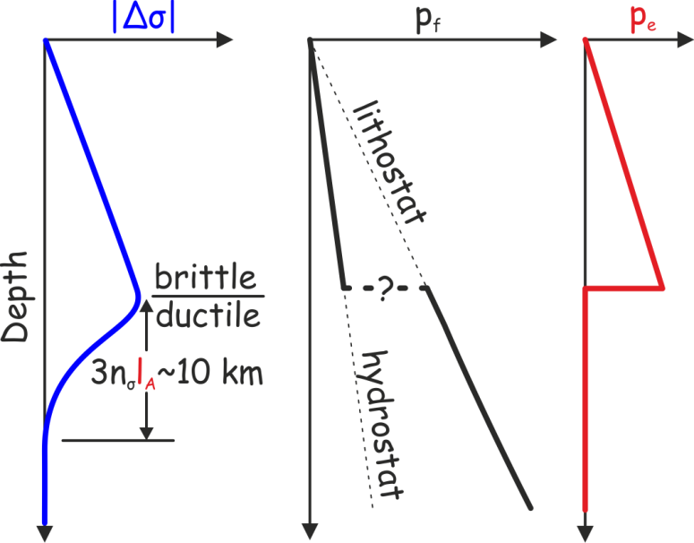
Brittle ductile

Slide 33
Initial Conditions?
Rubey & Hubbert ’58, Brace & Kohlstedt ’80, Etheridge et al ’84, Sibson ’86, Zoback & Townend ’01, Tenthorey & Cox ‘06

Slide 34
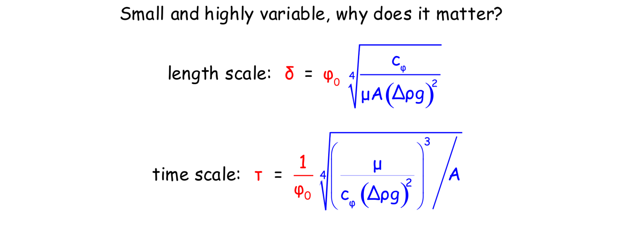
Permeability
known or measurable material properties
Assuming average values are representative of initial conditions gives an upper bound on the length scale for fluid flow and a lower bound for the time scale
* ~φ from metamorphic diffusion profiles, e.g., Skelton et al. 2001
Notes:
Average “porosity” gives a maximum estimate

Slide 35
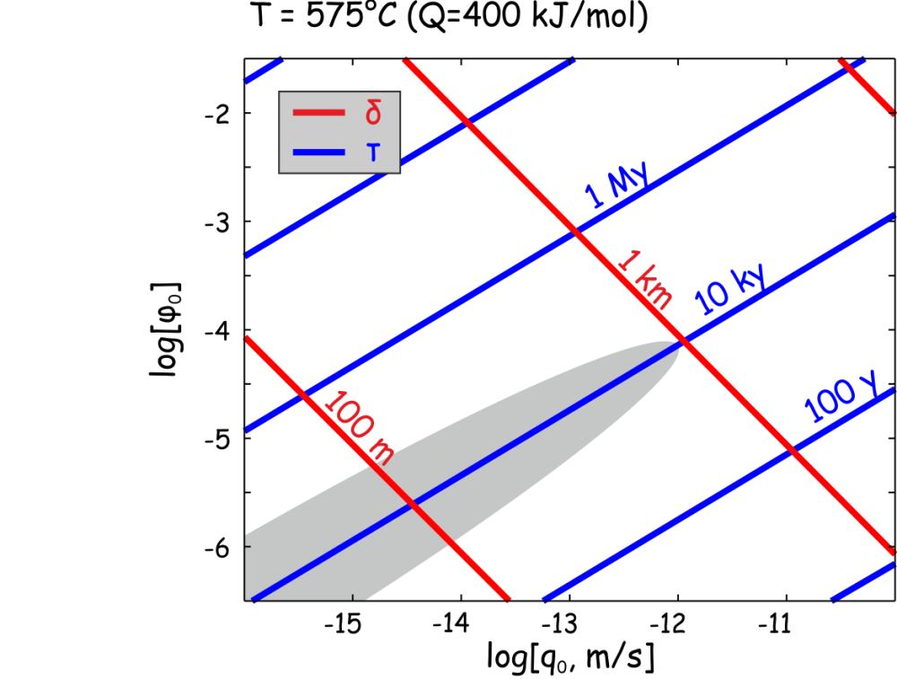
Do we know anything about the compaction scales? Pootet…
Short duration (10³-10⁵ y) of fluid-rock interaction during amphibolite grade (T > 500ºC) metamorphism* = τ?
q₀ < 10⁻¹² m/s ~ average fluxes
*Young & Rumble 1994, van Haren et al 1996, Graham et al 1998

Slide 36
A Minimal Model:
ΔV_{reaction} = 0
constant shear viscosity, l_{A} = ∞

Slide 37
Time Evolution
*Scott & Stevenson ’84, Richter & Mckenzie ’84, Fowler ‘84

Slide 38
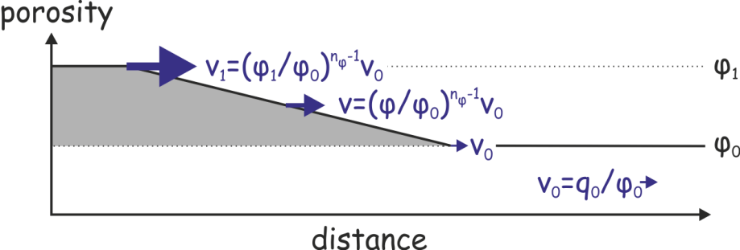
Why don’t they dissipate?

Slide 39
Numerical model of metamorphic devolatilization
They carry a flux than the time-averaged vertically integrated fluid production
Waves are steady state solutions to the compaction equations
Connolly ‘97
Notes:
Fully coupled kinetics for DV>0 dehydration
Quantitative details unimportant
Excess flux carried by waves greater than the fluid production -> periodicity

Slide 40
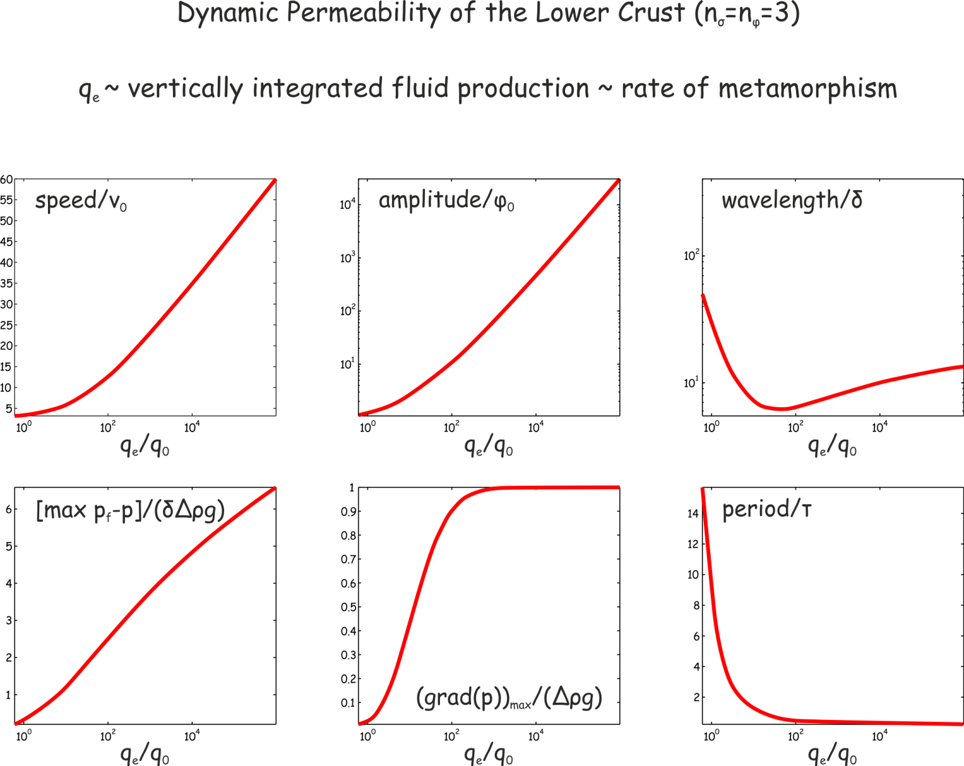
Connolly & Podladchikov ‘11
Notes:
Waves correspond to steady state wave solutions to the compaction equations.
Equating the excess flux to reaction flux gives a prediction of the dynamic permeability,
Implies the dynamic permeability is a function of the background flux porosity.

Slide 41
“…it all depends on whether you want to view a rock as an idealised system or a real one.” -- an anonymous petrologist at Cambridge (UK)

Slide 42
A baby step toward reality: 2/3D flow in a constant viscosity matrix
Scott & Stevenson ’86, Wiggins & Spiegelman ‘95

Slide 43
Thermal Activation: Death of the Blob
Connolly & Podladchikov ‘98

Slide 44
In the absence of other deformation mechanisms, the mid-crust is a graveyard for lower crustal porosity waves
The existence of graveyards is supported by geophysical evidence* for sub-horizontal accumulations of fluid beneath the brittle-ductile transition
*e.g. Suetnova et al ’94, Hammer & Clowes ’99, Ozel et al ’99, Liotta & Ranalli ’99, Makovsky & Klemperer ’99, Vanyan & Gliko ’99, Stern et al ’01, Jiracek et al ’07

Slide 45
What other mechanisms?

Slide 47
Flow through a decompaction-weakening matrix from a high porosity source
Strong spatial focusing, channel spacing ~ δ, channel width ~ σ_{y}/Δρg, τ = τ_{viscous}width/δ
Connolly & Podladchikov ‘07

Slide 48
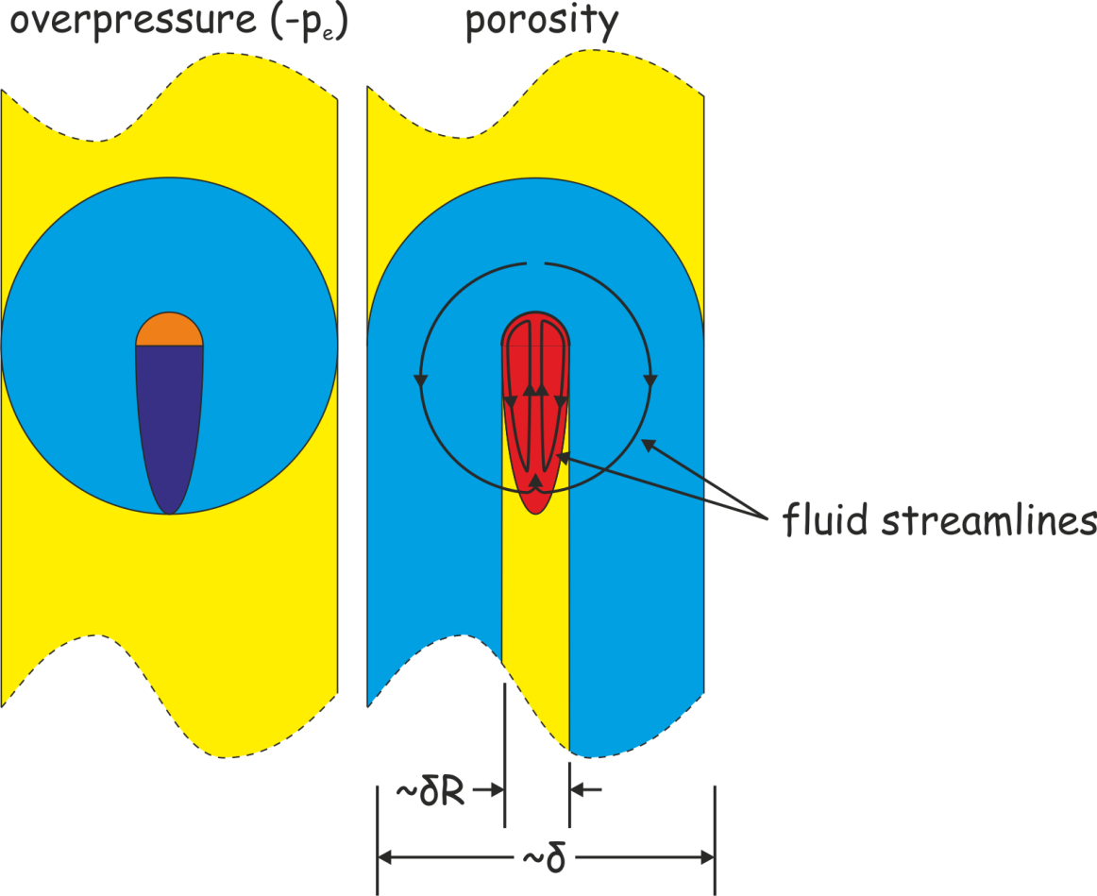
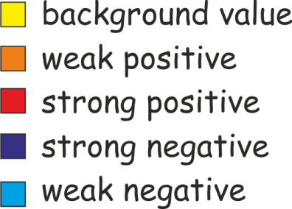
Decompaction Weakening

Slide 49
Lateral Fluid Flow Lateral flow is toward low p_{f}, i.e., a drain (except in metamorphic petrology where fluids flow “up-” or “down-temperature”)

Slide 51
Connolly ‘10

Slide 52
Noncompacting, t = 110 ky

Slide 53
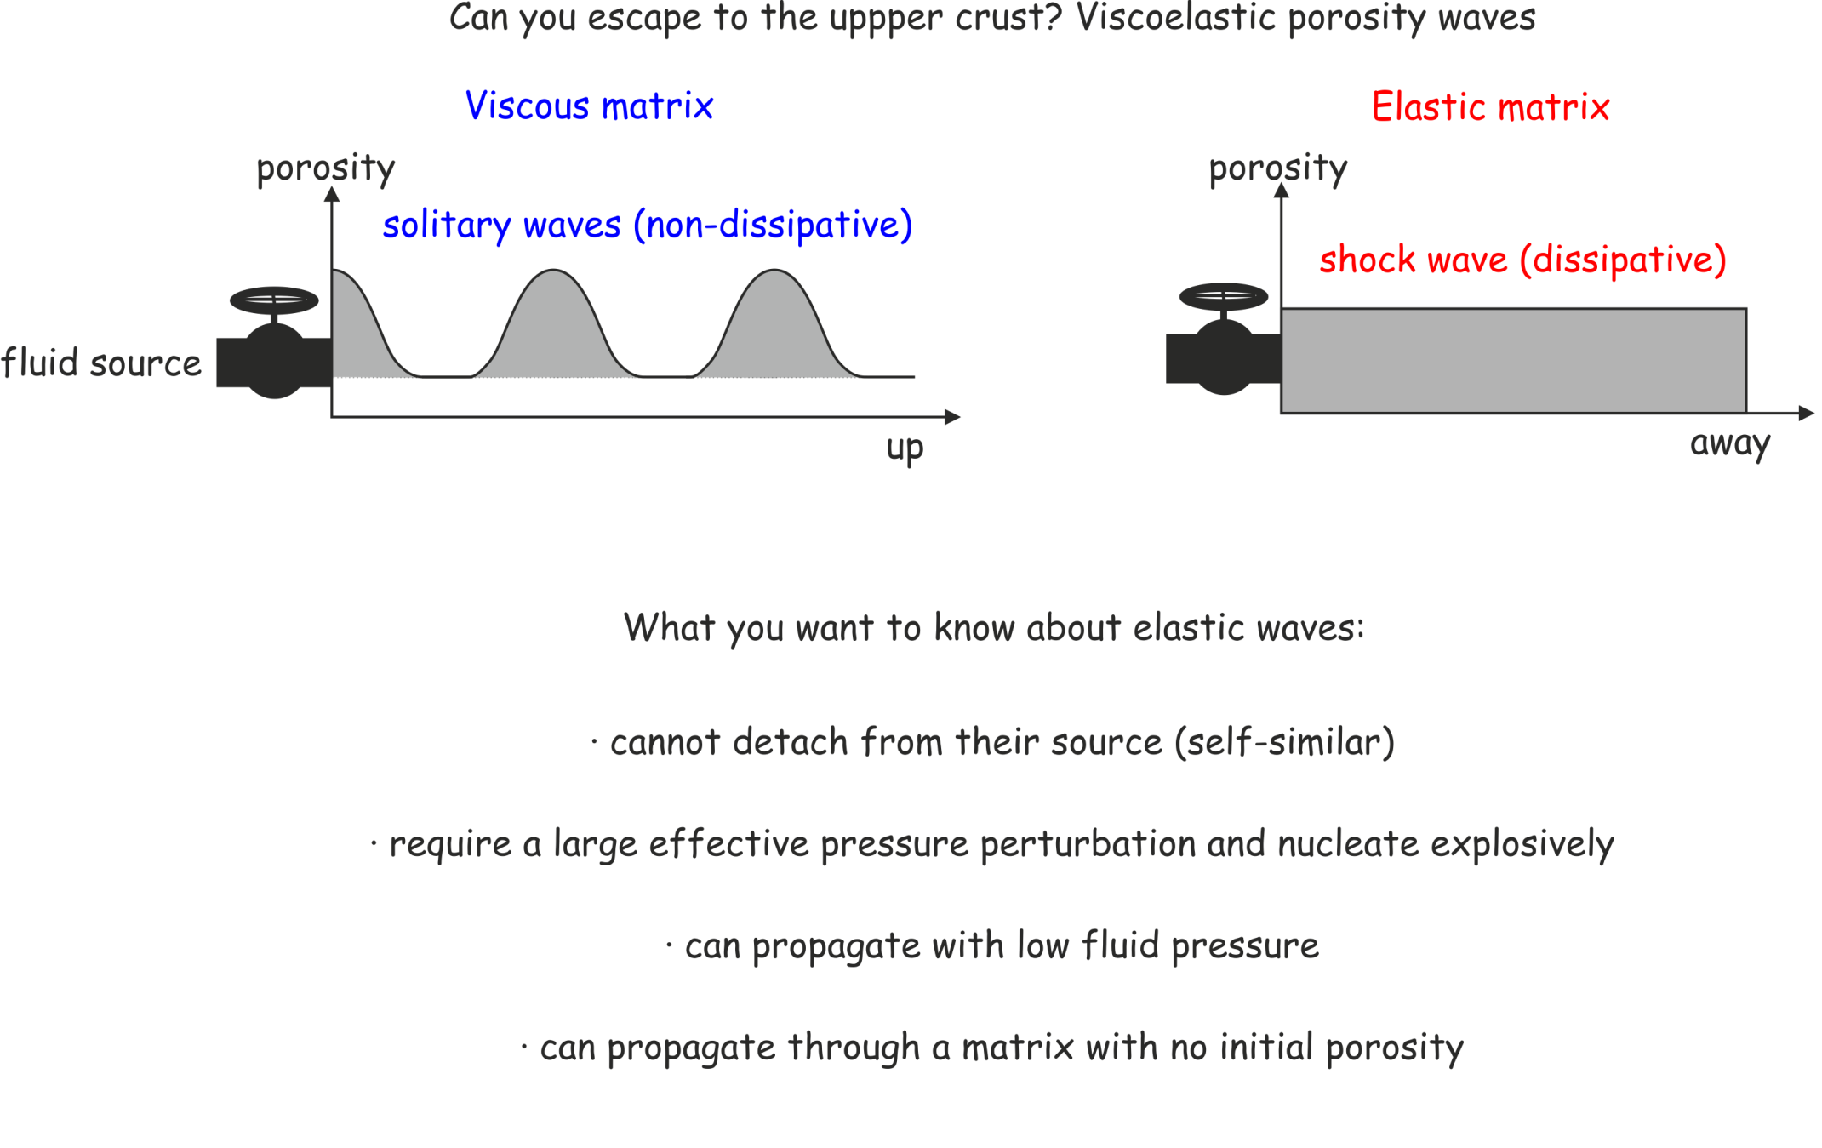

Slide 54
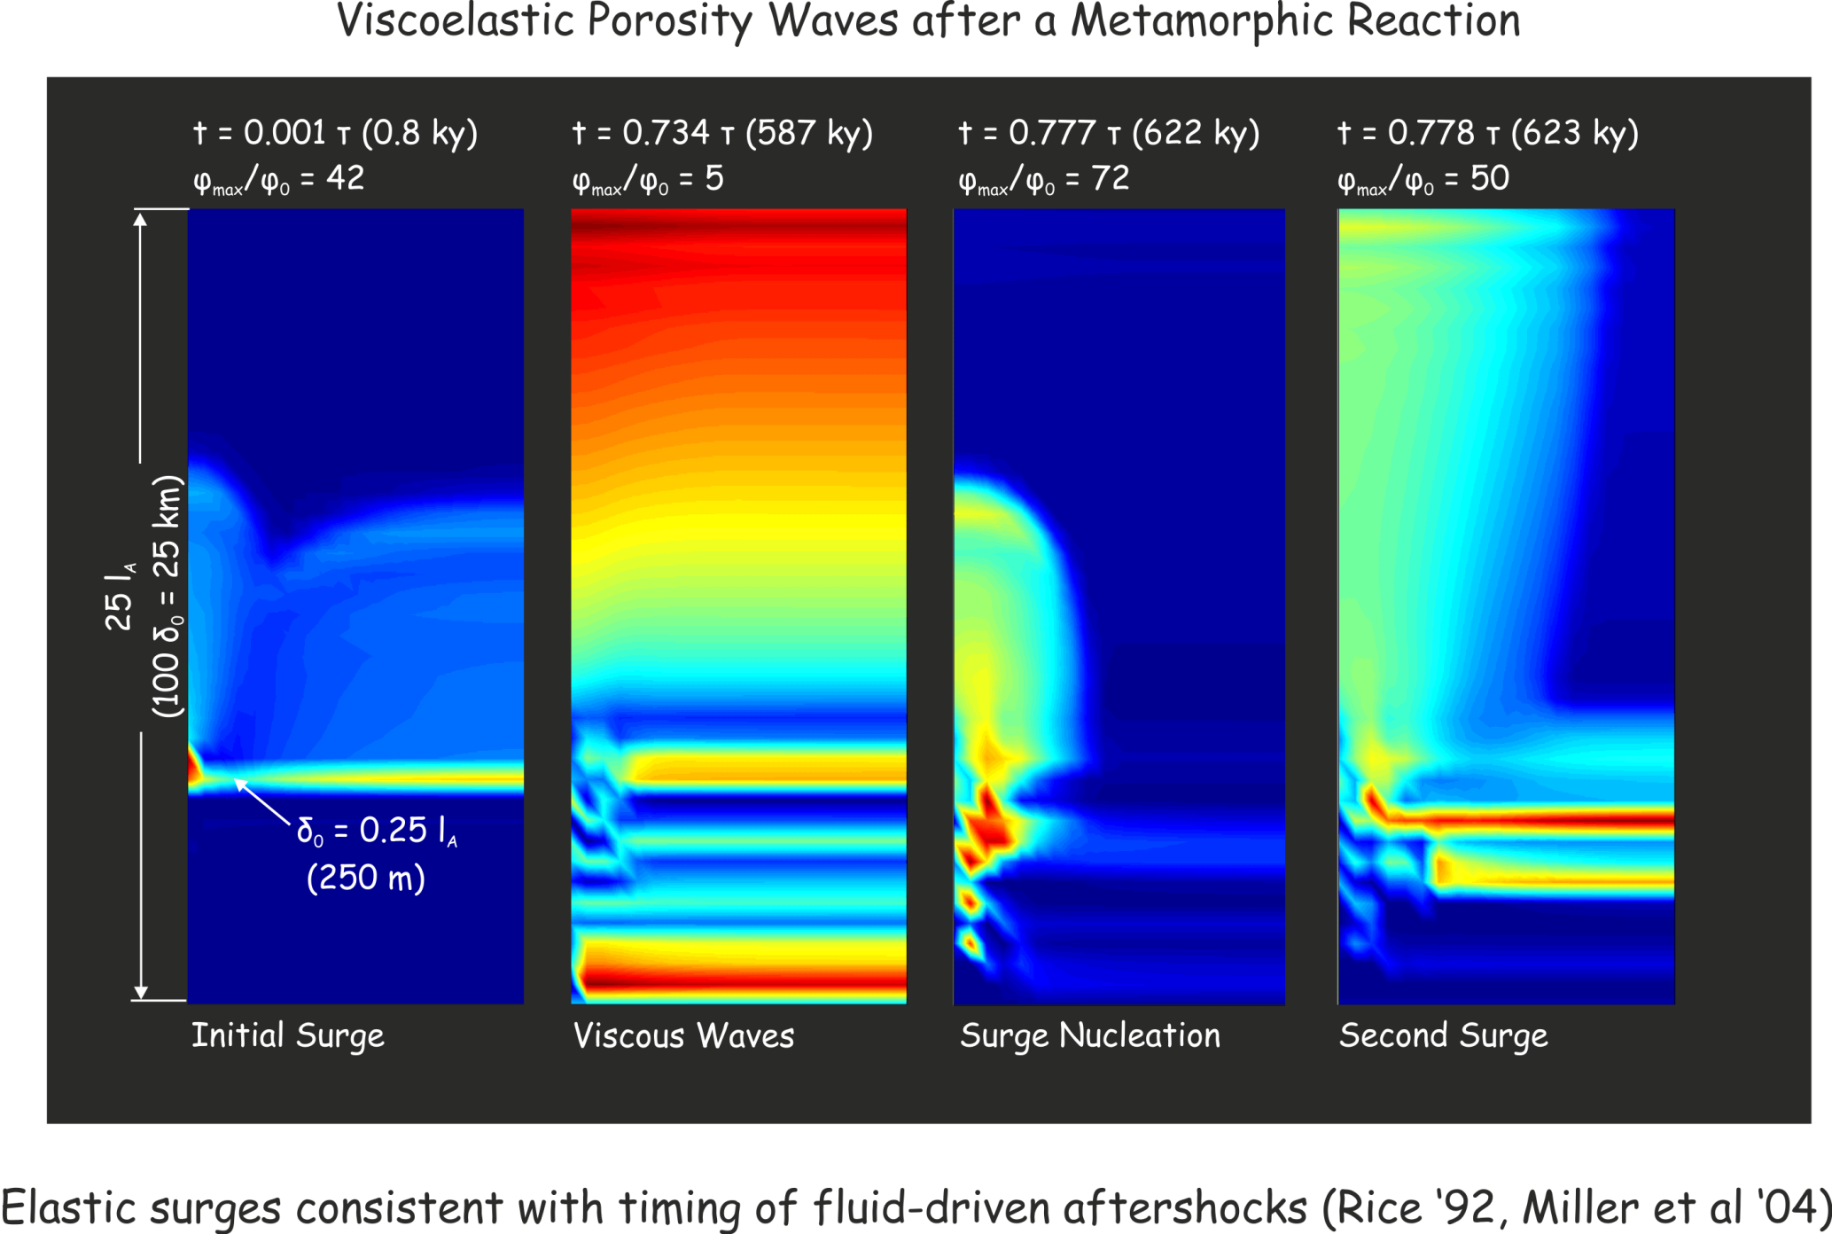
Connolly & Podladchikov ‘98

Slide 55
Has anyone ever seen a porosity wave?

Slide 56
Conclusions
Less is known about the initial state than the about possible hydrodynamic perturbations (e.g. devolatilization)
Compaction happens, there is no steady-state lower crustal hydrologic regime, pretending otherwise is not a good idea (obvious, but people do it)
In isolation, viscous compaction leads to fluid accumulation in horizons beneath the brittle-ductile transition
Lower crustal fluid flow is inherently episodic and self organizes on spatial and temporal scales that are directly determined by rheology (and the unknown initial porosity)
Ignoring compaction in lower crustal fluid flow is fair enough, but the compaction length and time scales should be used to check the feasibility of rigid models
viscous
High p_{f}
Darcy
isostatic

Slide 57
Concluding Remarks
Less is known about the initial state than the about possible hydrodynamic perturbations (e.g. devolatilization)
Compaction is fast relative to metamorphic fluid production at temperatures > 500 C, and it cannot be much slower than metamorphism in general
Can I make a useful prediction?
I don’t know, but I have a hypothesis that ignores neither compaction nor rock strength and has intrinisic time and spatial scales
Ignoring compaction in models of lower crustal fluid flow is fair enough, but the compaction length and time scales should be used to check the feasibility of rigid models
viscous
High p_{f}
Darcy
isostatic

Slide 58
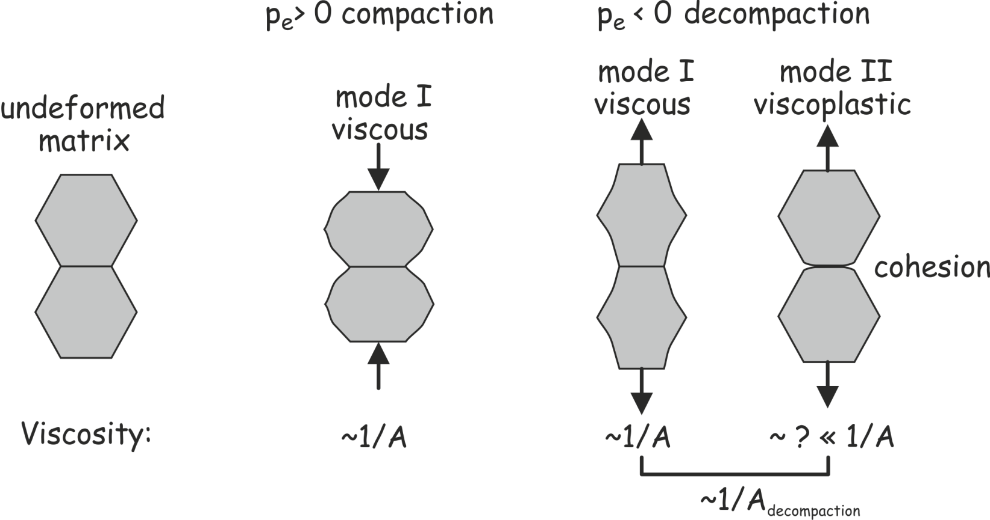

Slide 59
Rubey & Hubbert ’58

Slide 60
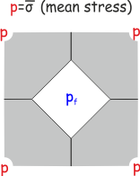
Rheology
non-linear viscous

Slide 61
Darcy’s Law
Darcy
isostatic

Slide 62
Permeability

Slide 63
Rheology
non-linear viscous

Slide 64
No one disputes that pervasive compaction occurs
Modern (rigidist) school: τ_{compaction} >> τ_{metamorphism}
Classical school: τ_{compaction} << τ_{metamorphism}
In moderate-grade (500-600 C) rocks, duration of fluid rock interaction is short (10³-10⁵ y) compared to the metamorphic time scale (10⁷-10⁸ y, e.g. Young and Rumble 1993, van Haren et al. 1996, Graham et al 1998)
2 min
90 s
30 s
1 min

Slide 65
Is there a brittle-ductile transition for compaction?
Picture of pressure profile, picture of differential stress profile
The brittle ductile transition is defined on the basis of the crusts response to tectonic stress
By happy coincidence the effective stress and differential are comparable, ergo ephi~esigma
If ephi ~ 10-15, then ~0.5 By to cause an order of magnitude change in porosity
=> Pervasive compaction cannot keep pace with metamorphism until several e-fold lengths below the B-D
=> Pervasive compaction is omninpresent, but slow, in the upper crust; faulting is responsible for high upper crustal permeability.
=> Localized compaction seals faults on a much shorter time scale; fault-valve behavior

Slide 66
Is there a brittle-ductile transition for compaction?
Picture of pressure profile, picture of differential stress profile
The brittle ductile transition is defined on the basis of the crusts response to tectonic stress
By happy coincidence the effective stress and differential are comparable, ergo ephi~esigma
If ephi ~ 10-15, then ~0.5 By to cause an order of magnitude change in porosity
=> Pervasive compaction cannot keep pace with metamorphism until several e-fold lengths below the B-D
=> Pervasive compaction is omninpresent, but slow, in the upper crust; faulting is responsible for high upper crustal permeability.
=> Localized compaction seals faults on a much shorter time scale; fault-valve behavior

Slide 67
Am I trying to sell you a spherical cow*?
Porosity waves are a consequence of 4 essential assumptions
If there is a spherical cow to be found, it is lurking among these assumptions.
*an absurd or non-physical assumption, e.g., cows are spherical.

Slide 68
Compaction rheology No one disputes that irreversible compaction occurs The modern (rigid) school assumes τ_{compaction} >> τ_{fluid flow}
It cannot be elastic or plastic because: Elastic – reversible Plastic (cataclasis) – effective stress ~ O(1) GPa
=> Assumption #2: Lower crustal compaction is viscous (i.e., time-dependent, irreversible deformation)
viscous

Slide 69
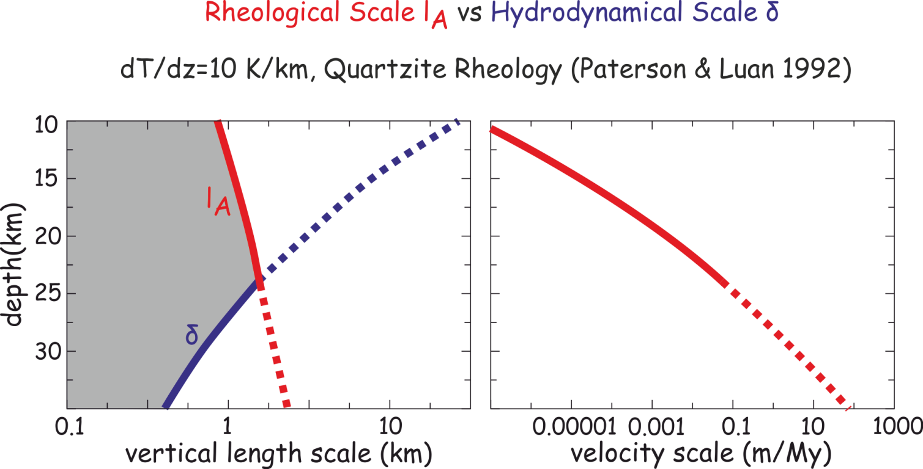
Thermal activation: A tale of two length scales

Slide 70
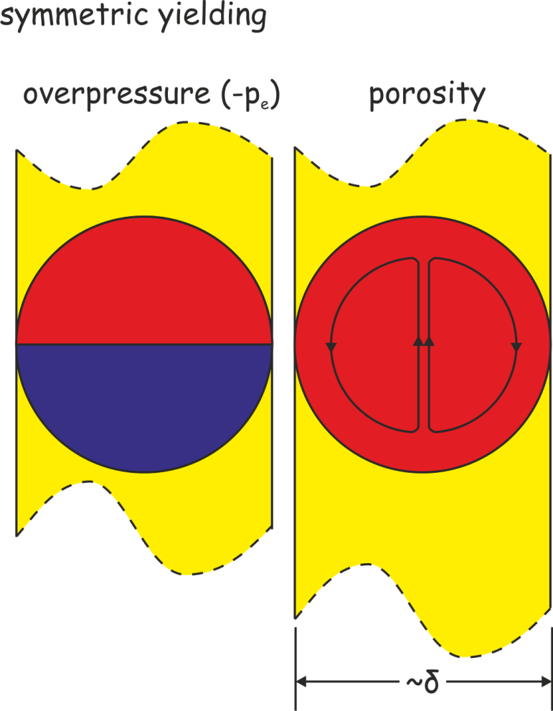
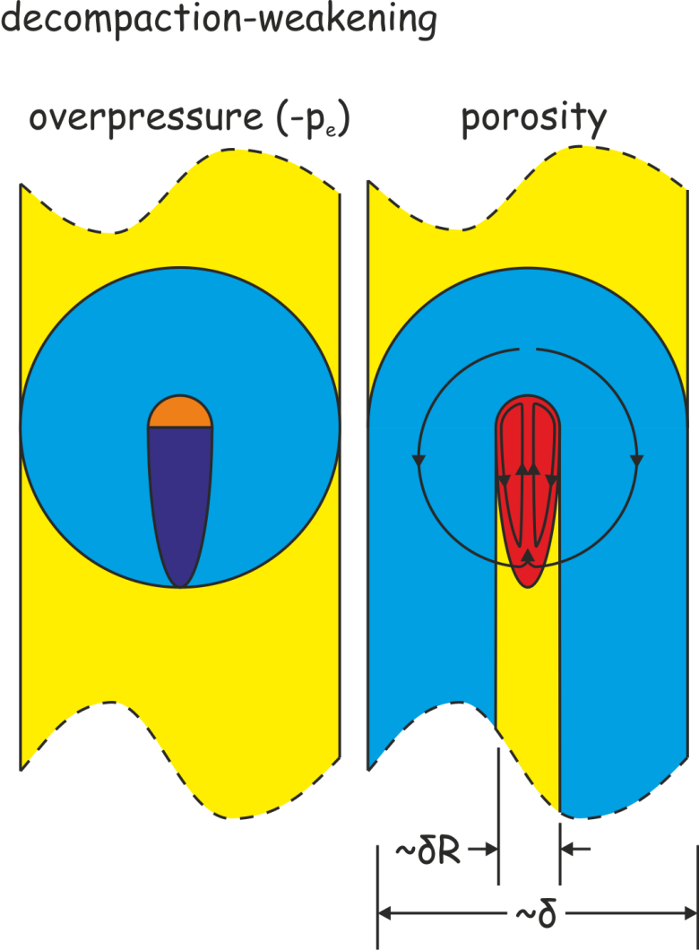
Decompaction Weakening

Slide 71
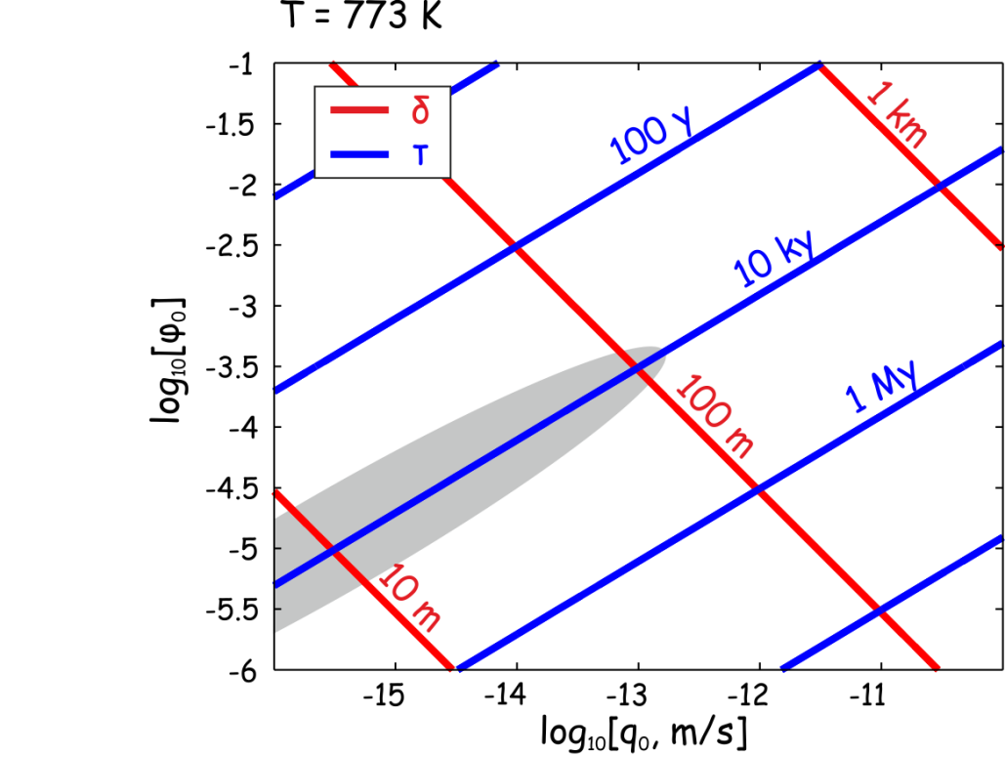
An estimate of the length scale in terms of things we know?
10³-10⁵ y duration of fluid-rock interaction during amphibolite grade (T >773 K) metamorphism* = τ?
*Young & Rumble 1994, van Haren et al. 1996, Graham et al 1998

Slide 72
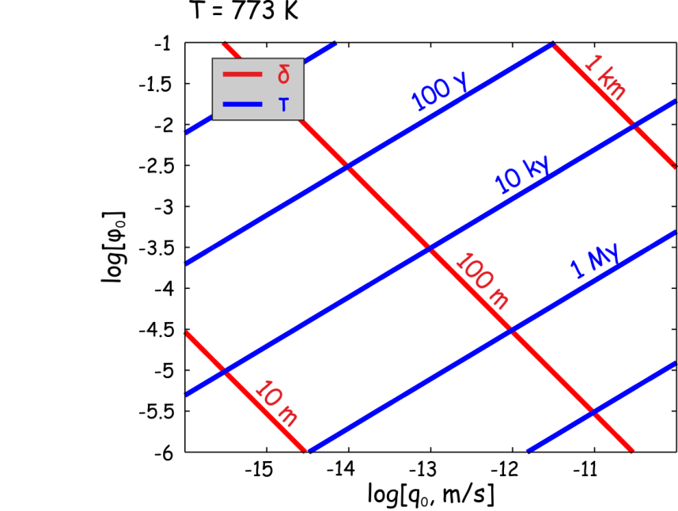
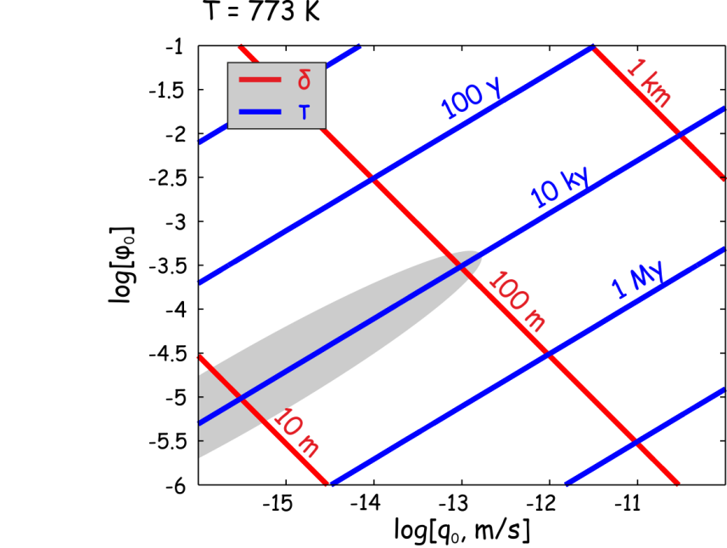
Numbers for the compaction time and length scales f(A, q, φ, T)?
*Young & Rumble 1994, van Haren et al. 1996, Graham et al 1998

Slide 73
Can you escape porosity waves by moving to the upper crust?
Elastic fluid and rock properties become important when rock viscosity is large or porosity is small
Viscosity => ∞ in the vicinity of the earth's surface
Porosity => 0 above reaction fronts in compacted rocks
=> Viscoelasticity

